Slide 1
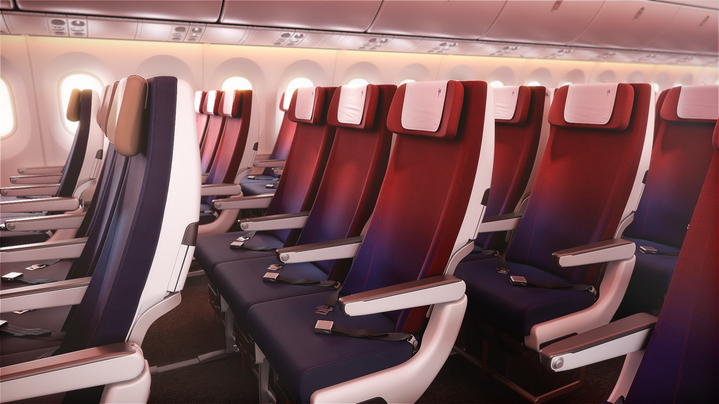



Welcome to
Economy Class

Slide 2
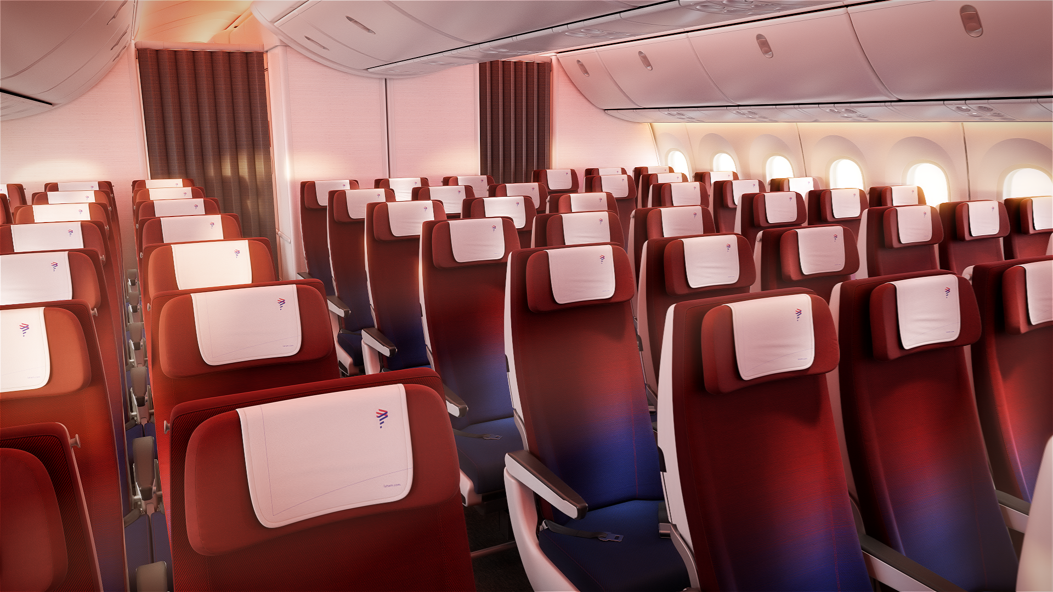



A renew Economy Class reimagine economy travel

Slide 3
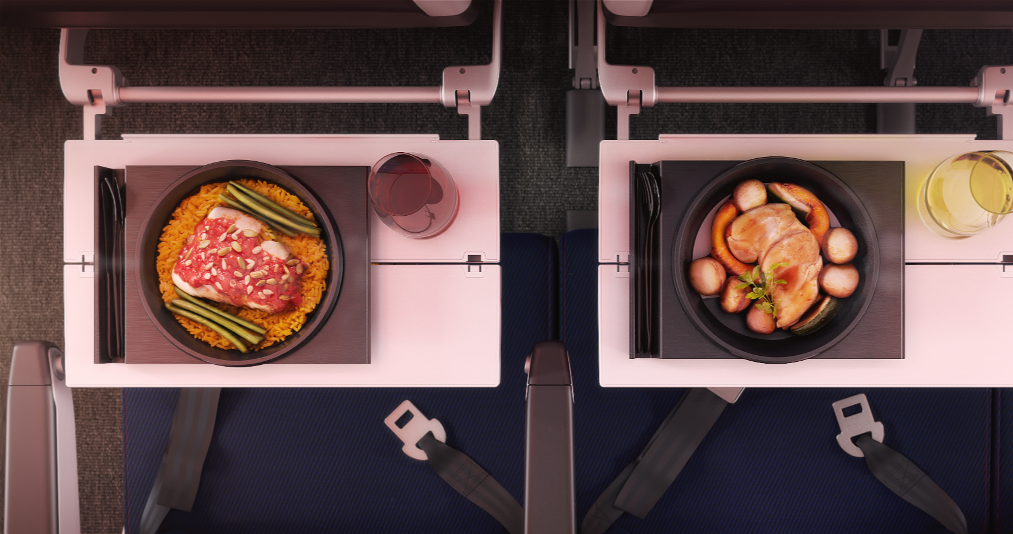


Gastronomy

Slide 4
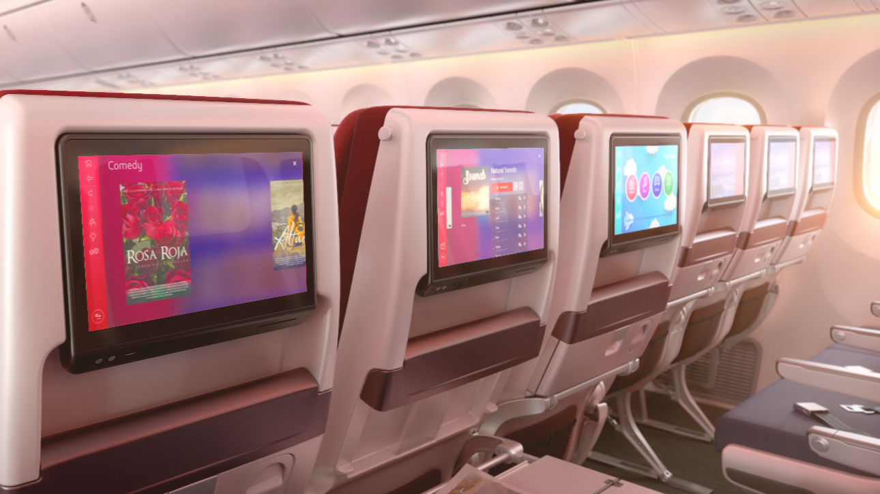

Bigger screens with the best content selection

Slide 5
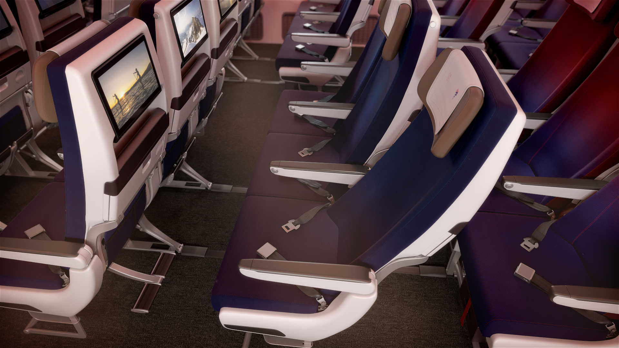


LATAM + Seats with adjustable footrest and more space to recline

Slide 6
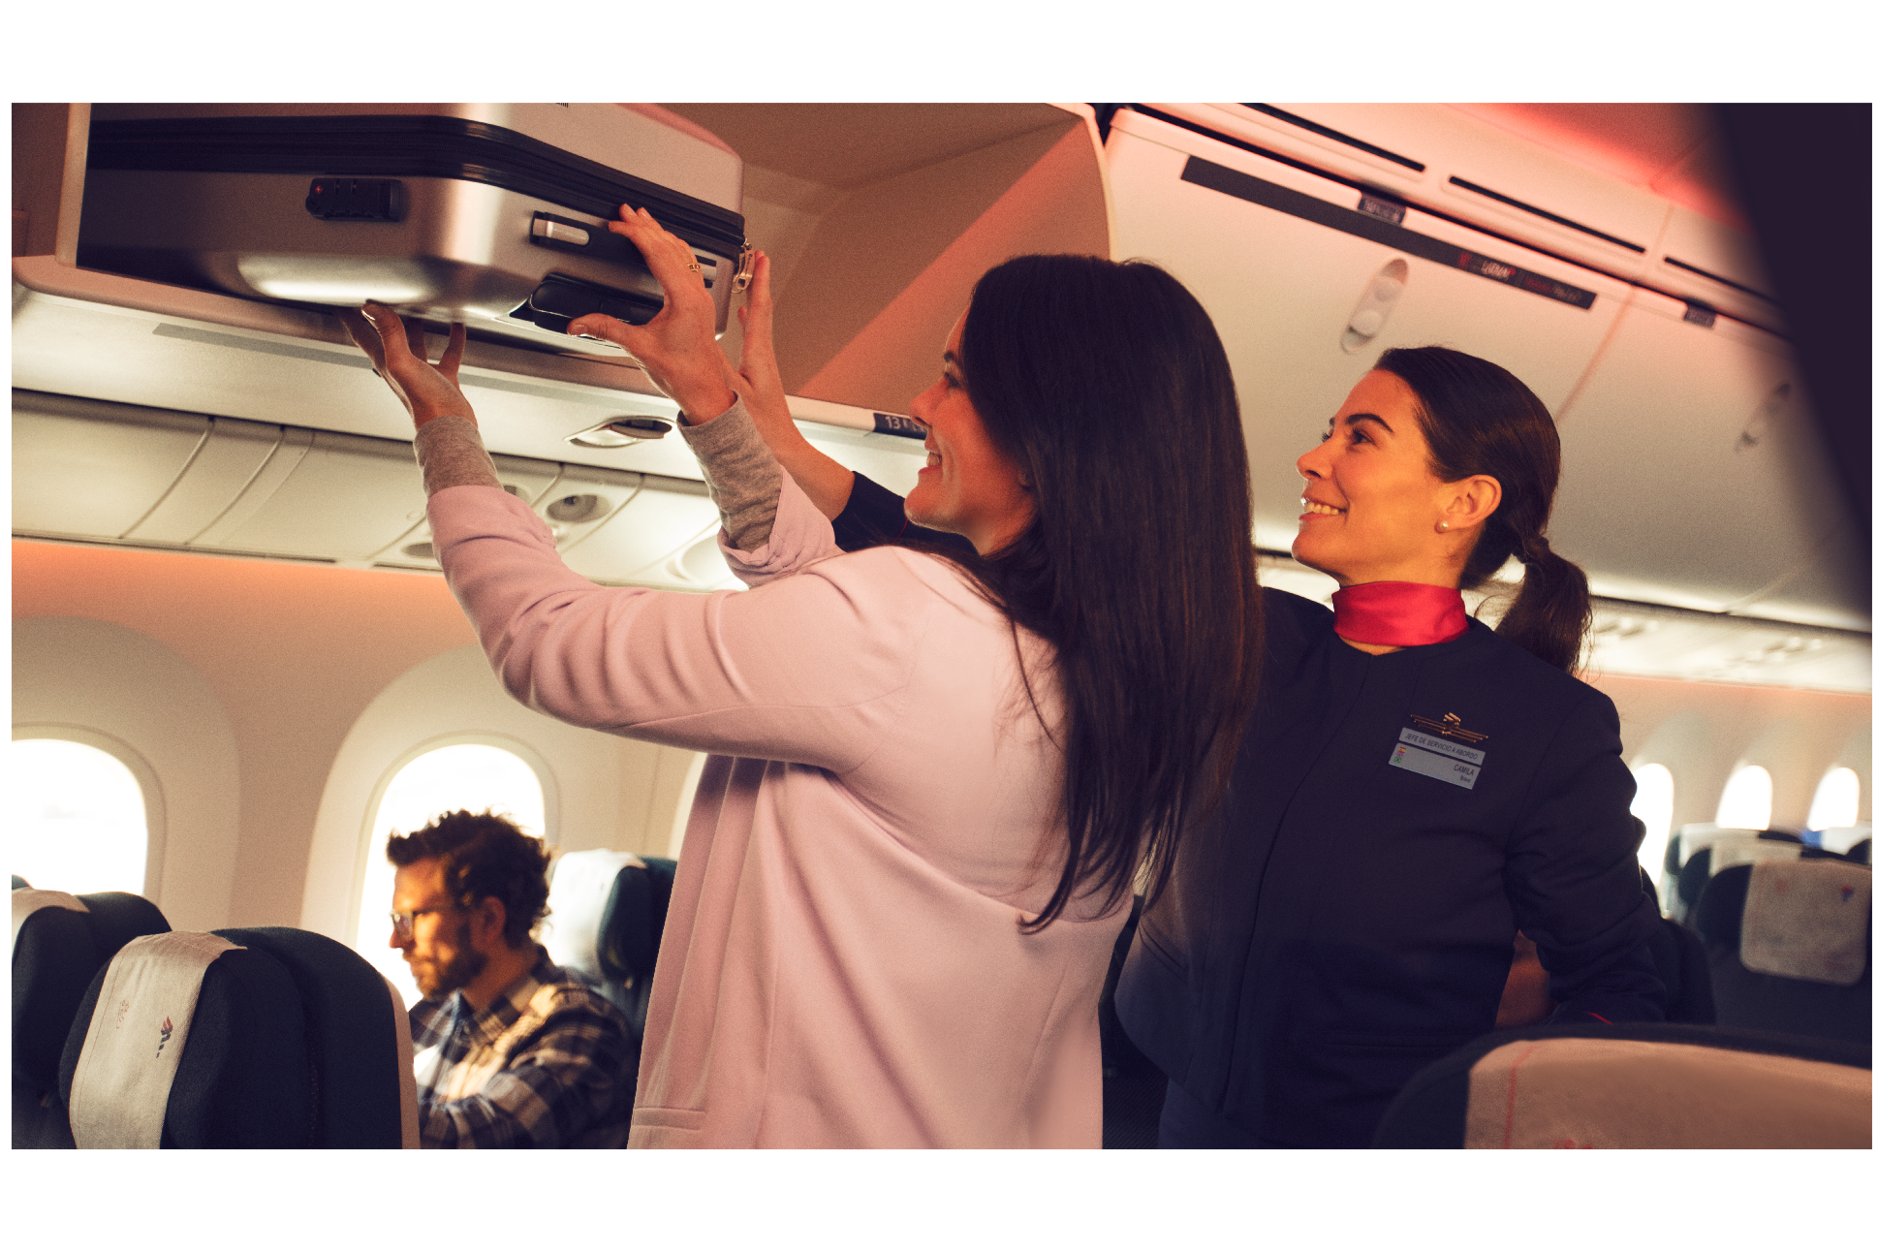


LATAM + Dedicated overhead bins

Slide 7


LATAM + Preferred boarding and deplaning

Slide 8


2019 © LATAM AIRLINES GROUP S.A. - All rights reserved.

