Slide 1
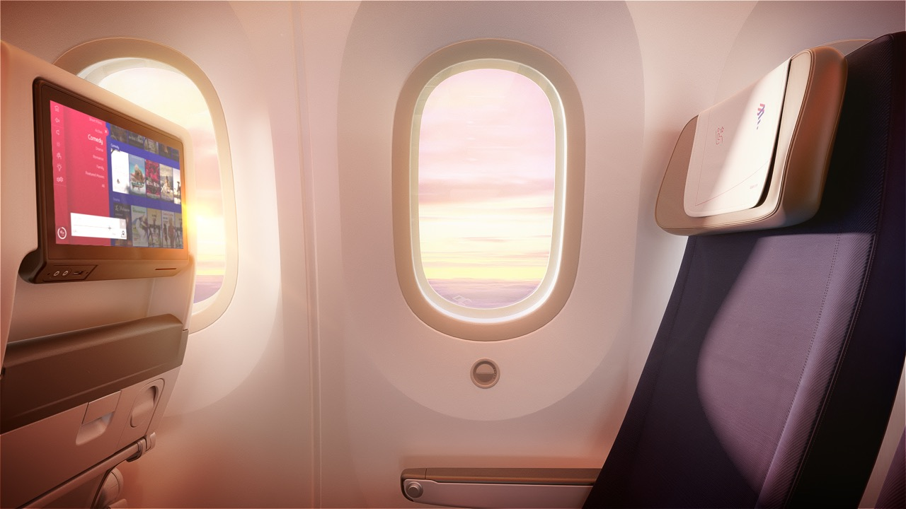



Welcome to
Premium Economy

Slide 2
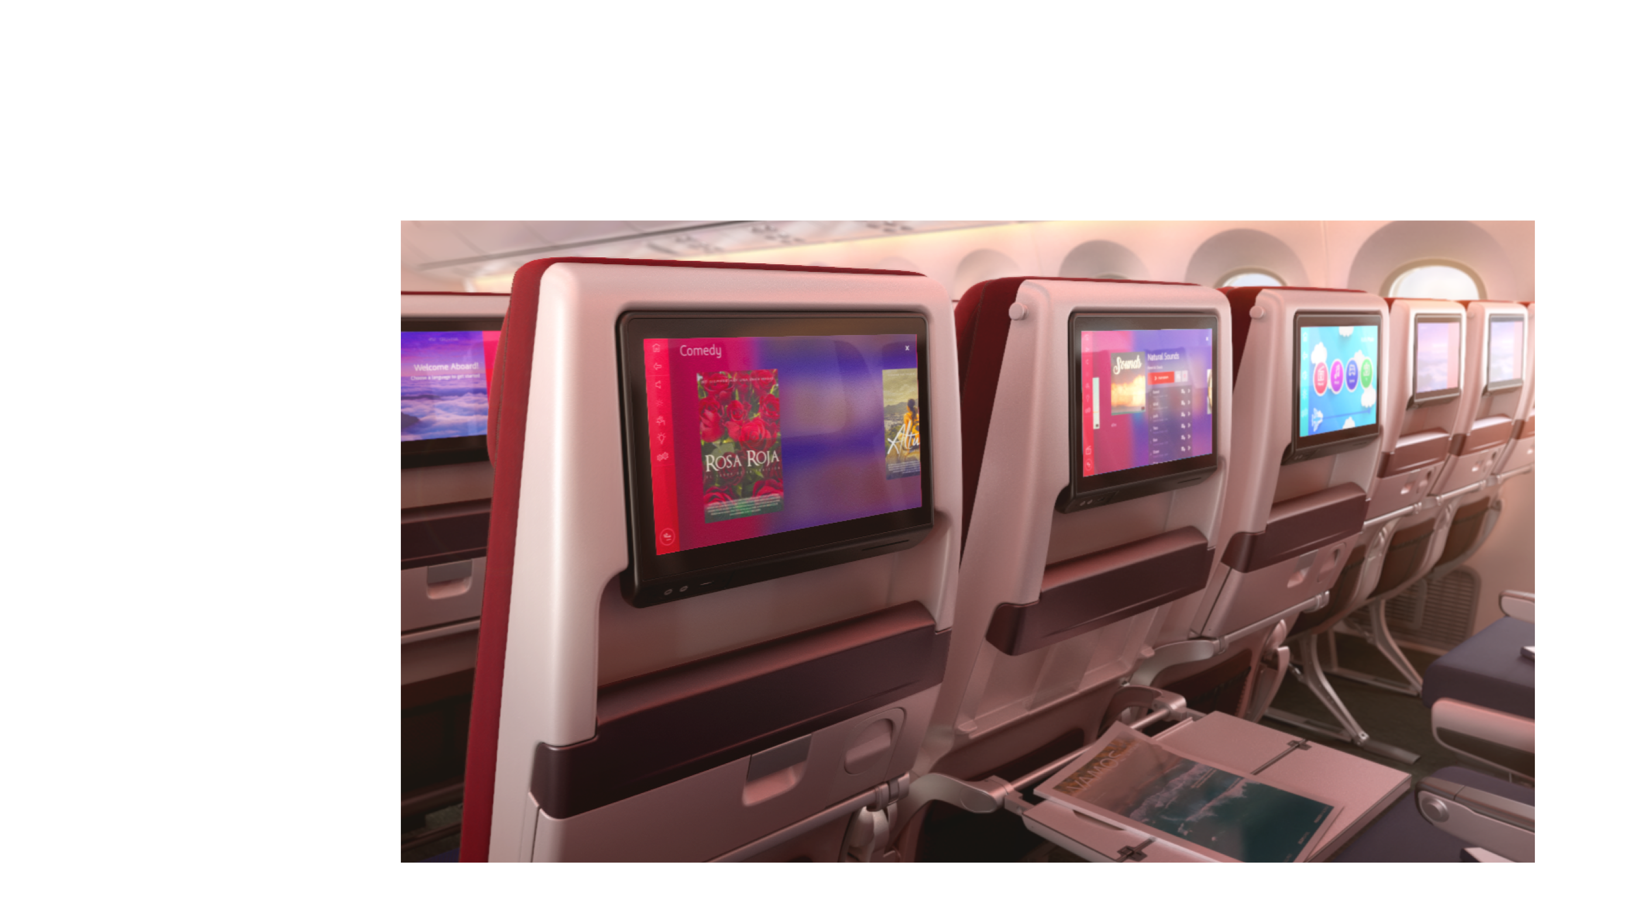



Bigger screens with the best content selection

Slide 3
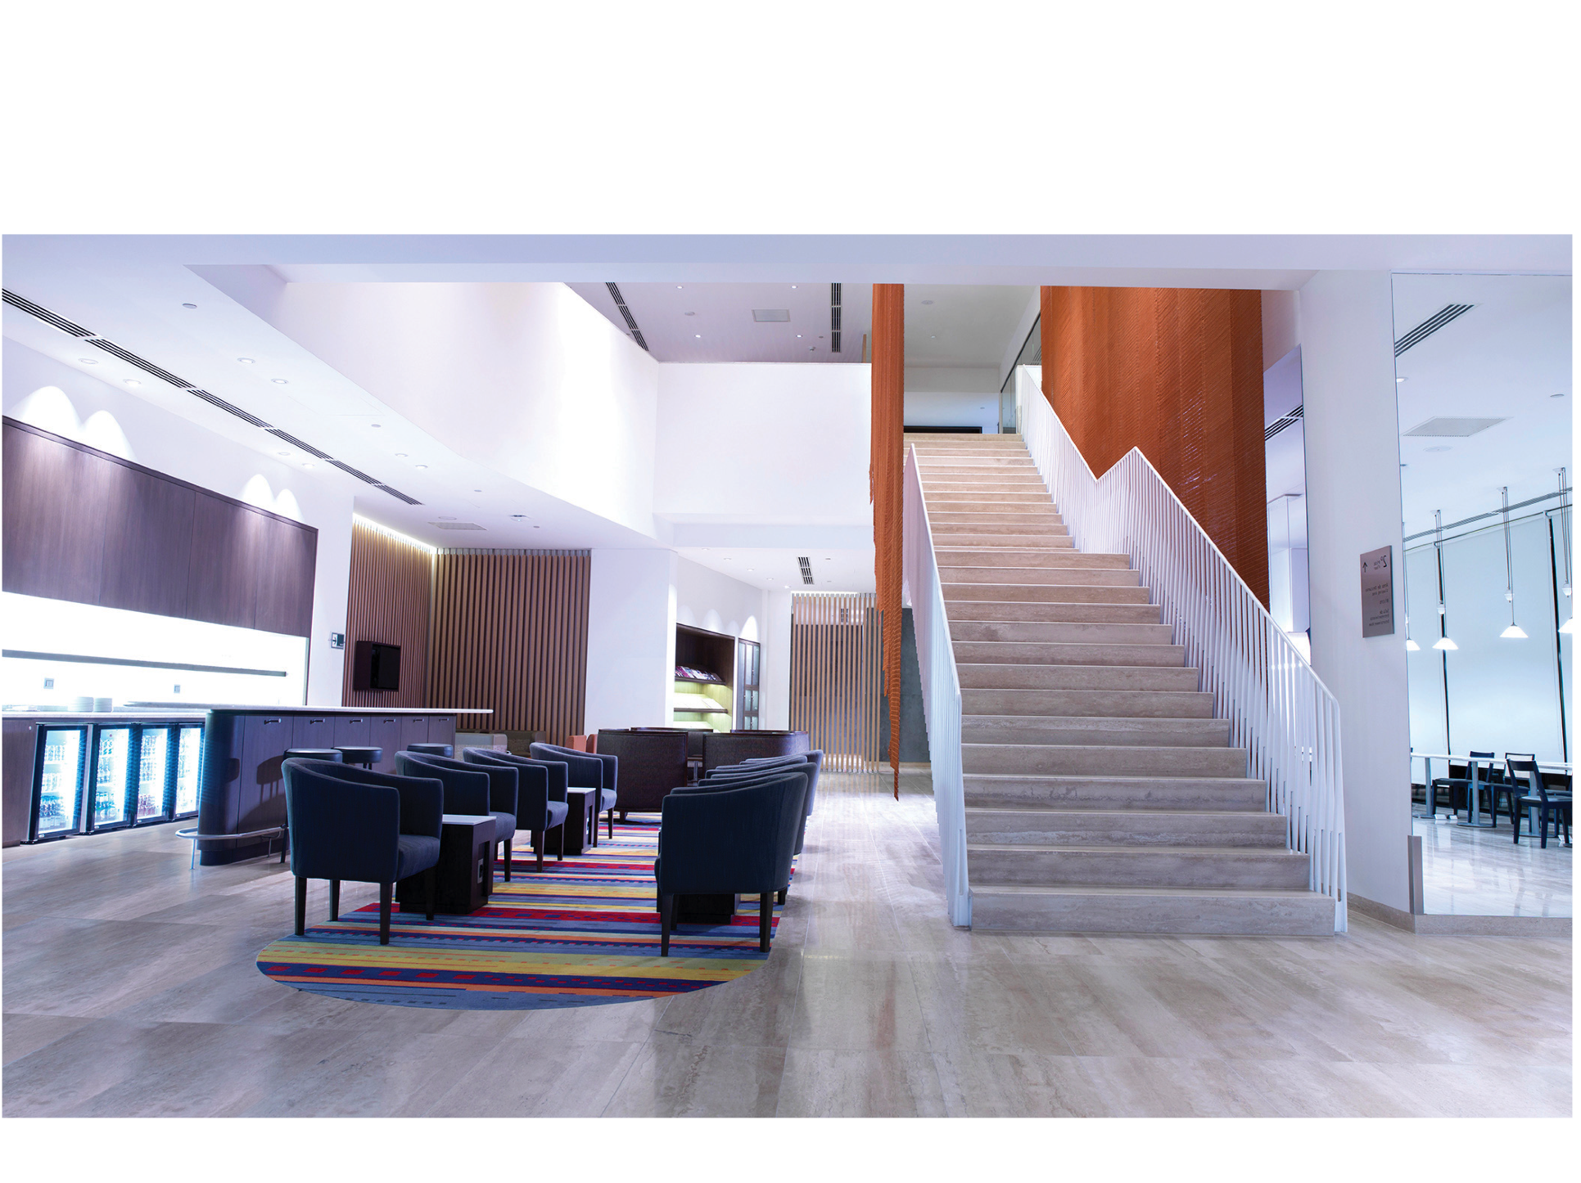


LATAM Airlines
VIP lounge access

Slide 4
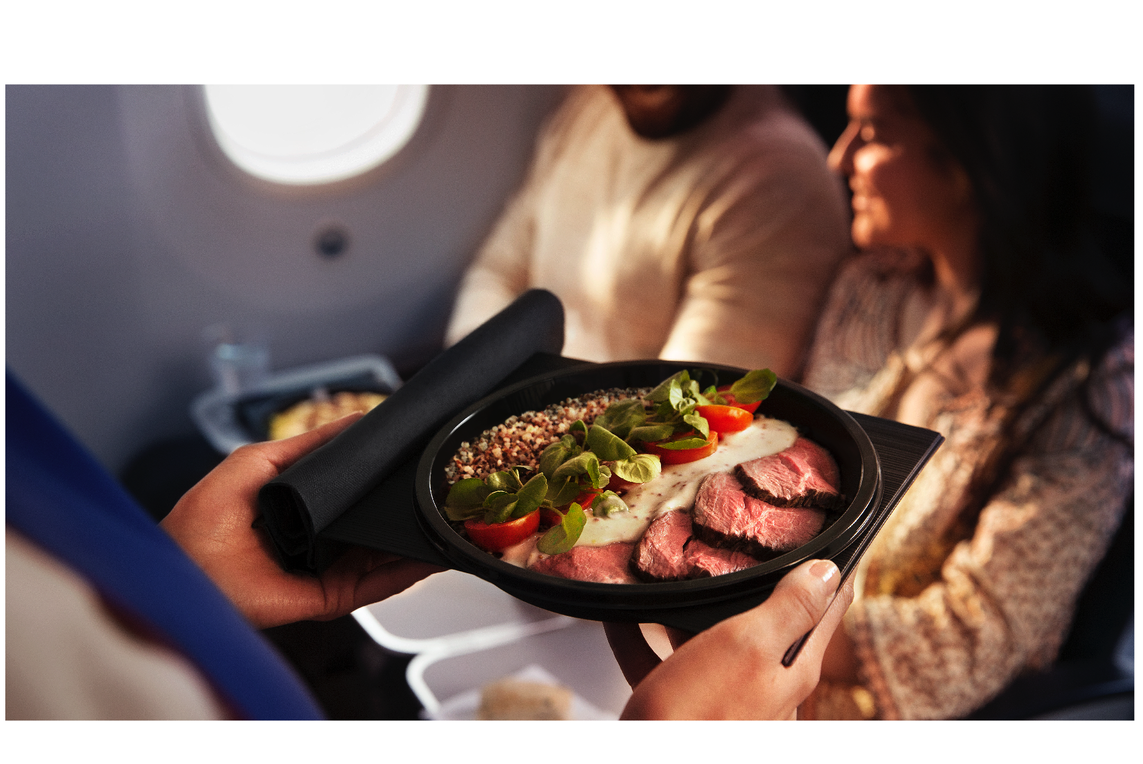


Award-winning food service and sommelier list inspired by South American flavors

Slide 5



Seats with more space and recline

Slide 6


Adjustable foot rest for additional comfort

Slide 7
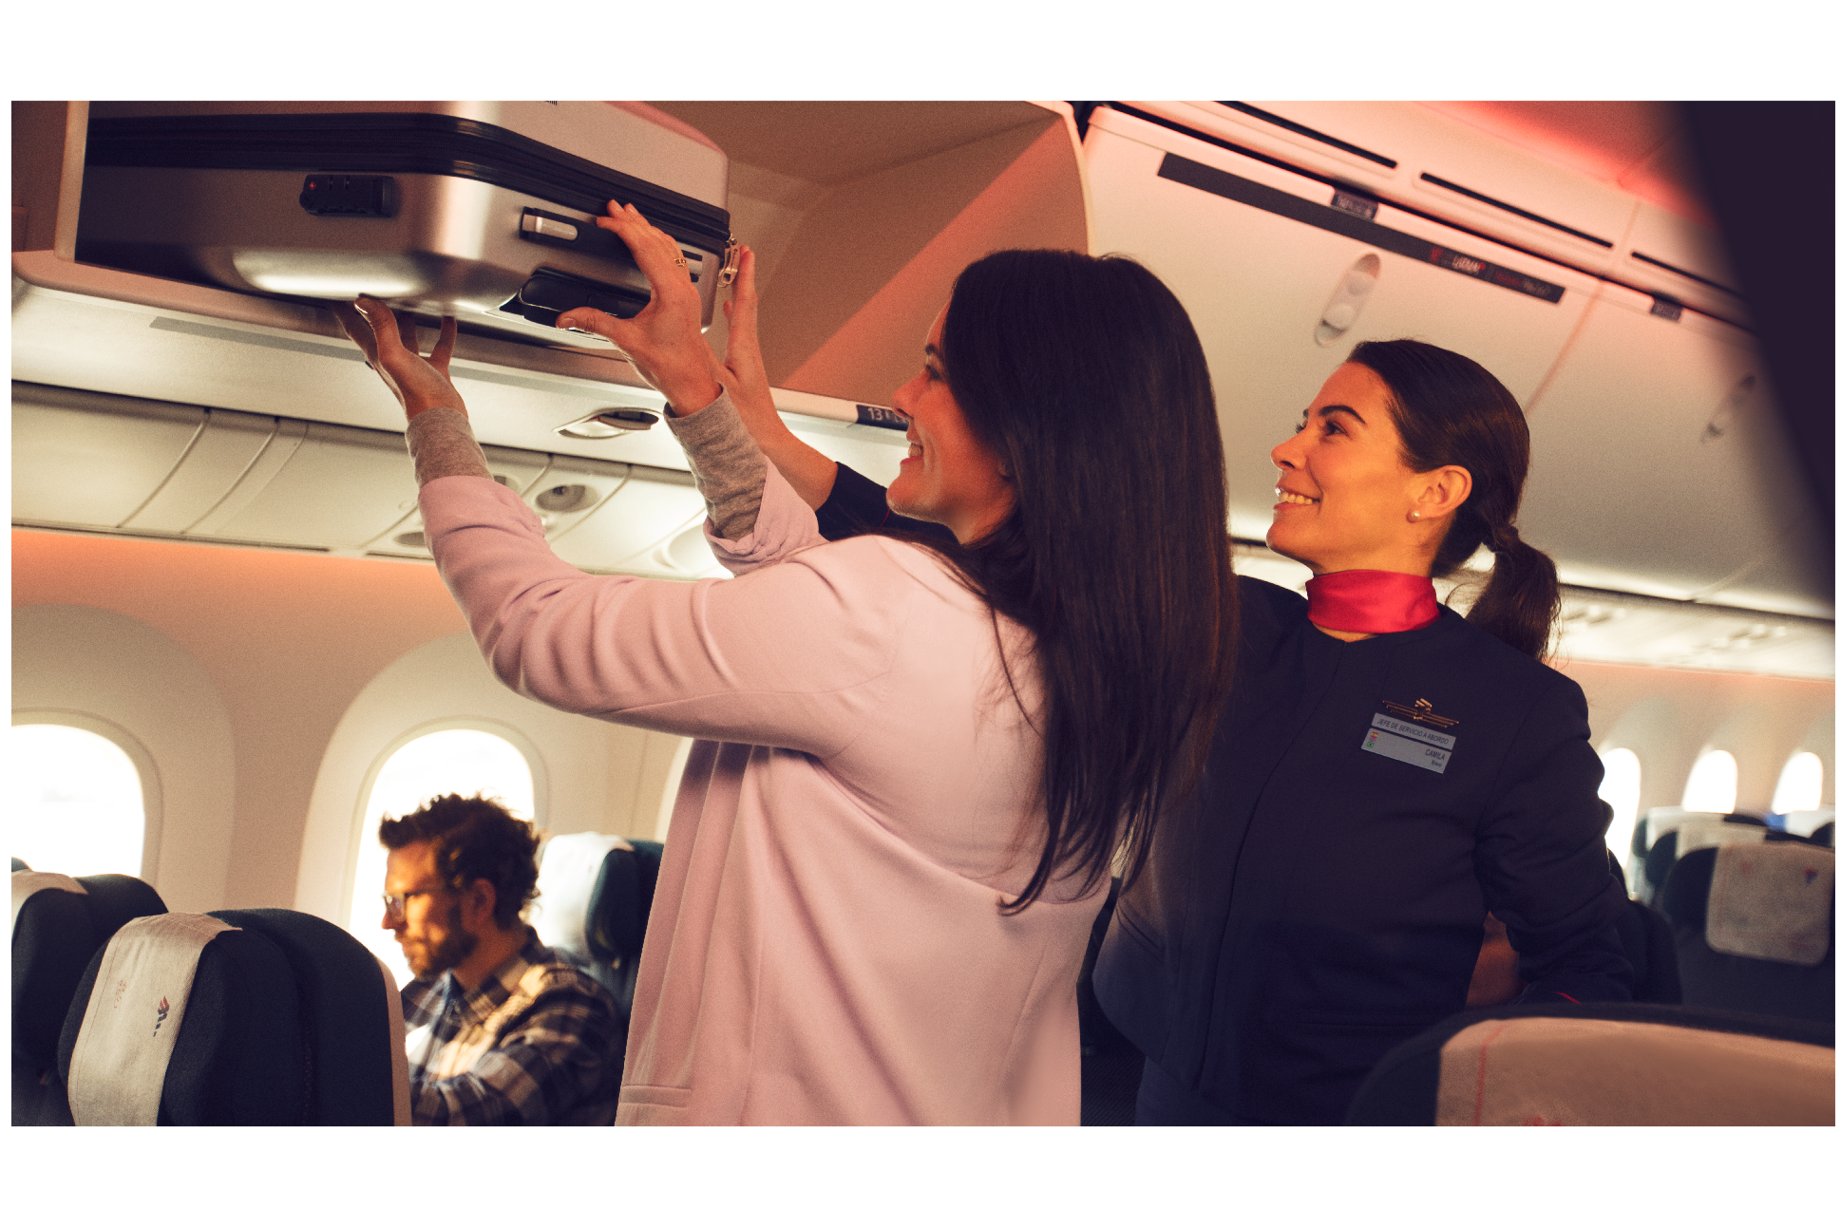


Preferred boarding and deplaning

Slide 8


2019 © LATAM AIRLINES GROUP S.A. - All rights reserved.

