Slide 1
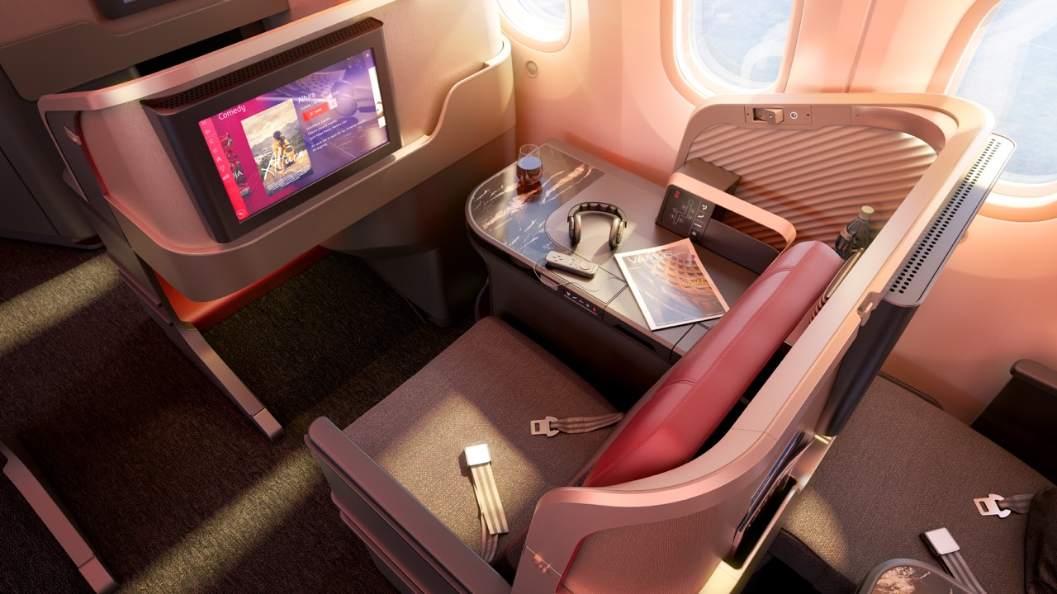



Welcome to a new
Premium Business Experience
We have carefully redesigned, renovated and revamped our cabins to give passengers a new level of onboard comfort and pleasure in every moment of their flight experience. Every detail has been crafted keeping the traveler in mind.

Slide 2
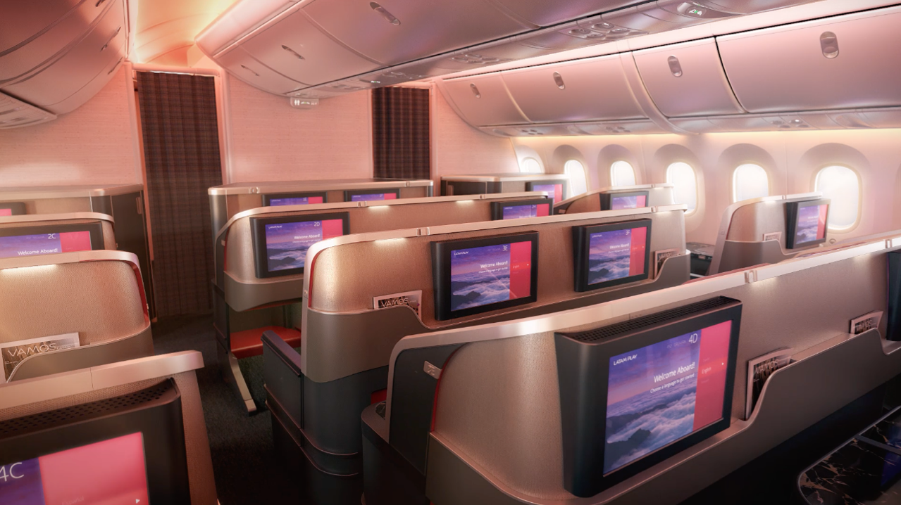



Direct aisle access
Enjoyable ease and freedom of movement

Slide 3
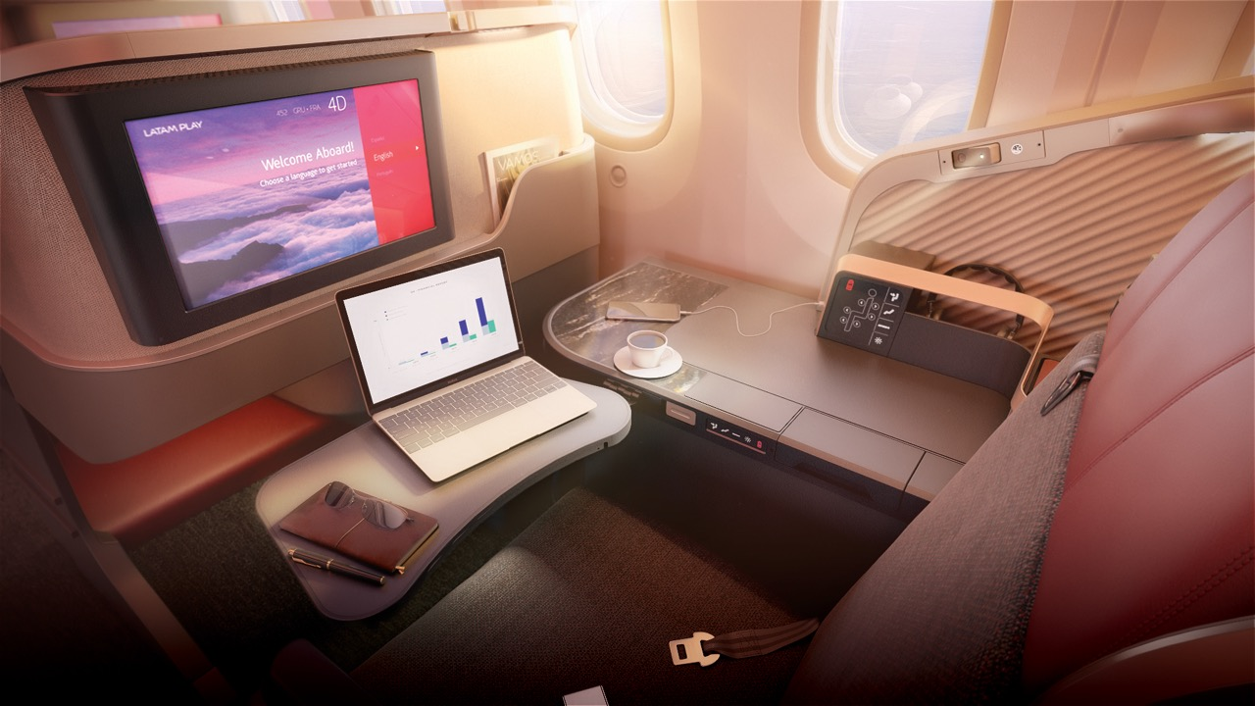

Additional Convenience
More space for your personal items

Slide 4
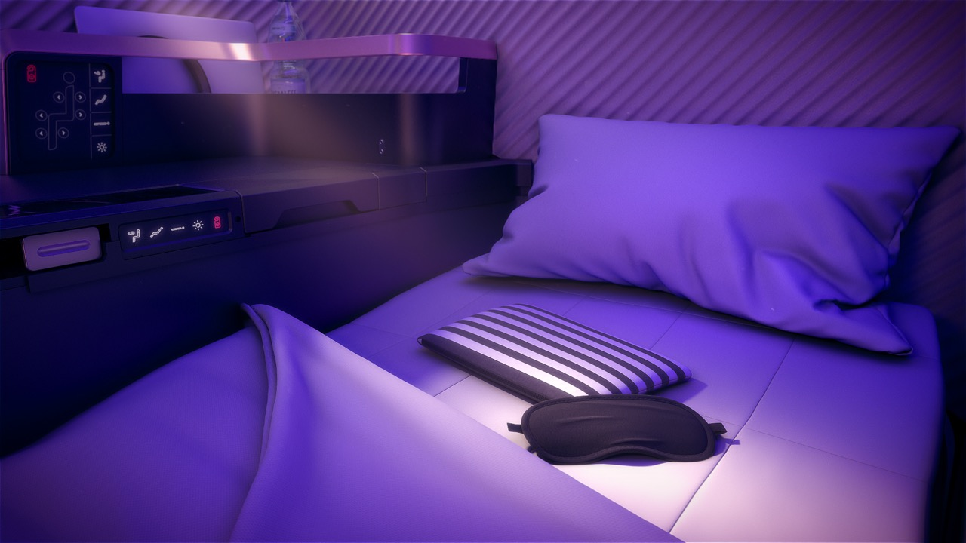

Restful experience
Additional privacy and full-flat seats to sleep in total comfort

Slide 5
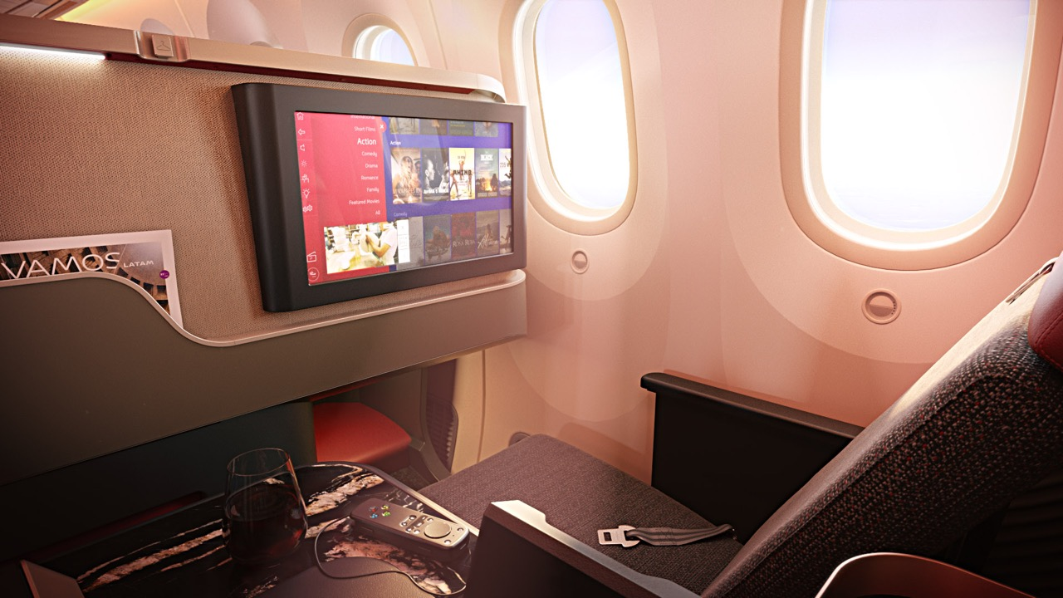

Enhanced Visibility
The best entertainment in the region with latest generation screens

Slide 6
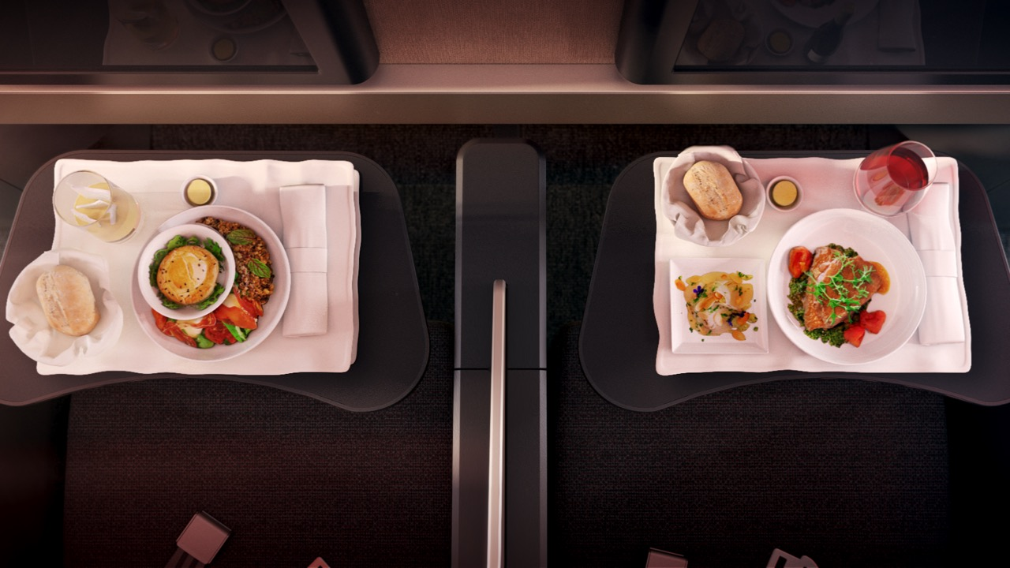

New gastronomic experience
Enhanced award-winning food service and sommelier list inspired by South American flavors

Slide 7
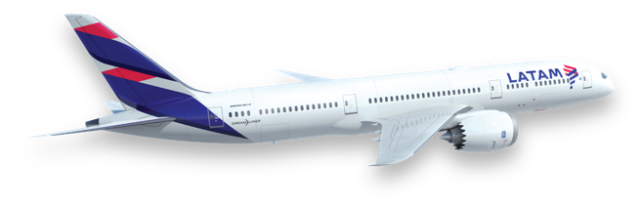

2019 © LATAM AIRLINES GROUP S.A. - All rights reserved.

