Slide 1
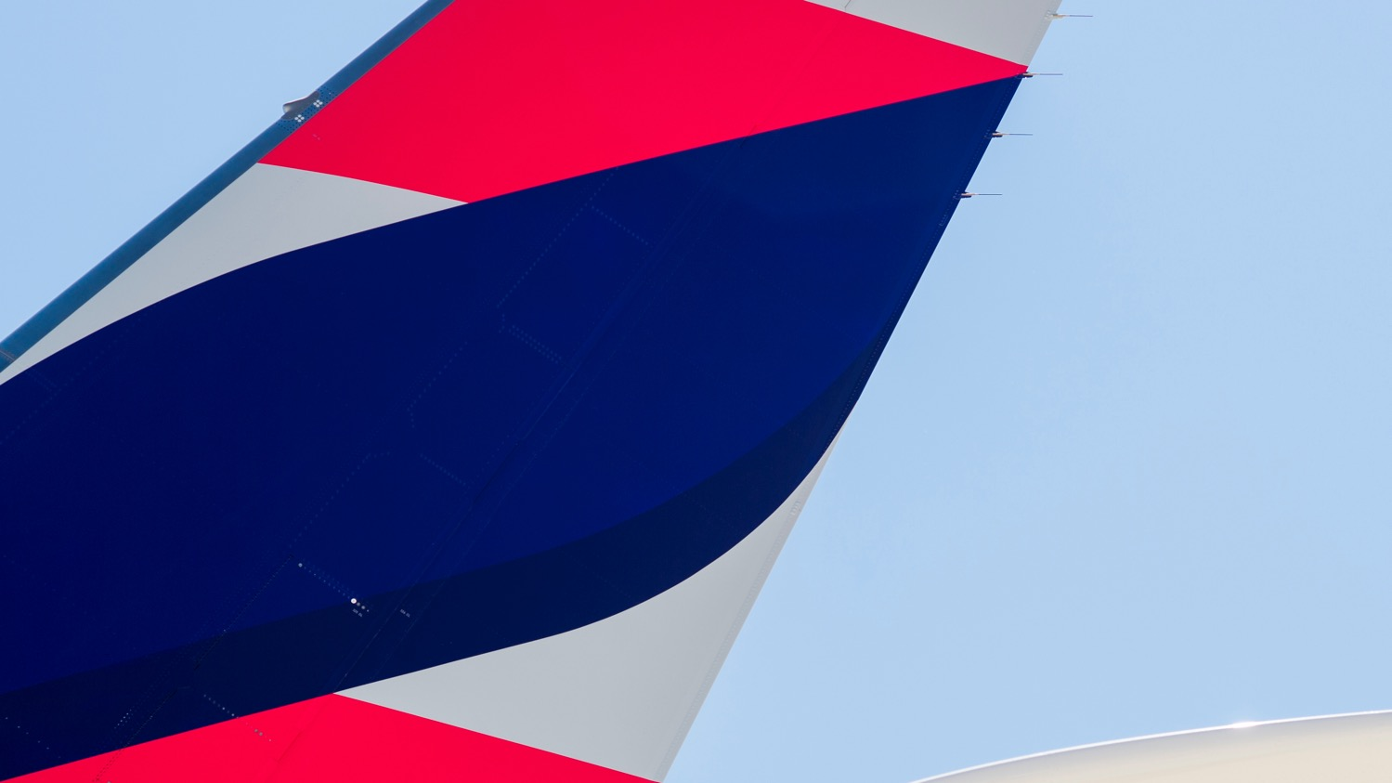

New
Cabins

Slide 2

We will renovate the cabins of over 200 aircraft in our fleet.

Slide 3
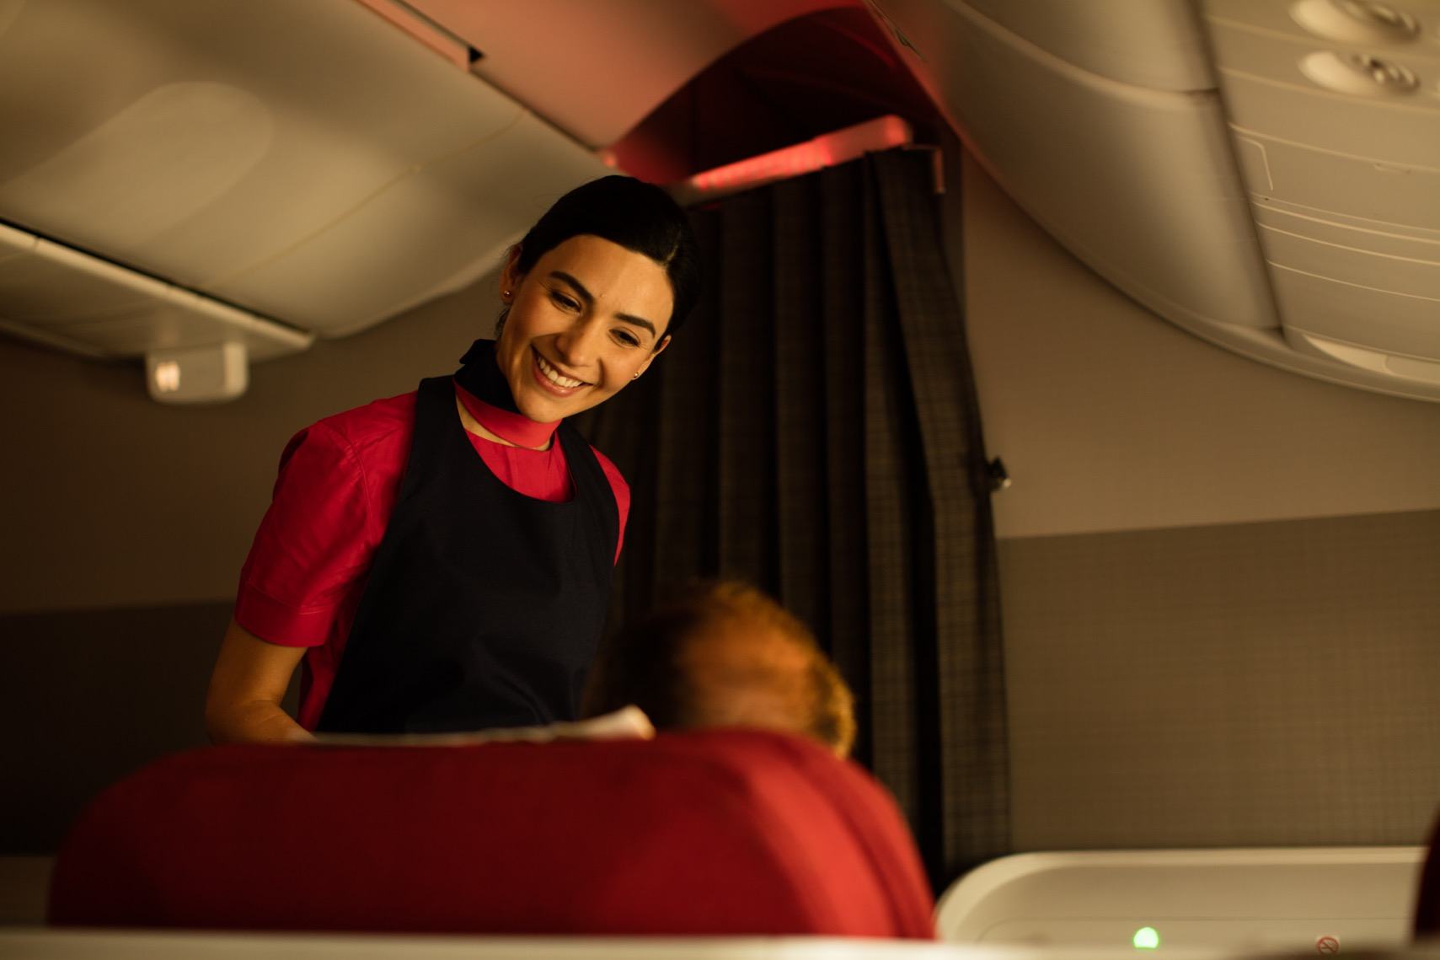
With the objective of offering our passengers a more personalised flight experience, with both more options and flexibility.

Slide 4




INTERNATIONAL FLIGHTS
Business Class
A new Premium Business service and seat design focused on privacy and rest
Full flat bed
Direct aisle access
Space for personal items
State of the art on-board entertainment
New business class service

Slide 5
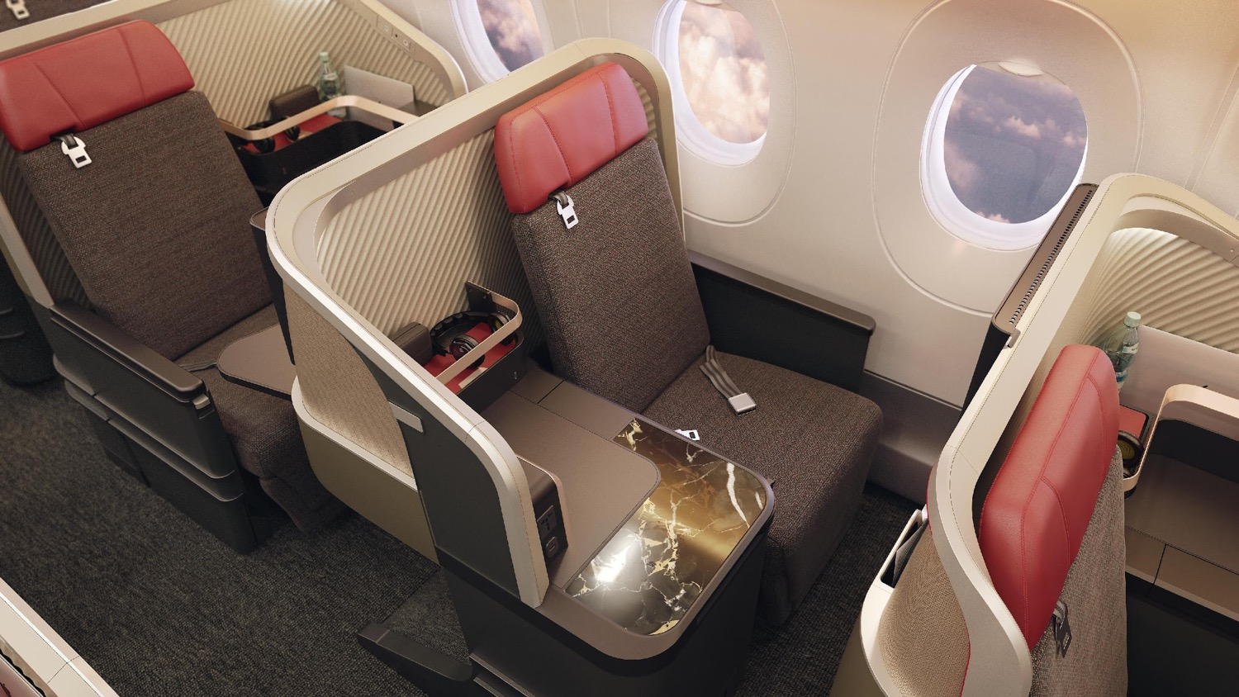

Slide 6
AISLE SEAT
WINDOW SEAT

Slide 7
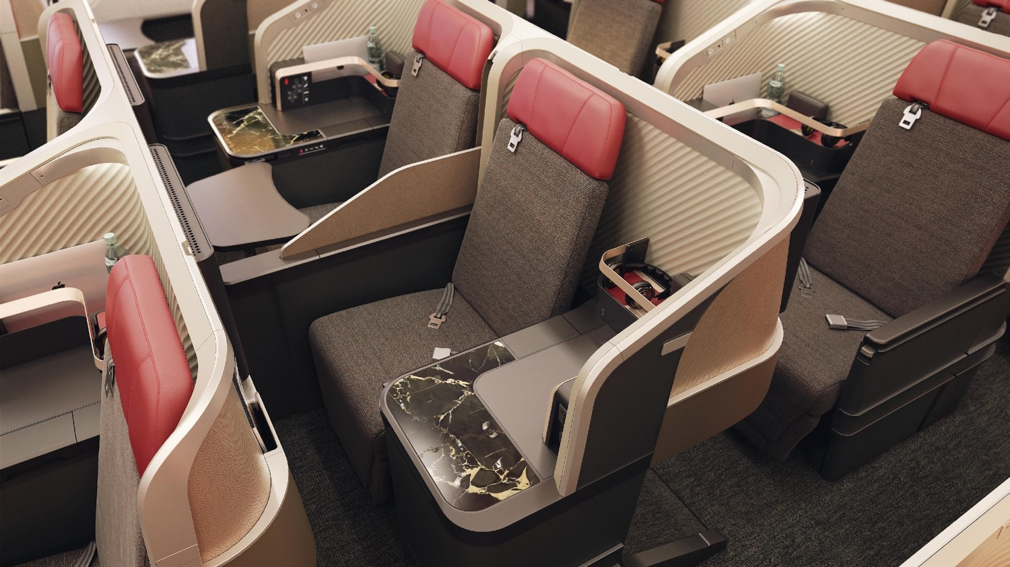

Slide 8
ADJUSTABLE DIVIDER
FOR PRIVACY
MORE
PRIVACY
IDEAL SEATS FOR
TRAVEL COMPANION

Slide 9
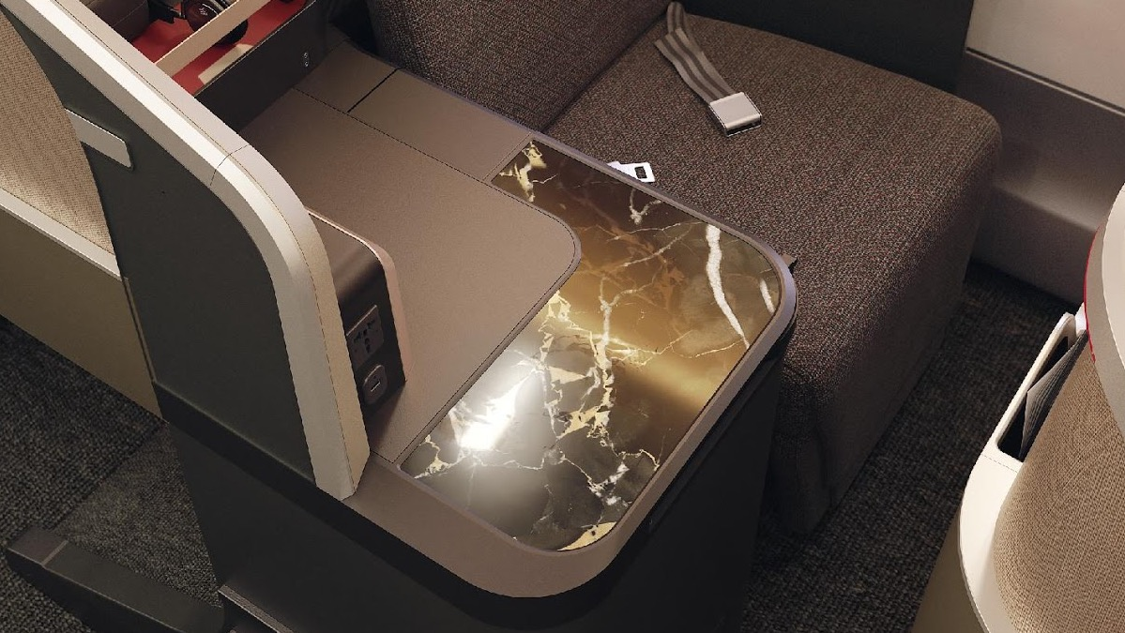

Slide 10
SIDE TABLE WITH
GRANITE SURFACE

Slide 11
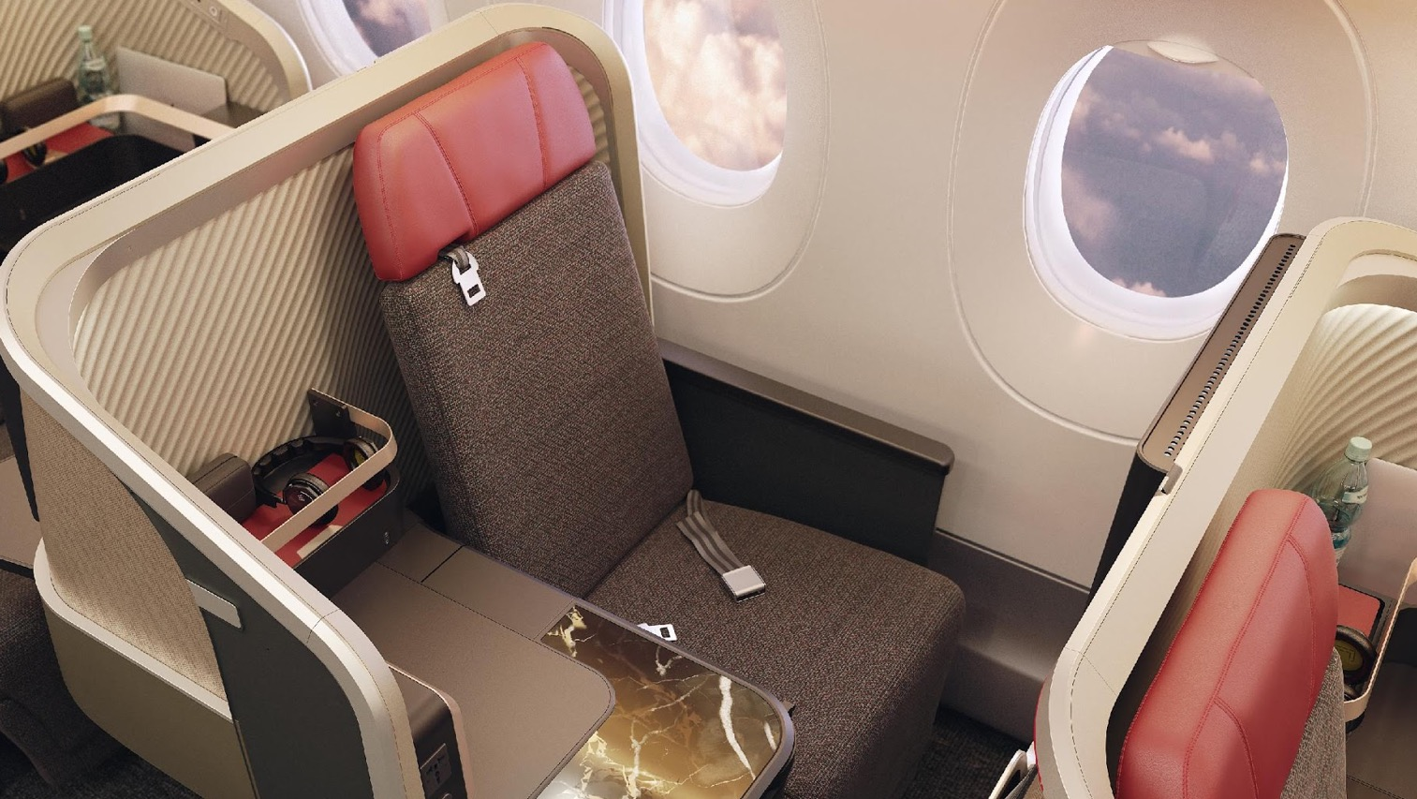

Slide 12
CUSHIONS DESIGNED
FOR MAXIMUM COMFORT

Slide 13
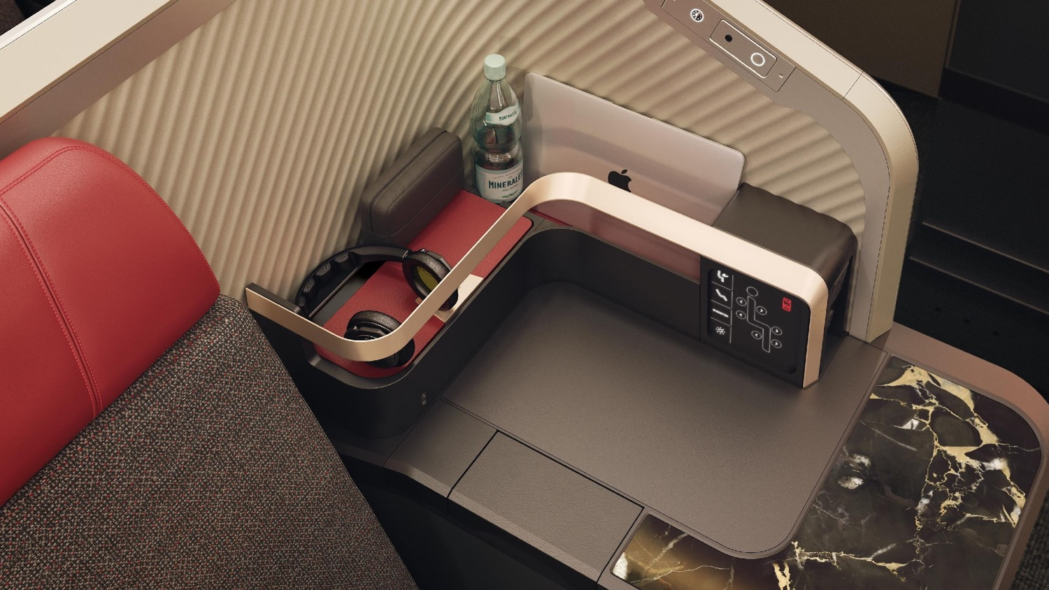

Slide 14
PLUG SOCKET AND
USB CHARGE POINT
MORE SPACE FOR
PERSONAL ITEMS

Slide 15
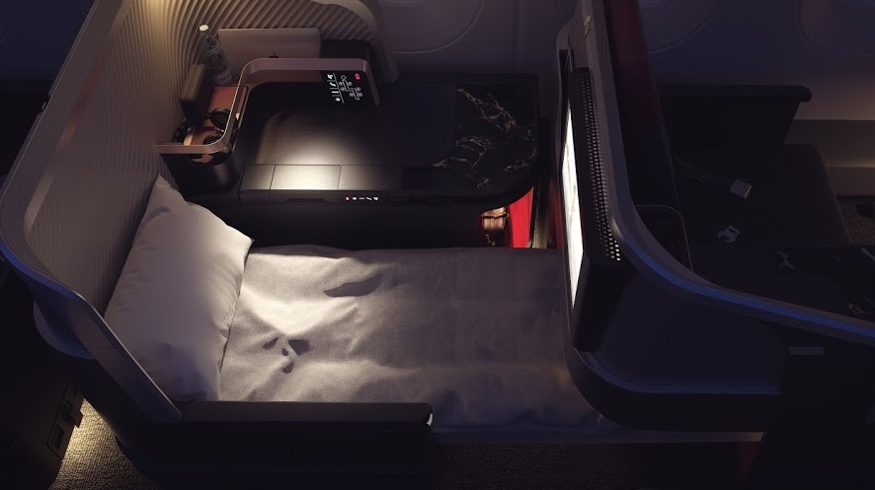

Slide 16
100% HORIZONTAL
REST SPACE

Slide 17
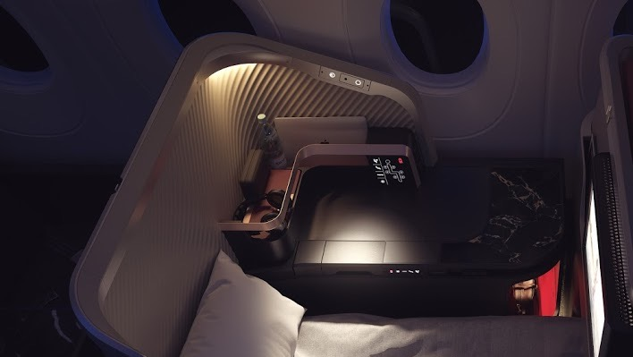

Slide 18
MOOD
LIGHTING
READING LAMP

Slide 19
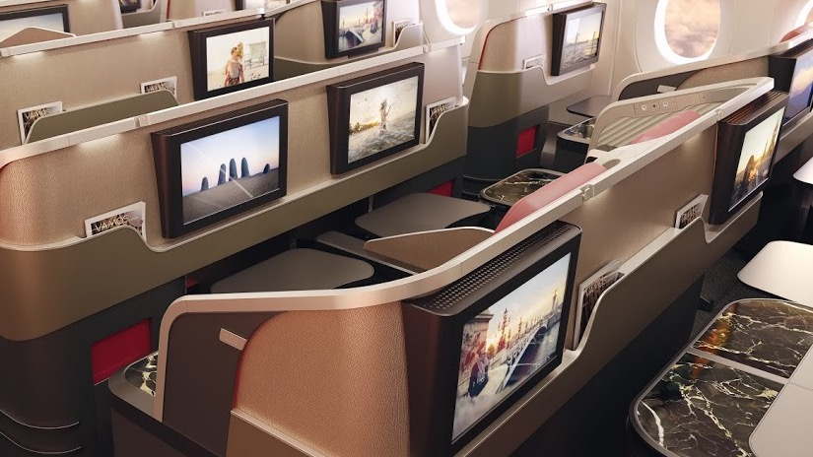

Slide 20
LARGER PERSONAL SCREENS

Slide 21






INTERNATIONAL FLIGHTS
Economy Class
Ergonomically designed seats from Recaro
Quick charge USB ports
LATAM + seats
Renovated seats
12” personal screens

Slide 22
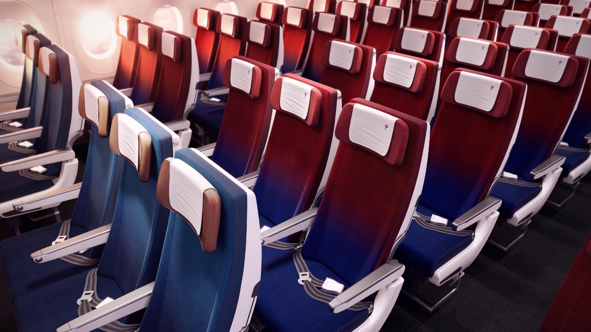

Slide 23
ECONOMY
LATAM + SEAT

Slide 24
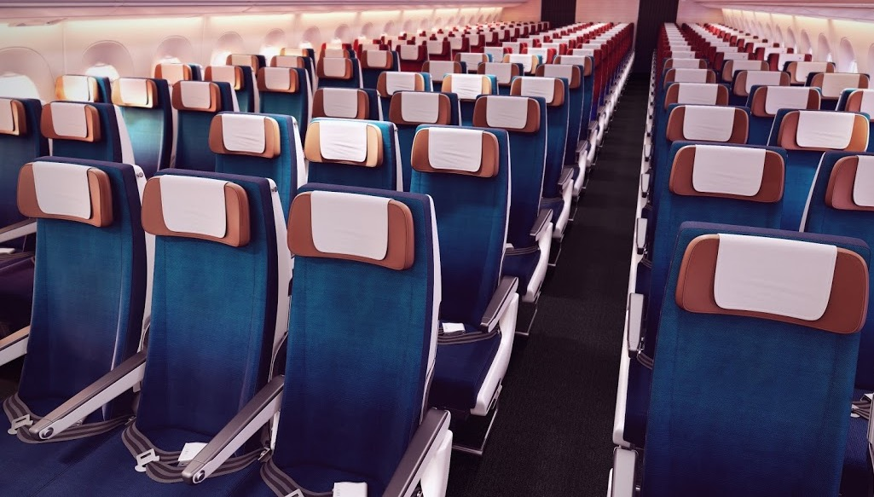

Slide 25
LATAM+ SEAT
PITCH 35¨

Slide 26
LATAM+ SEAT
LARGER SCREENS
LATAM+ SEAT
PITCH 35¨

Slide 27
LATAM+ SEAT
MORE RECLINE
LATAM+ SEAT
LARGER SCREENS
LATAM+ SEAT
PITCH 35¨

Slide 28
LATAM+ SEAT
MORE RECLINE
LATAM+ SEAT
LARGER SCREENS
LATAM+ SEAT
PITCH 35¨
LATAM+ SEAT
ADJUSTABLE
FOOT REST

Slide 29
LATAM+ SEAT
MORE RECLINE
LATAM+ SEAT
LEATHER HEAD
SUPPORT
LATAM+ SEAT
LARGER SCREENS
LATAM+ SEAT
PITCH 35¨
LATAM+ SEAT
ADJUSTABLE
FOOT REST

Slide 30
ECONOMY

Slide 32
ECONOMY
PITCH ≥ 31”

Slide 33
ECONOMY
IMPROVED CUSHION
DESIGN
ECONOMY
PITCH ≥ 31”

Slide 34
ECONOMY
IMPROVED CUSHION
DESIGN
ECONOMY
UNIQUE SEAT
COVER
ECONOMY
PITCH ≥ 31”

Slide 35
ECONOMY
IMPROVED CUSHION
DESIGN
ECONOMY
UNIQUE SEAT
COVER
ECONOMY
PITCH ≥ 31”
ECONOMY
LARGER PERSONAL
SCREEN

Slide 36
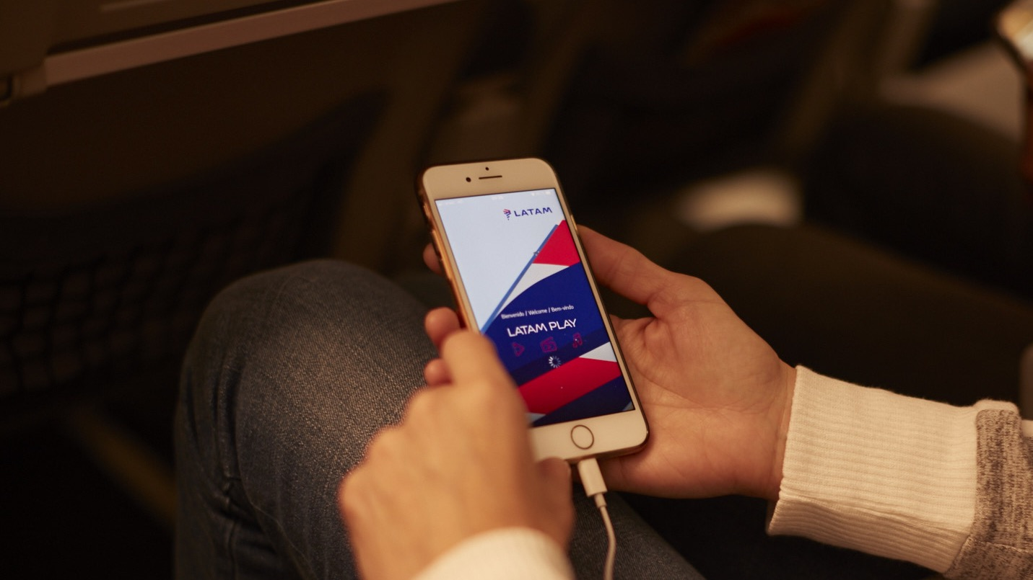

Regional and domestic flights
For passengers that travel in national flights and routes within Latin America, we have transformed the cabin of over 150 Airbus A320 and A321 aircraft to offer:
REGIONAL
Premium Economy Class
LATAM+ seat
LATAM Play, on-board entertainment system with more content and a USB charging port
DOMESTIC
LATAM+ seat
LATAM Play, on-board entertainment system with more content and a USB charging port

Slide 37
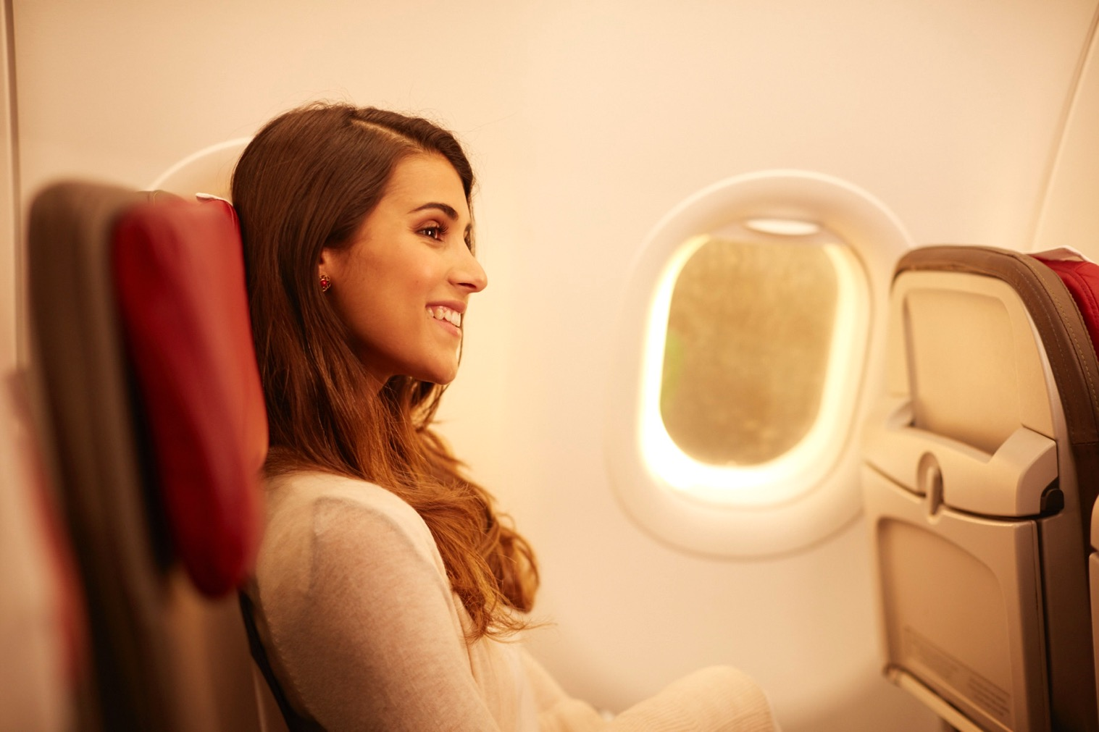


Seat
LATAM+
Available on national and regional flights.
Passenger will have access to:
At least 10cm extra leg room
Up to 40% more seat recline
Exclusive luggage compartment
Priority boarding

Slide 38


The cabin changes will take place gradually over a period of approximately two year. In the meantime the new cabins will coincide with the current configuration.
Given the individual characteristics of each aircraft, some of these features may not be available in certain airplanes.

