Slide 1
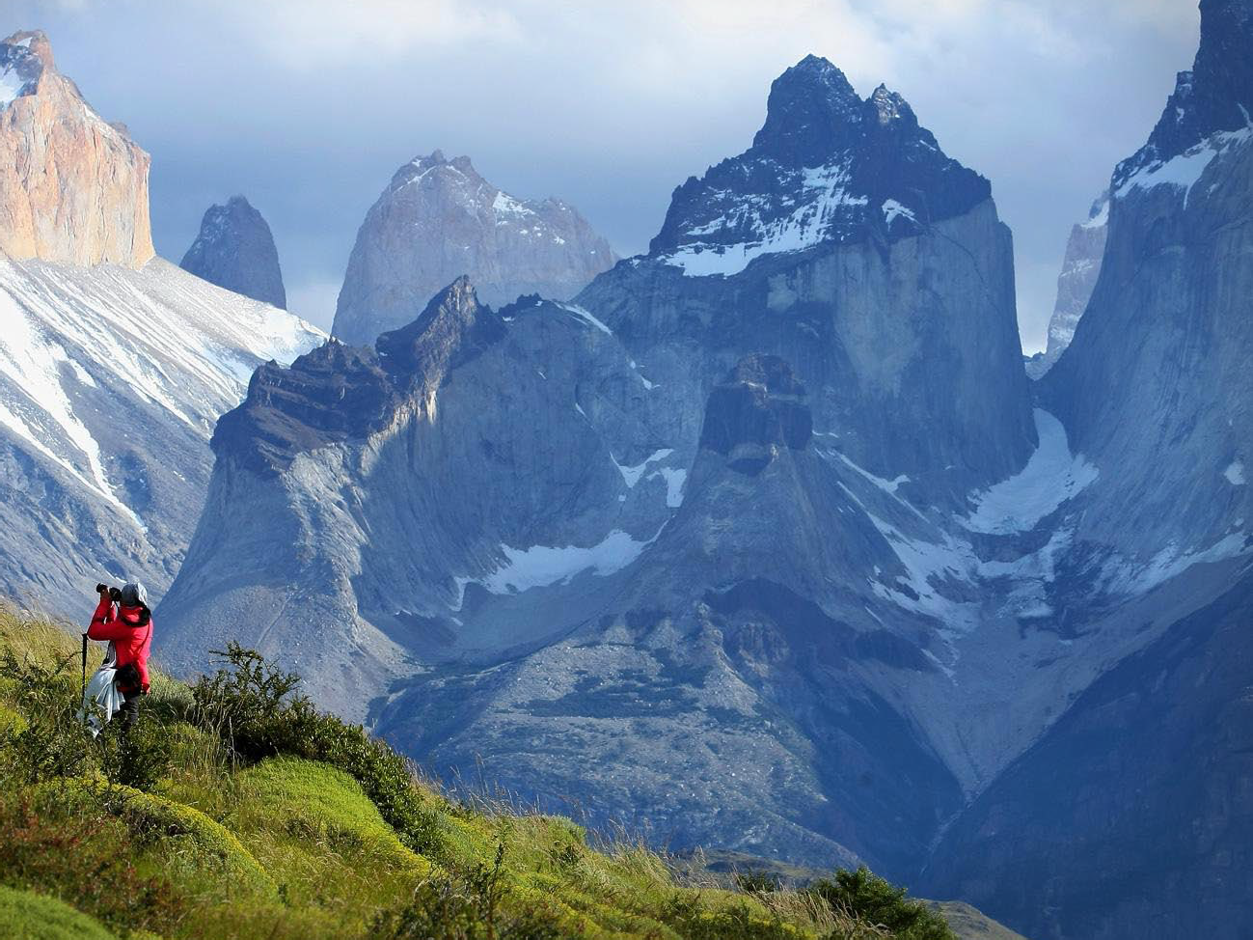
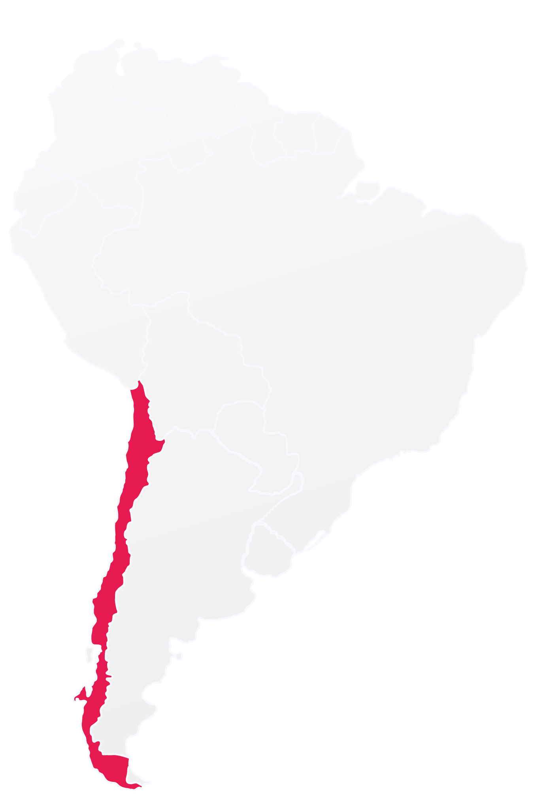


South America
CHILE

Slide 2


CHILE
Area
756,096 km² - 22 hab/km² Over 4,000 km of shoreline
Population
16,746,491
Language
Spanish
Santiago
Currency
Chilean peso

Slide 3
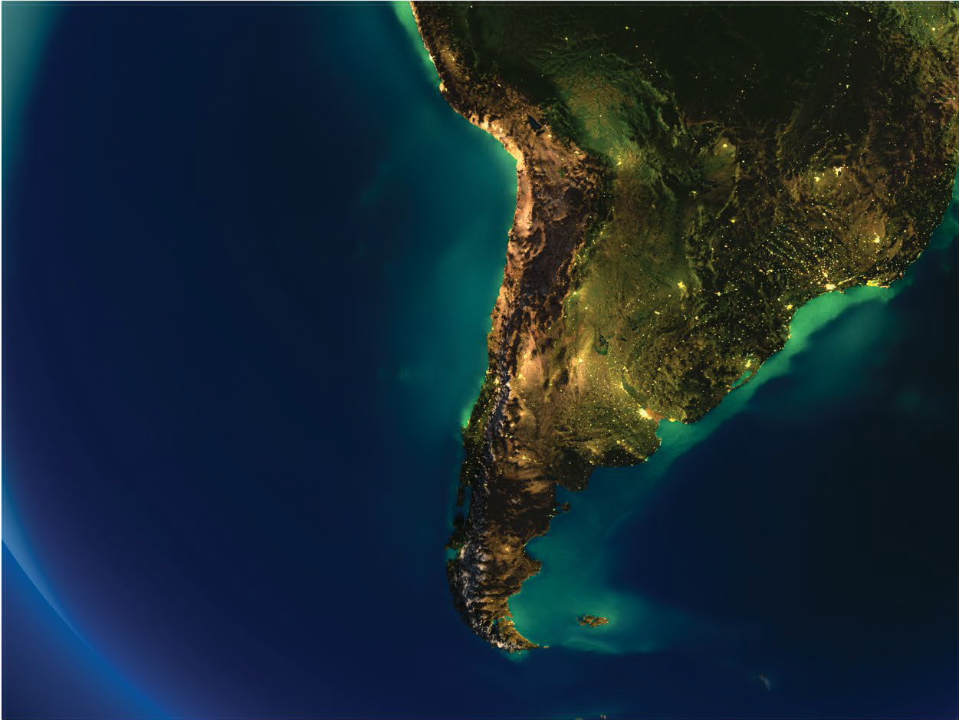

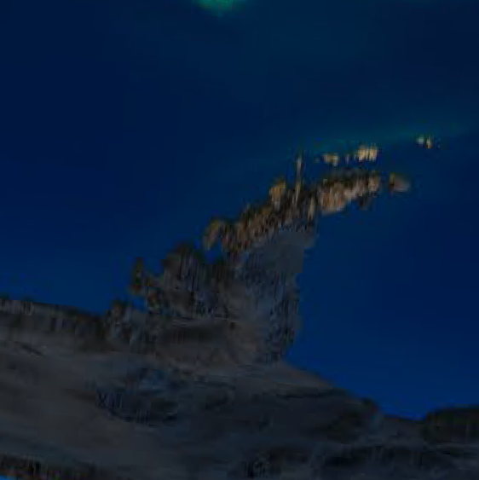
DOMESTIC CONNECTIONS
Arica Iquique
Calama
Antofagasta Copiapo
La Serena
Easter Island
Robinson Crusoe
Concepción
Santiago
Temuco Pucón
Osorno
Valdivia Puerto Montt
Antartic Territory
Balmaceda
Puerto Natales
Punta Arenas
Puerto Willianms

Slide 4
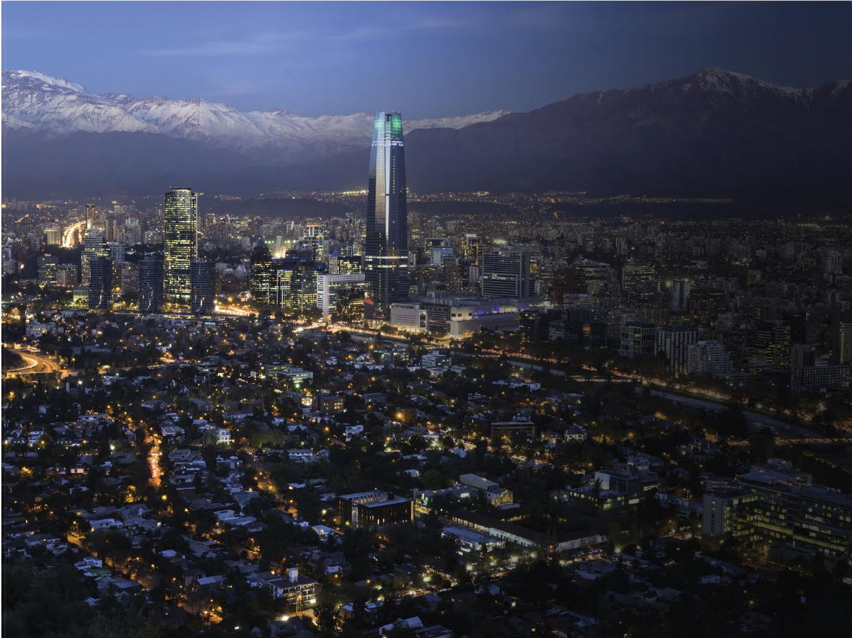


CHILE
IN FIVE ZONES
THE NORTH AND THE ATACAMA
DESERT
SANTIAGO AND THE CENTRAL
ZONE
Chile can be divided into five
distinct geographic and climatic zones.
•The North and The Atacama Desert
•Santiago and the Central Zone
•Lakes, Rivers and Volcanoes
•Patagonia and the extreme South
•The Islands
LAKES, RIVERS AND VOLCANOES
ISLANDS
PATAGONIA AND THE EXTREME
SOUTH

Slide 5
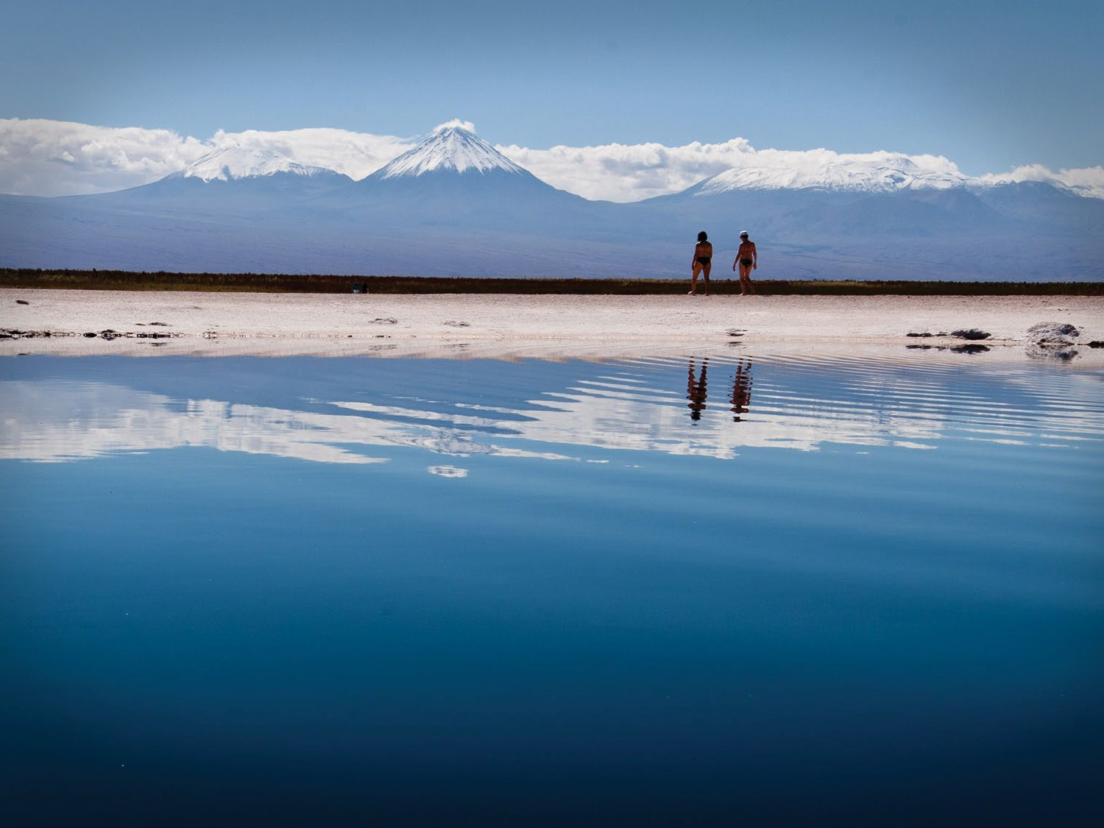
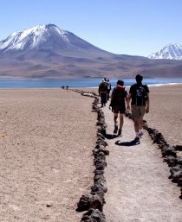
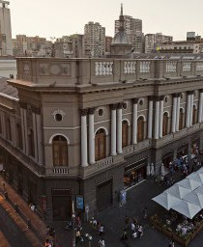
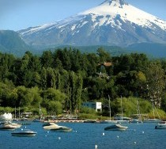
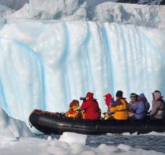
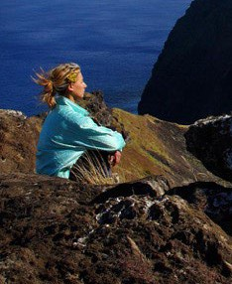
CHILE
IN FIVE ZONES
THE NORTH AND THE ATACAMA DESERT
SANTIAGO AND THE CENTRAL ZONE
LAKES, RIVERS AND VOLCANOES
PATAGONIA AND THE EXTREME SOUTH
ISLANDS: EASTER ISLAND, ROBINSON CRUSOE AND CHILOÉ

Slide 6
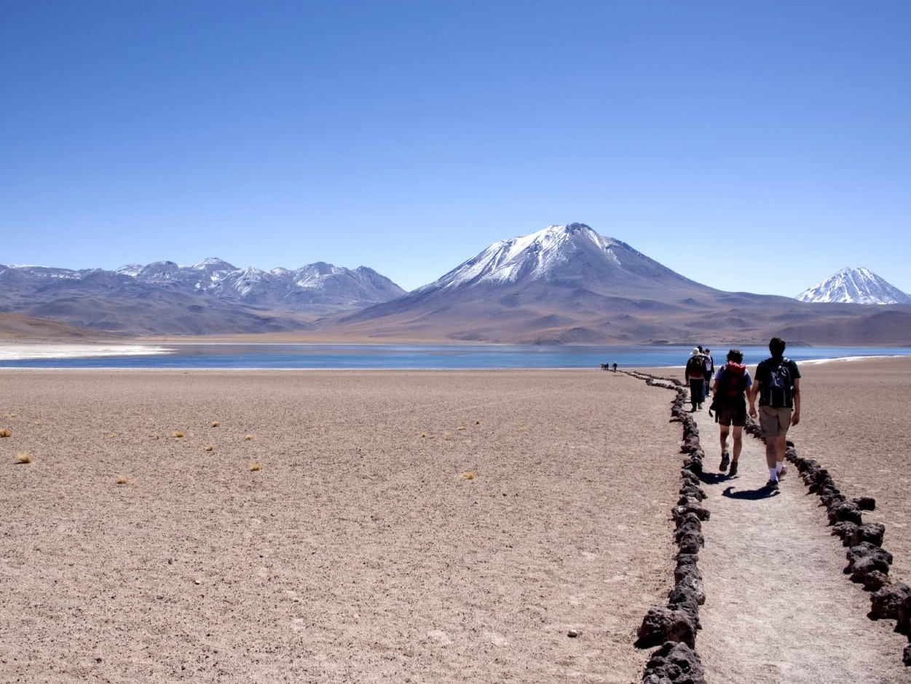
ZONE 1: THE NORTH
& THE ATACAMA DESERT

Slide 7
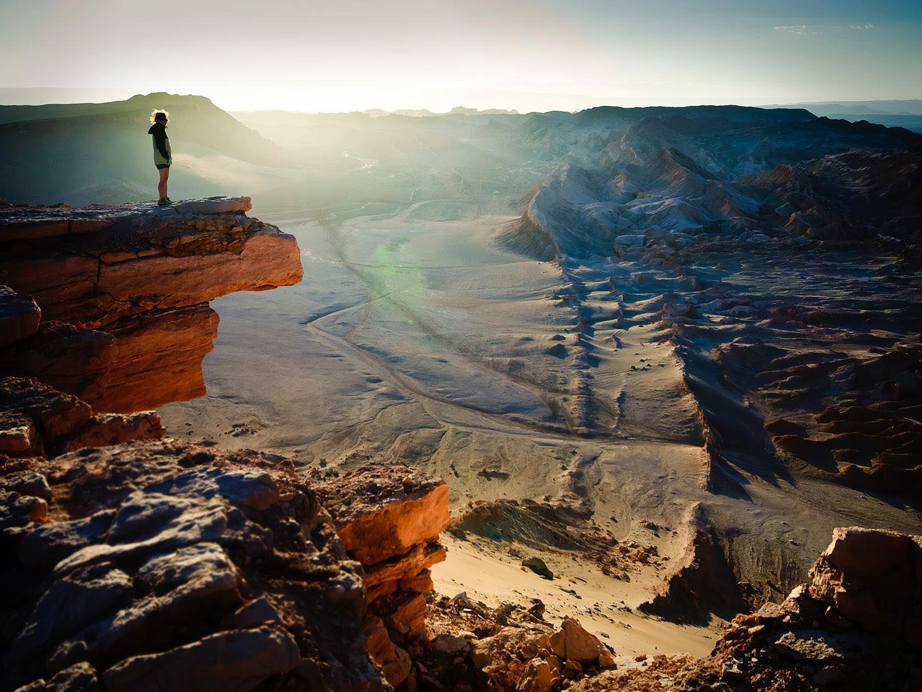

Main Highlights
THE NORTH
& THE ATACAMA DESERT
Arica
Iquique
San Pedro de Atacama
La Serena and the Astronomical Route
The Atacama Desert is the most arid place in the world. Some areas haven’t received rain in 300 years.
A world renown astronomical hub: the sky is clear 340 days a year.
Discover the charm of the local people and the first-class selection of hotels.
Great place for wildlife observation
Year round destination due to its climate
UNESCO World Heritage Site

Slide 8
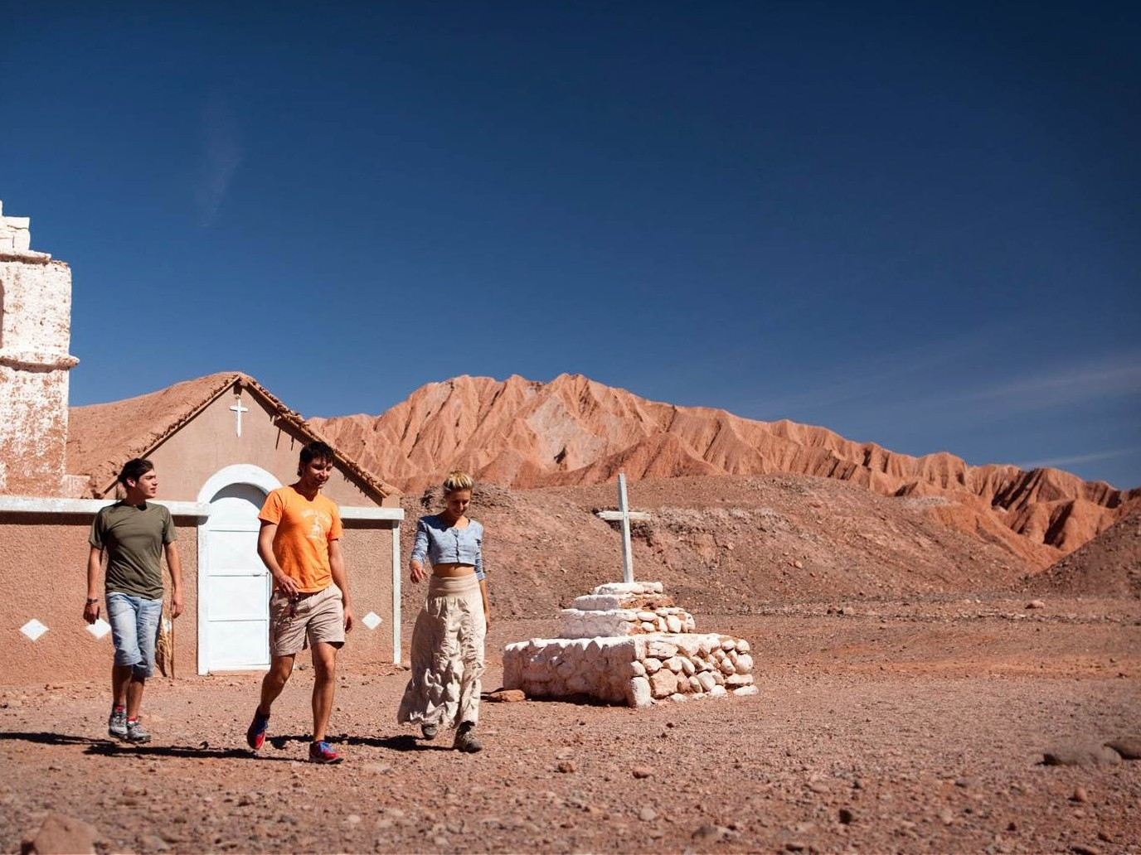

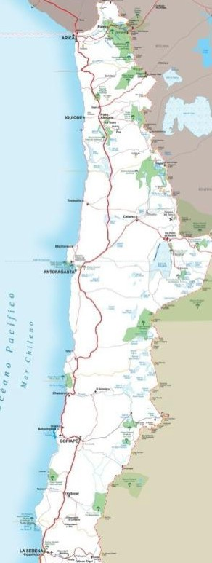


THE NORTH & THE ATACAMA DESERT
NORTH DISTANCES TABLE
Arica
City | Kilometers from Santiago | Miles from Santiago
Arica | 2.062 | 1.281
Iquique | 1.853 | 1.151
Antofagasta | 1.361 | 845
Calama | 1.574 | 978
Copiapó | 801 | 497
La Serena | 474 | 294
Coquimbo | 465 | 288
Iquique
San Pedro de Atacama
JAN FEB MAR APR MAY JUN
CLIMATE
OF THE AREA
JUL AUG SEP
OCT NOV DEC
La Serena

Slide 9
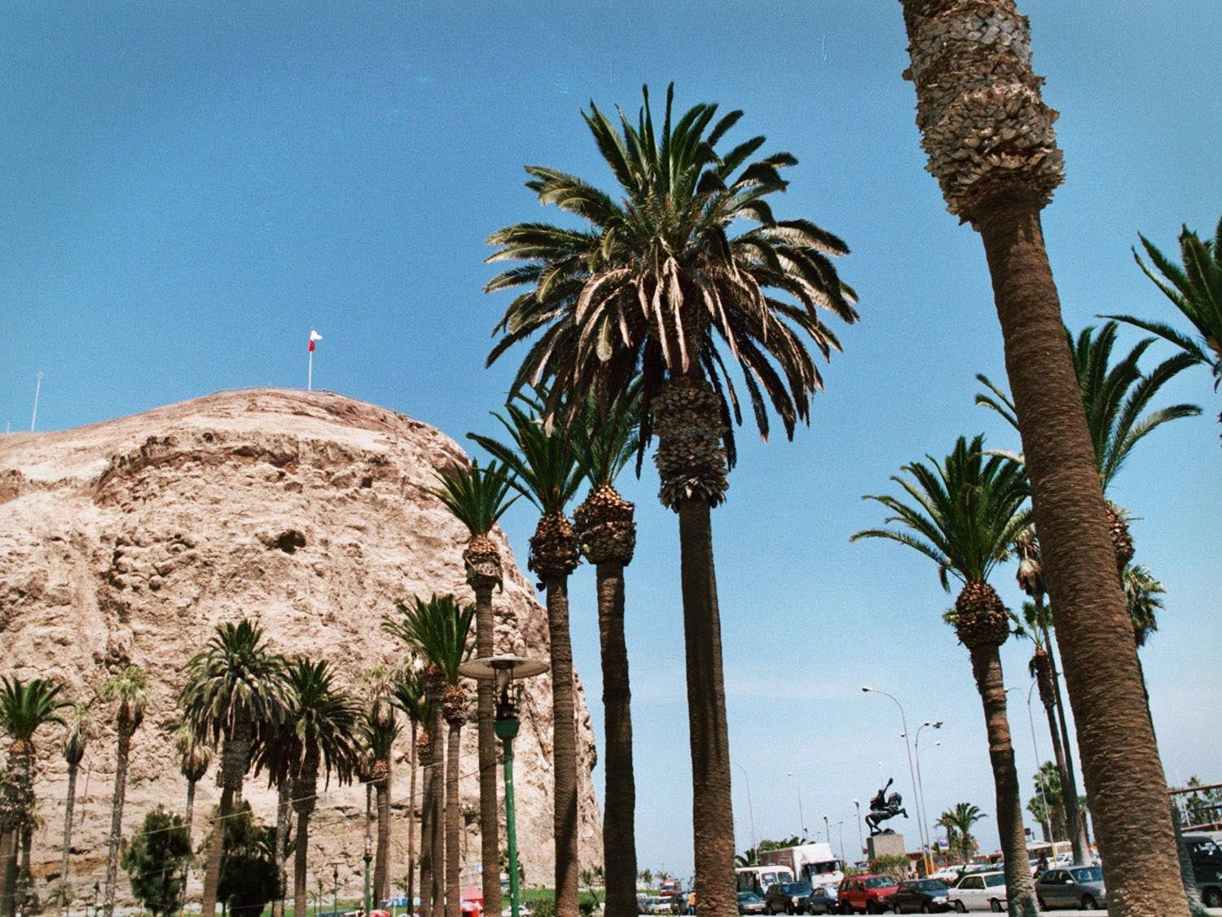



THE NORTH
& THE ATACAMA DESERT
Arica
5 Flights daily
3h flight
Recommended stay 2 - 3 days
Frequency of Flights and Itineraries
Departures from Santiago

Slide 10
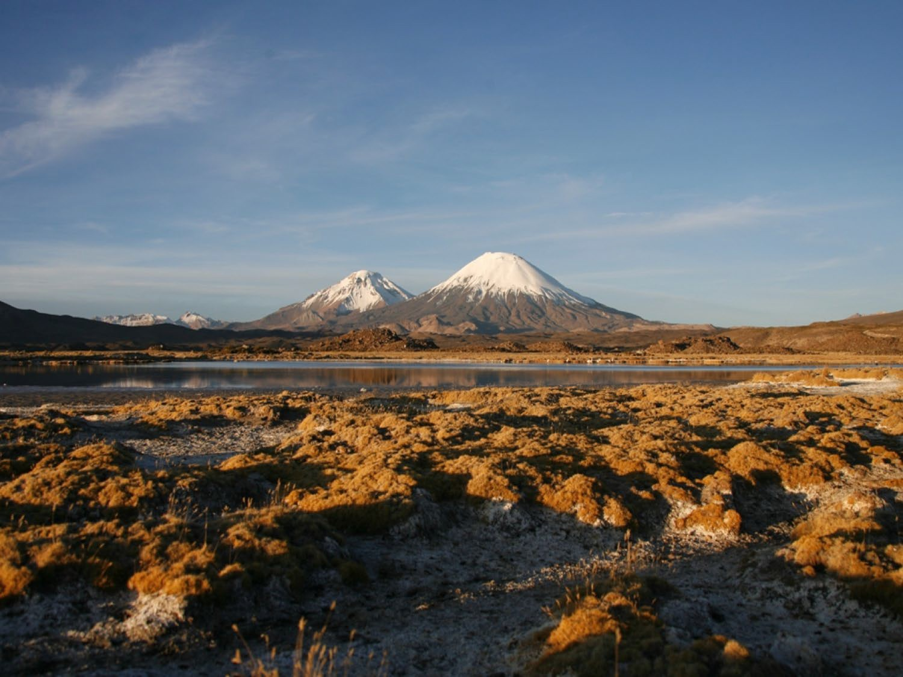

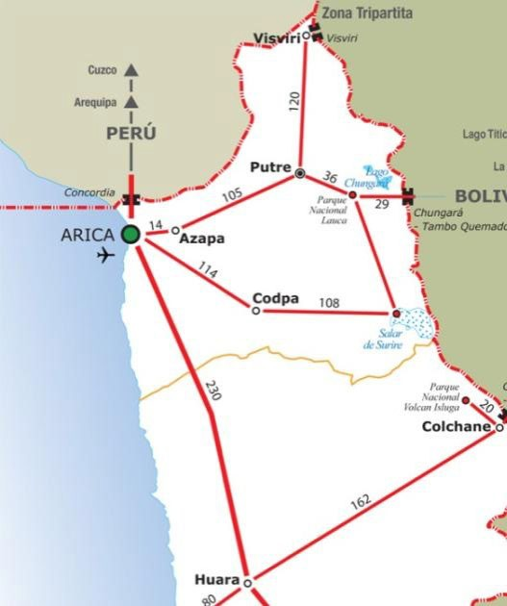


WHAT TO DO / WHAT TO SEE
THE NORTH &
THE ATACAMA DESERT
ARICA THE CAPITAL OF THE A RICA-PARINACOTA REGION
Arica’s most distinctive feature is the Morro, a rock formation 110 meters or (360 ft) high.
Lauca National Park Lake Chungara
Arica is considered a Surfer’s paradise.
Known as the “City of Eternal Spring” it has high temperatures year-round.
Its beaches, such as Bahía Chinchorro and Las Machas, are always in season.
The Chinchorro Mummies here are the oldest in the world.

Slide 11
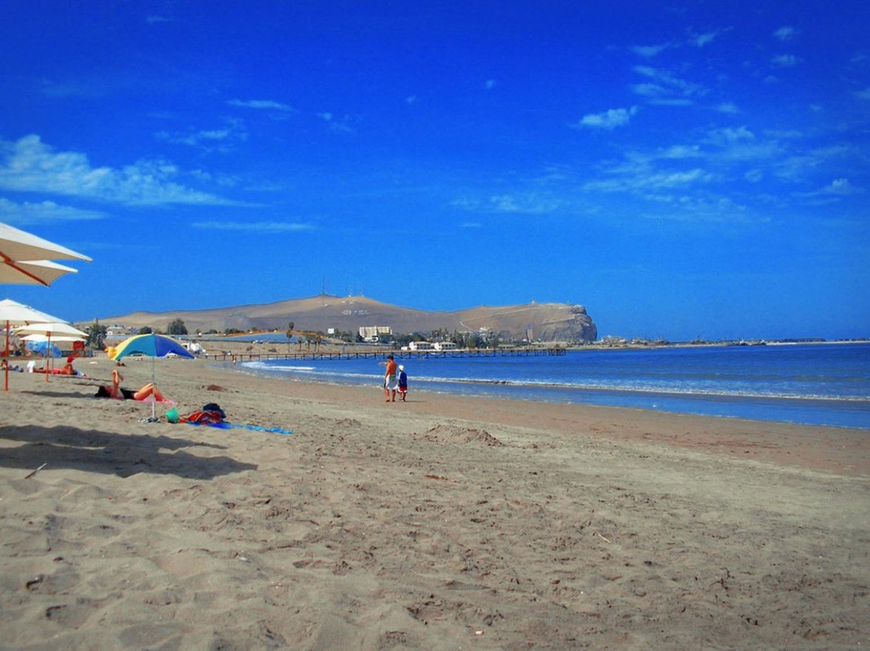
ARICA
THE NORTH
& THE ATACAMA DESERT

Slide 12
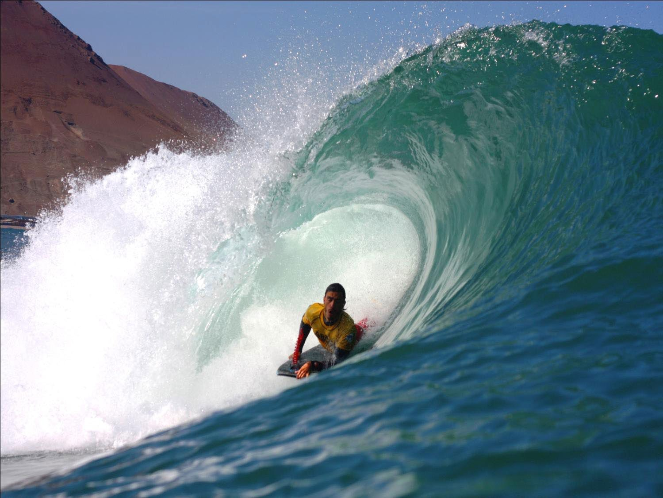
ARICA
THE NORTH
& THE ATACAMA DESERT

Slide 13
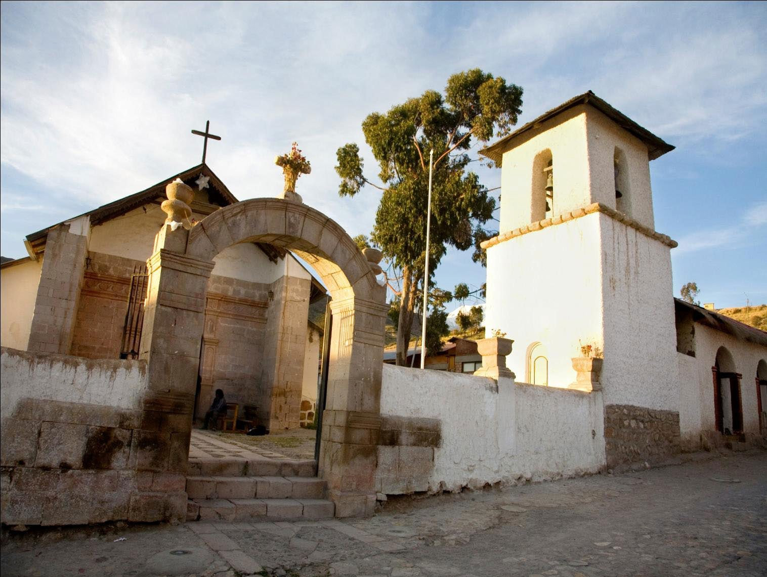
ARICA
THE NORTH
& THE ATACAMA DESERT

Slide 14
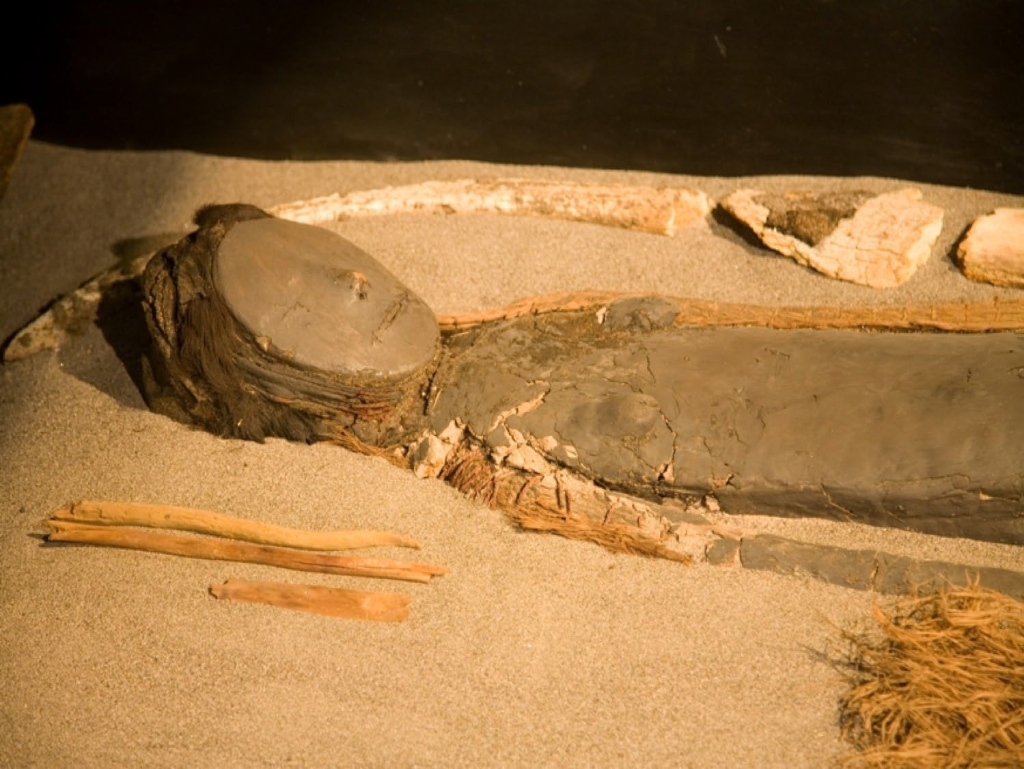
ARICA
THE NORTH
& THE ATACAMA DESERT

Slide 15
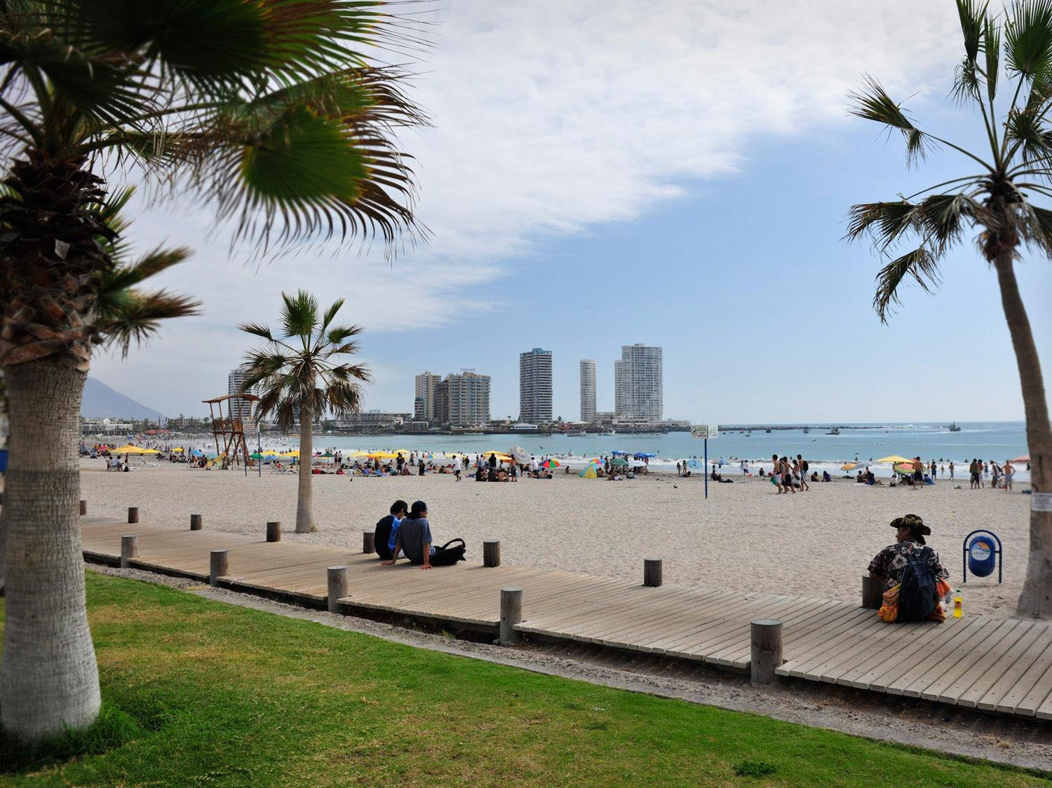


THE NORTH
& THE ATACAMA DESERT
Iquique
10 Flights daily
2h 30m flight
Recommended stay 2 - 3 days
Frequency of Flights and Itineraries
Departures from Santiago

Slide 16
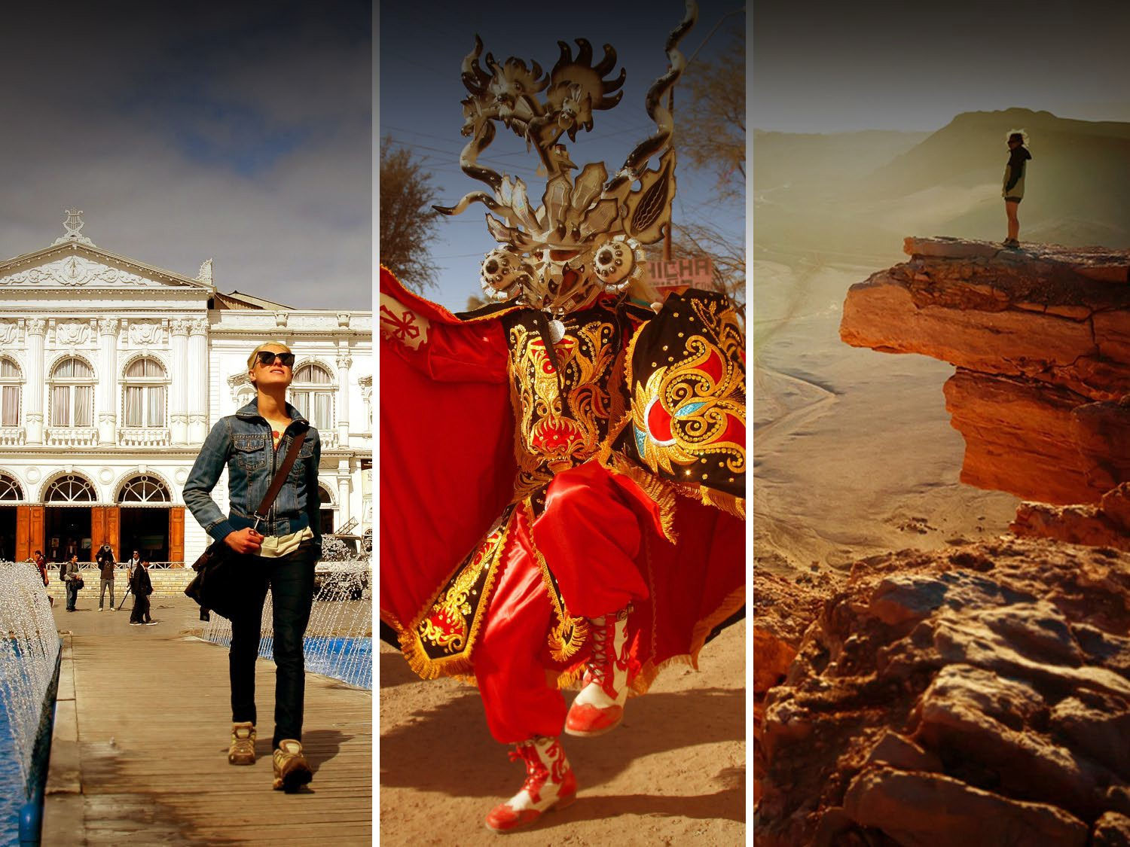
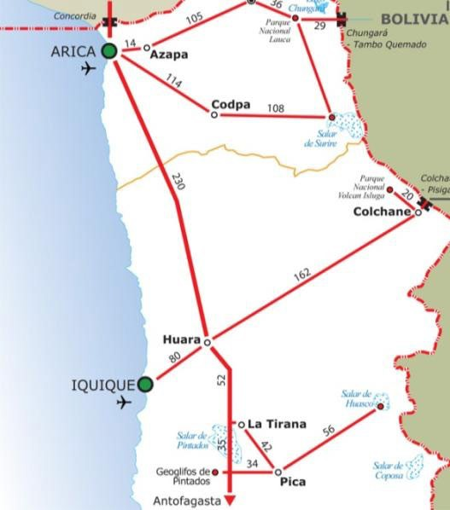
WHAT TO DO / WHAT TO SEE
THE NORTH &
THE ATACAMA DESERT
HERITAGE AND ADVENTURE SPORTS IN THE NORTH
La Tirana Festival(July 12 – 18): dozens of religious congregations dance in honor of Our Lady of Mount Carmel.
The heritage and history of saltpeter: the saltpeter works of Humberstone and Santa Laura are historic monuments and UNESCO World Heritage Sites.
Entrance to the Altiplano and spectacular Salt Flats
Iquique has a beautiful historical district
Paragliding capital of the North

Slide 17
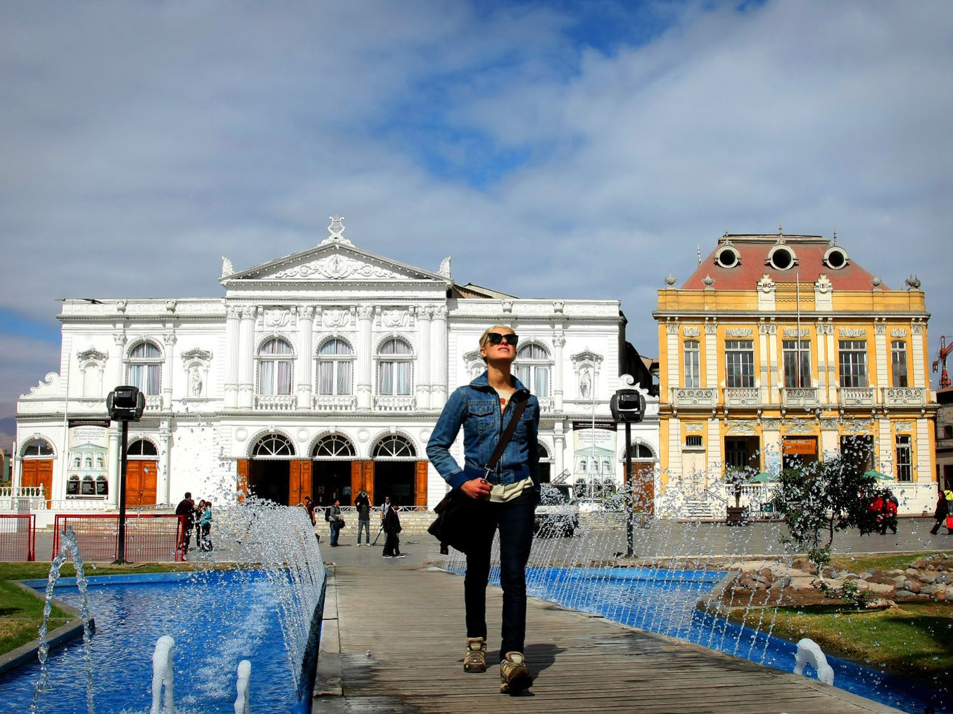
IQUIQUE
THE NORTH
& THE ATACAMA DESERT

Slide 18
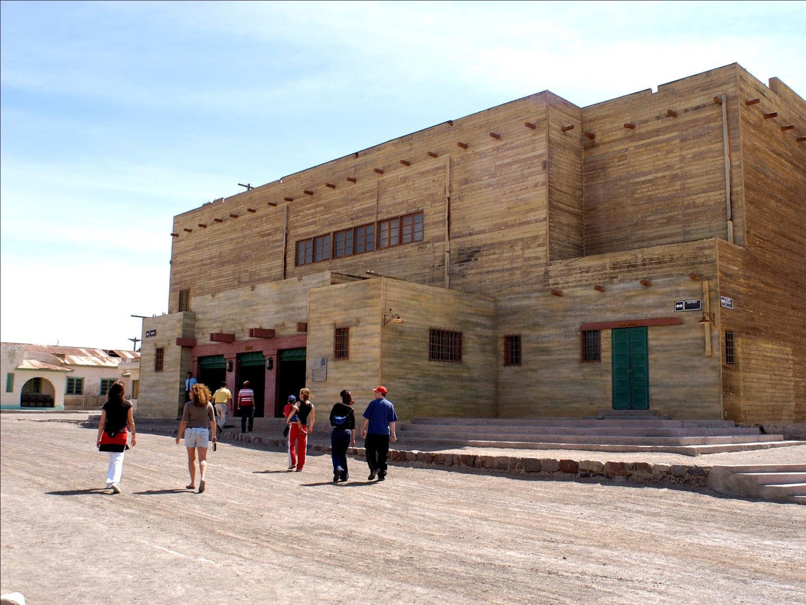
IQUIQUE
THE NORTH
& THE ATACAMA DESERT

Slide 19
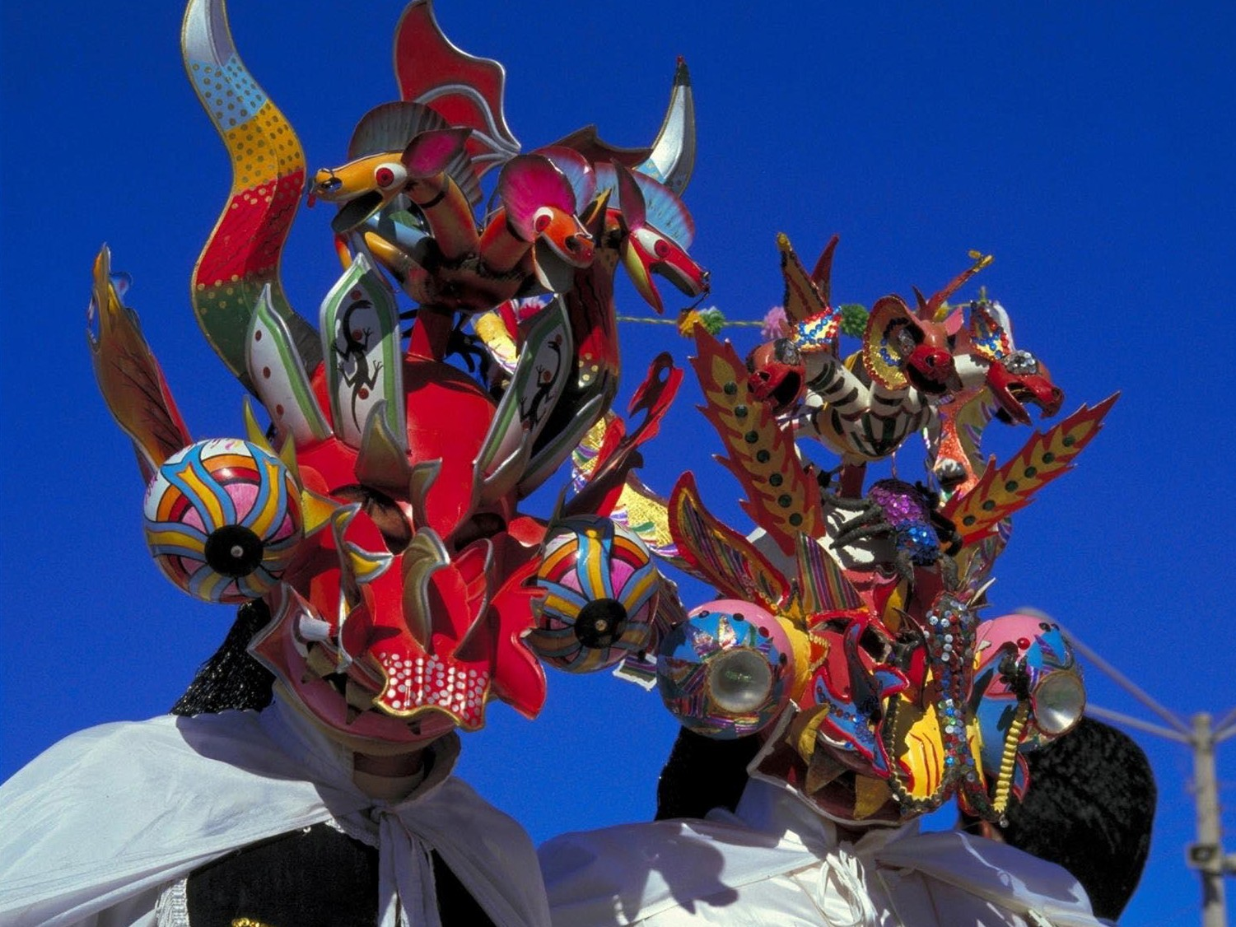
IQUIQUE
THE NORTH
& THE ATACAMA DESERT

Slide 20
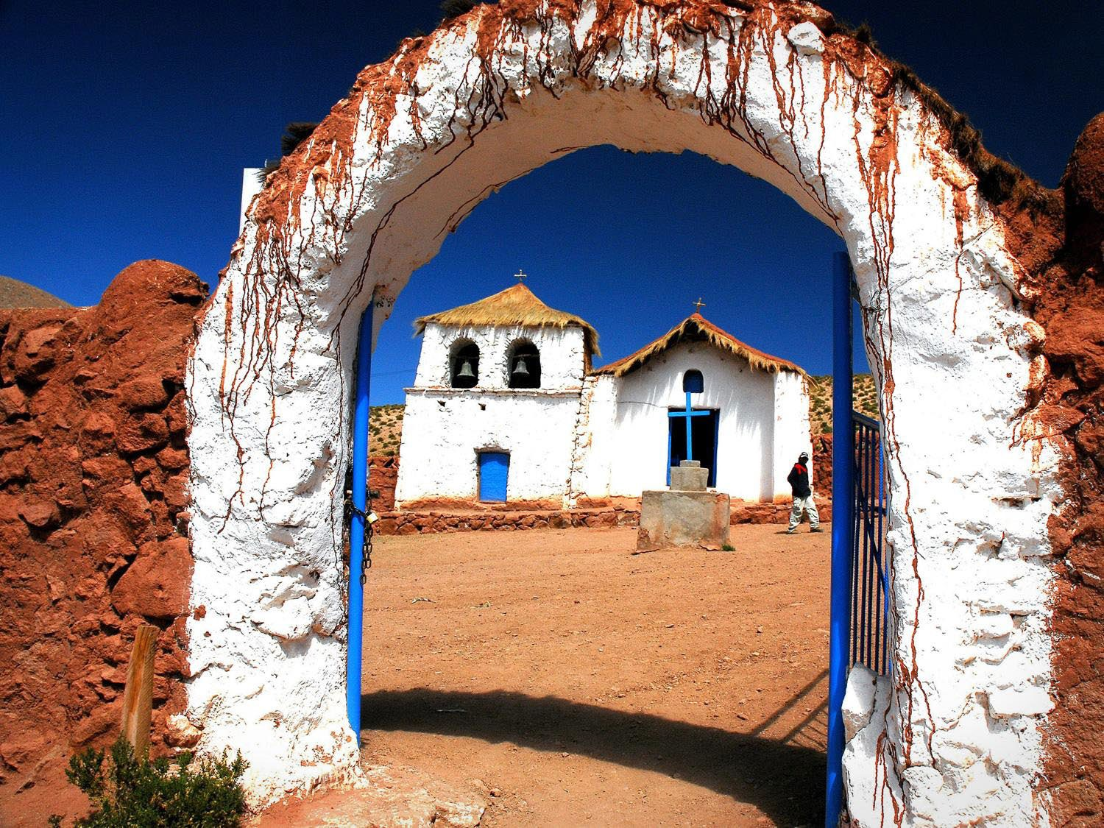


THE NORTH
& THE ATACAMA DESERT
San Pedro
8 Daily flights to Calama
1h 50m flight
Transfer 1hr 15m from Calama Recommended stay 4 days
Frequency of Flights and Itineraries
Departures from Santiago

Slide 21
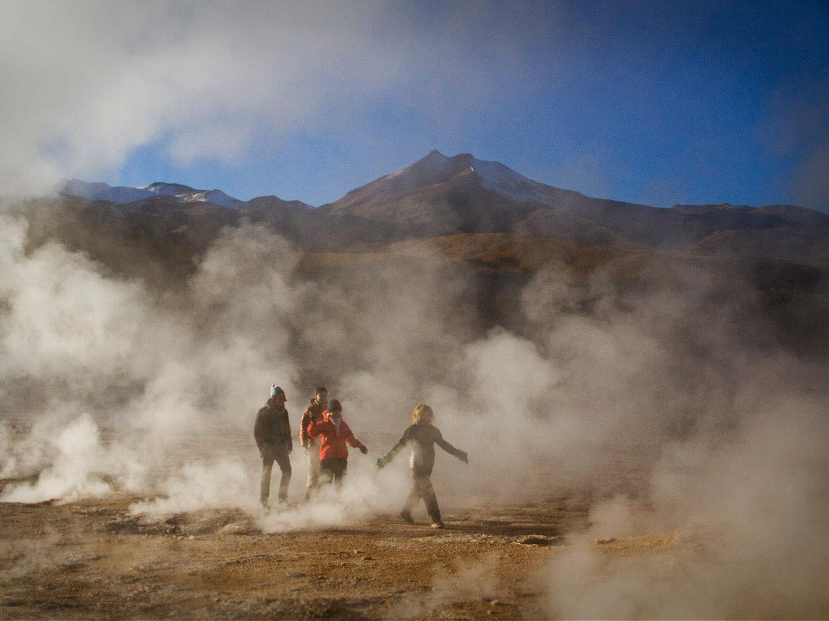
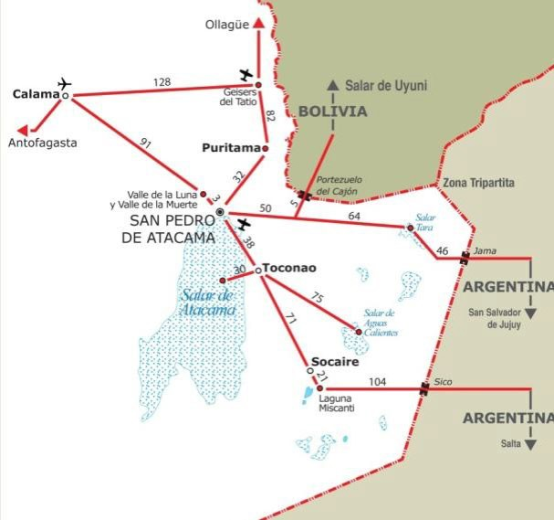
WHAT TO DO / WHAT TO SEE
THE NORTH &
THE ATACAMA DESERT
NATURAL INSPIRATION IN SAN PEDRO
Musts are:
El Tatio Geyser fields
The Atacama Salt Flat, and the Chaxa Lagoon, habitat for flamingoes and other high plateau birds.
The Moon and Death valleys
The High Mountain lakes of Miscanti & Meñiques
The Andean Villages of Toconao, Rio Grande and Machuca
The central square of San Pedro de Atacama and its green surroundings.
Archaeological Capital of Chile

Slide 22
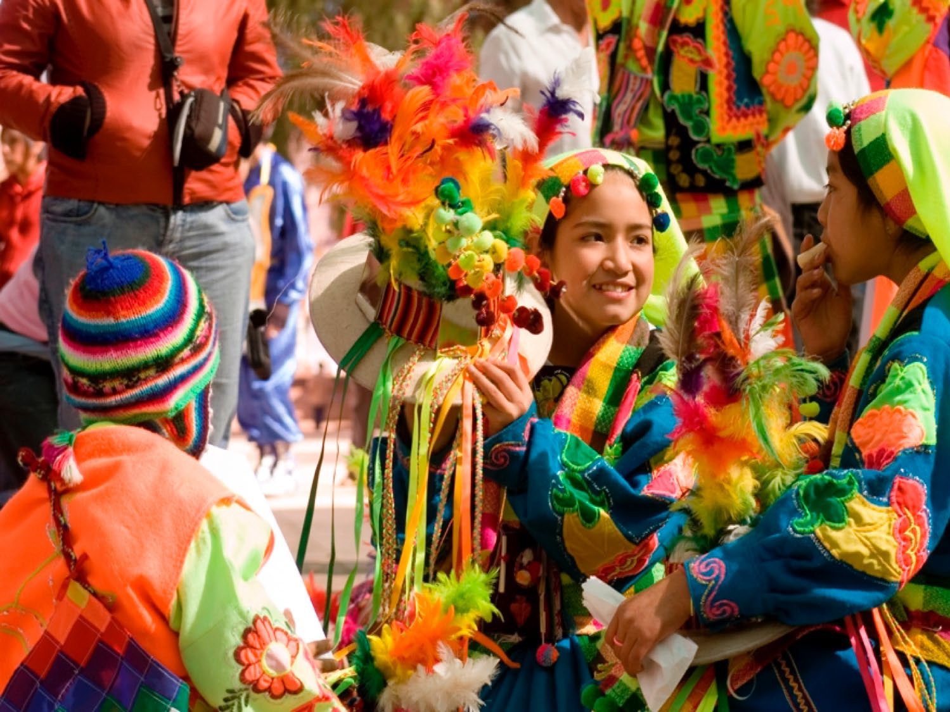
SAN PEDRO
THE NORTH
& THE ATACAMA DESERT

Slide 23
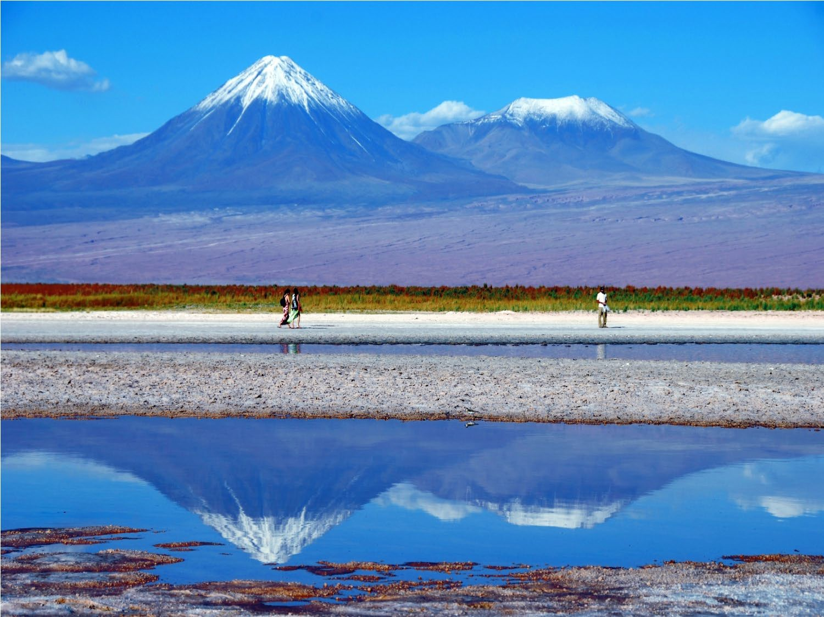
SAN PEDRO
THE NORTH
& THE ATACAMA DESERT

Slide 24
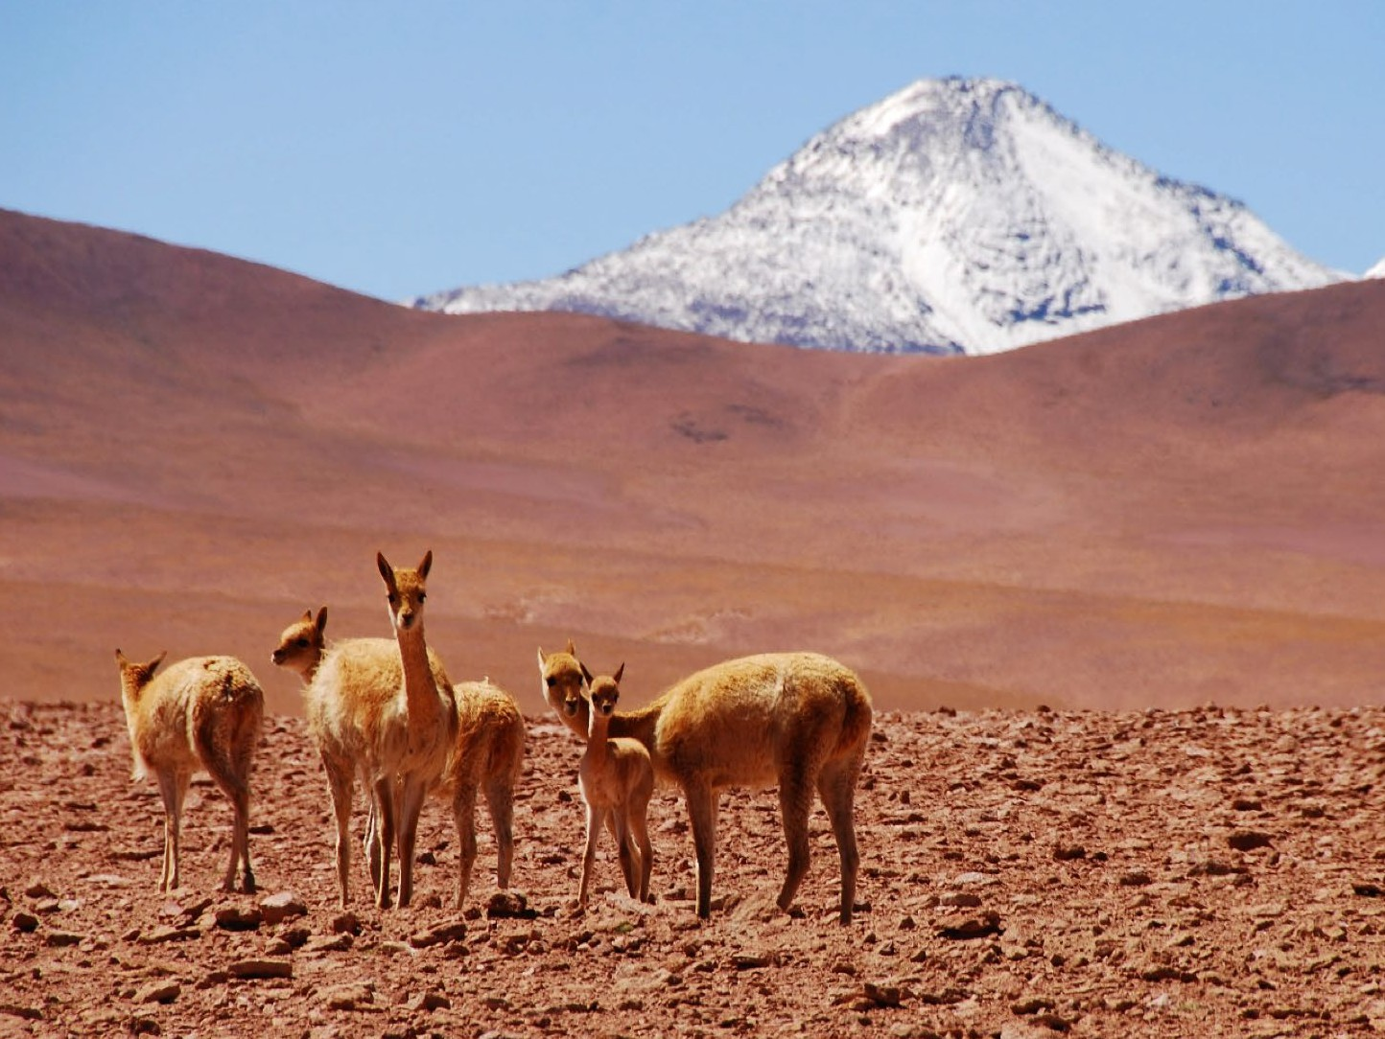
SAN PEDRO
THE NORTH
& THE ATACAMA DESERT

Slide 25
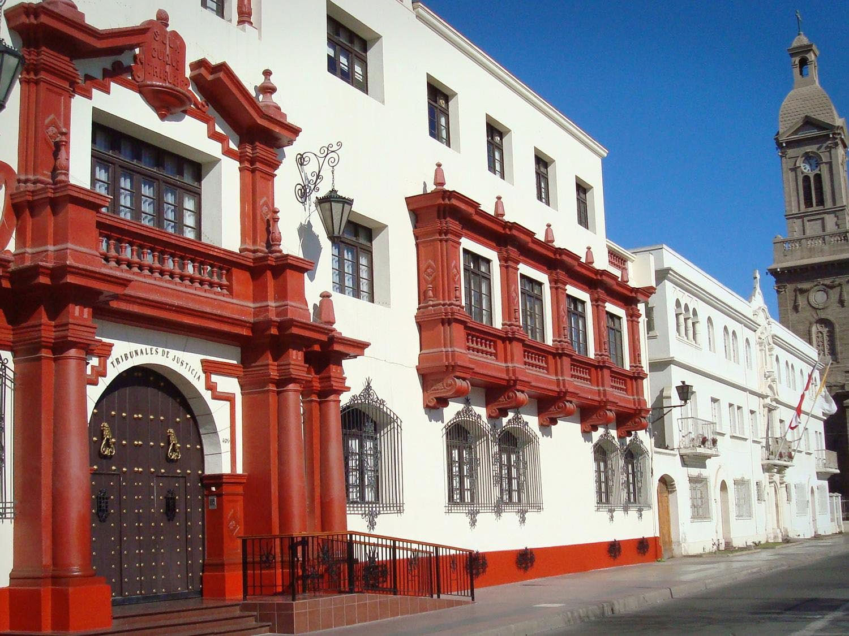


THE NORTH
& THE ATACAMA DESERT
La Serena
5 Flights daily
45m flight
Recommended stay 3 days
Frequency of Flights and Itineraries
Departures from Santiago

Slide 26
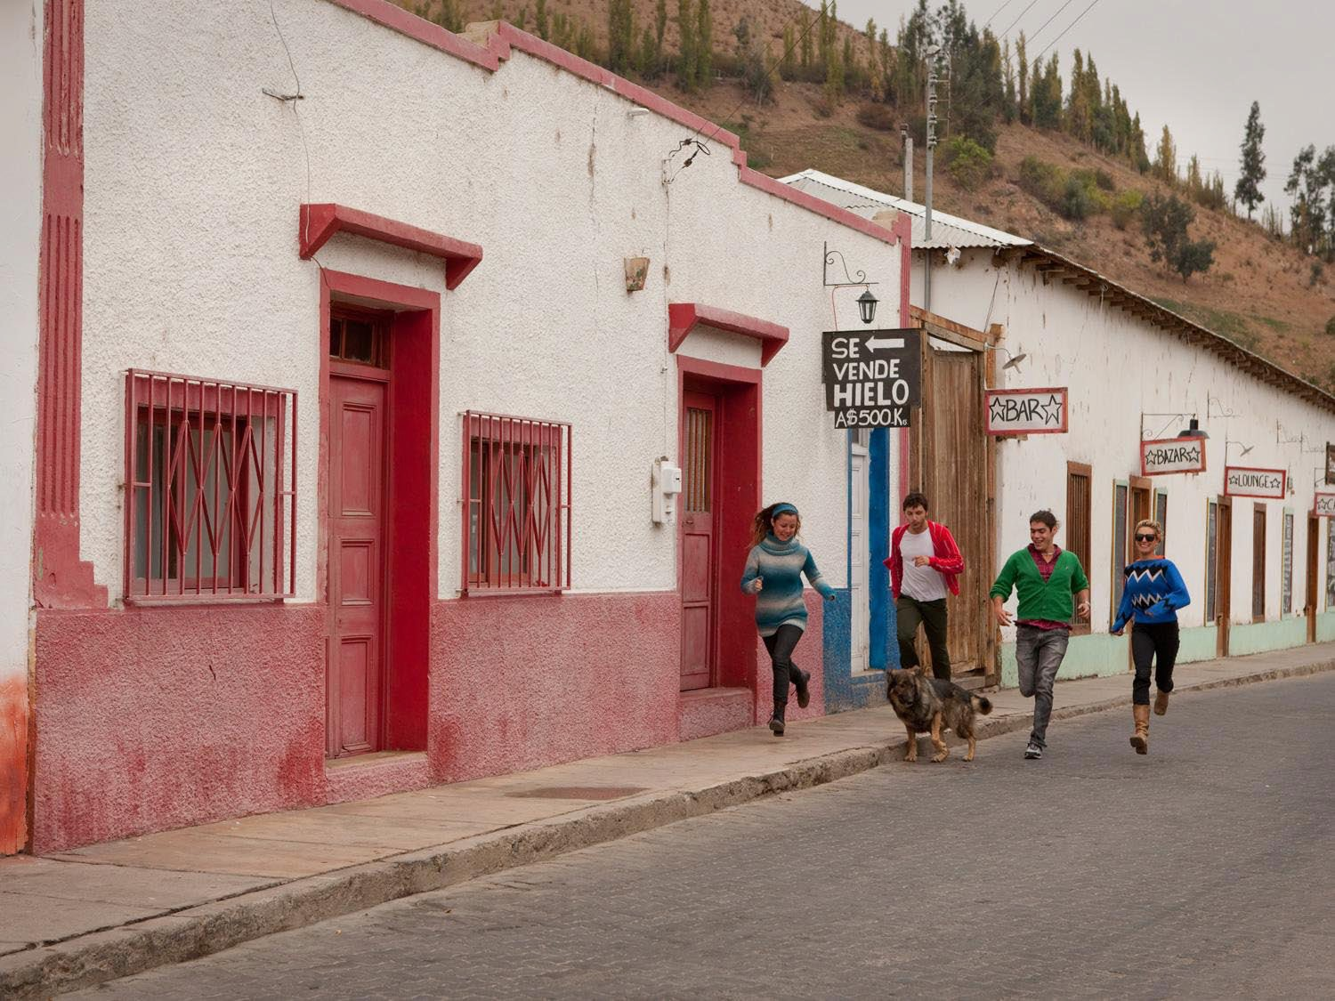
LA SERENA
THE NORTH
& THE ATACAMA DESERT

Slide 27
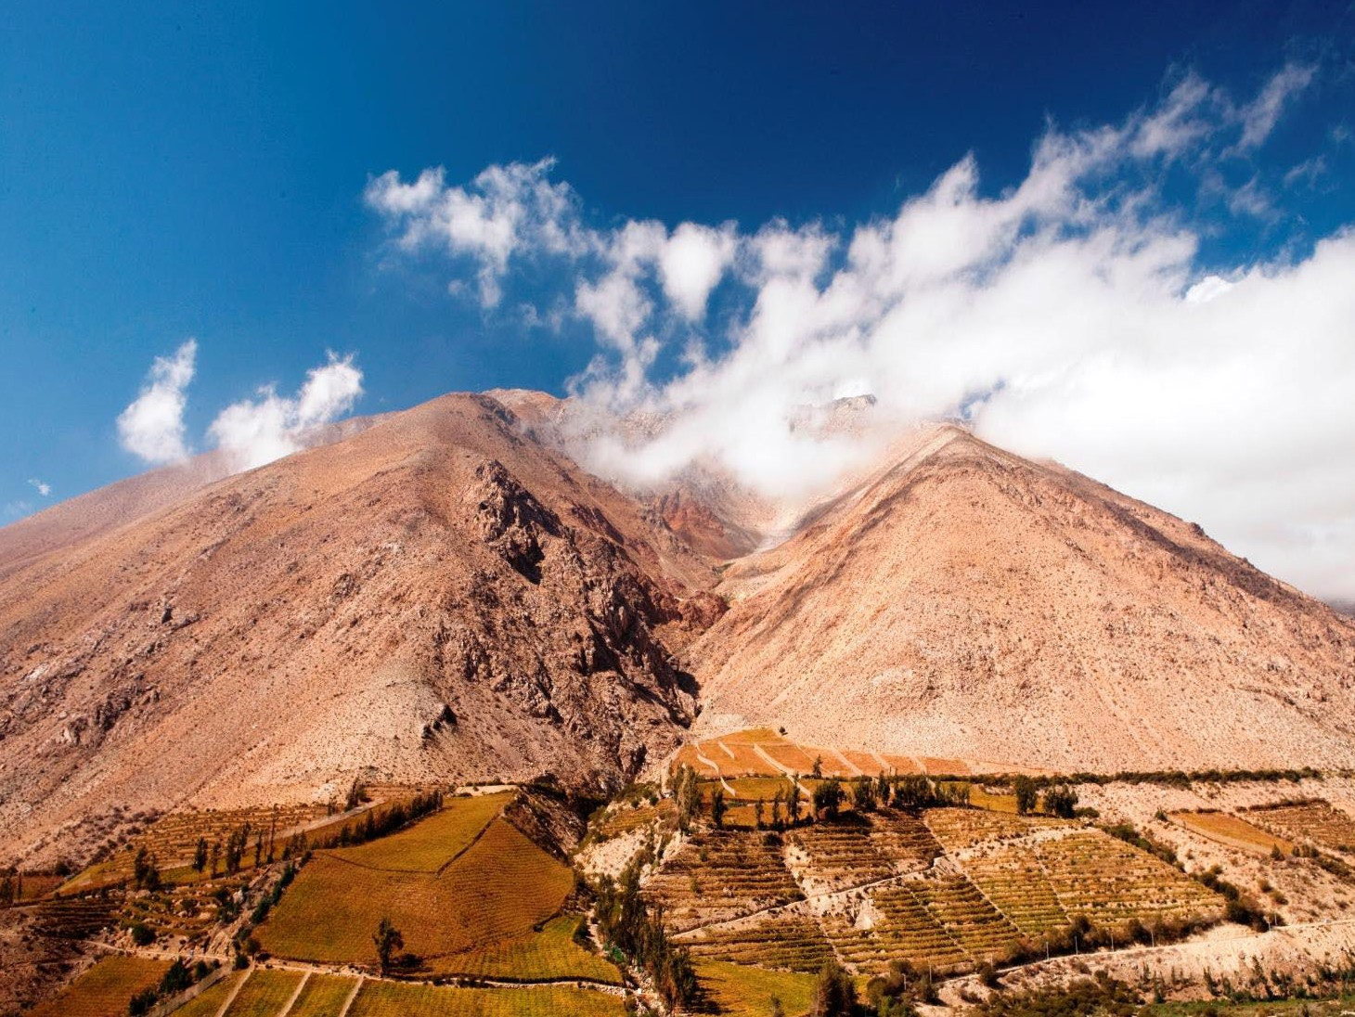
LA SERENA
THE NORTH
& THE ATACAMA DESERT

Slide 28
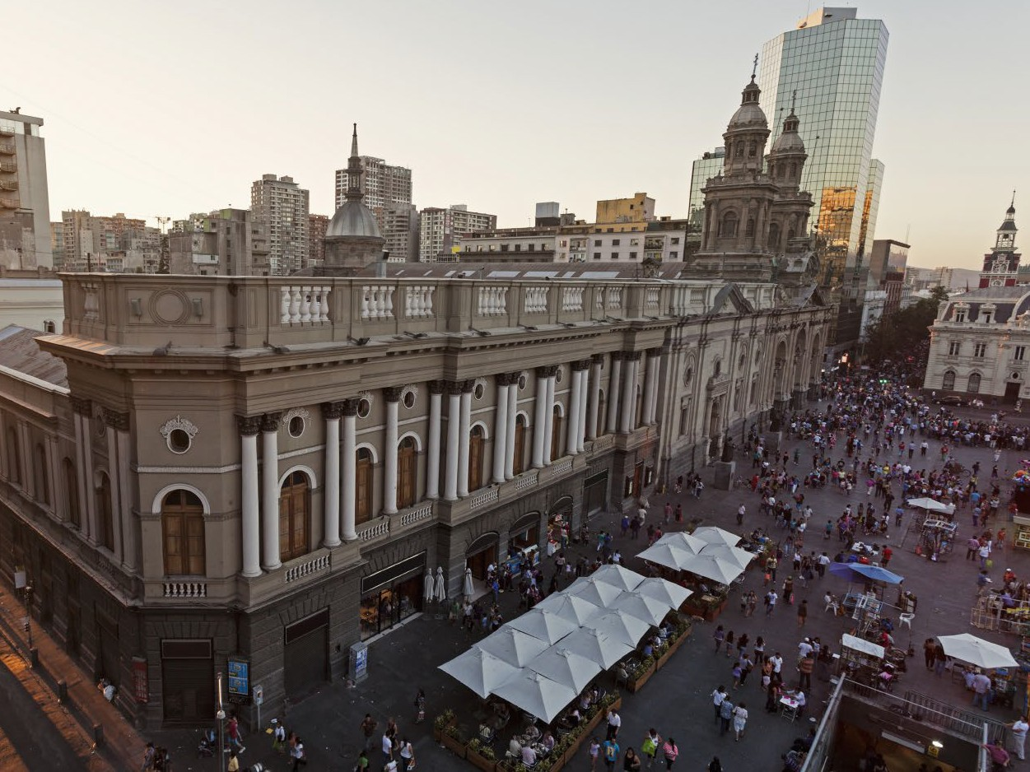
ZONE 2: SANTIAGO & THE CENTRAL ZONE

Slide 29
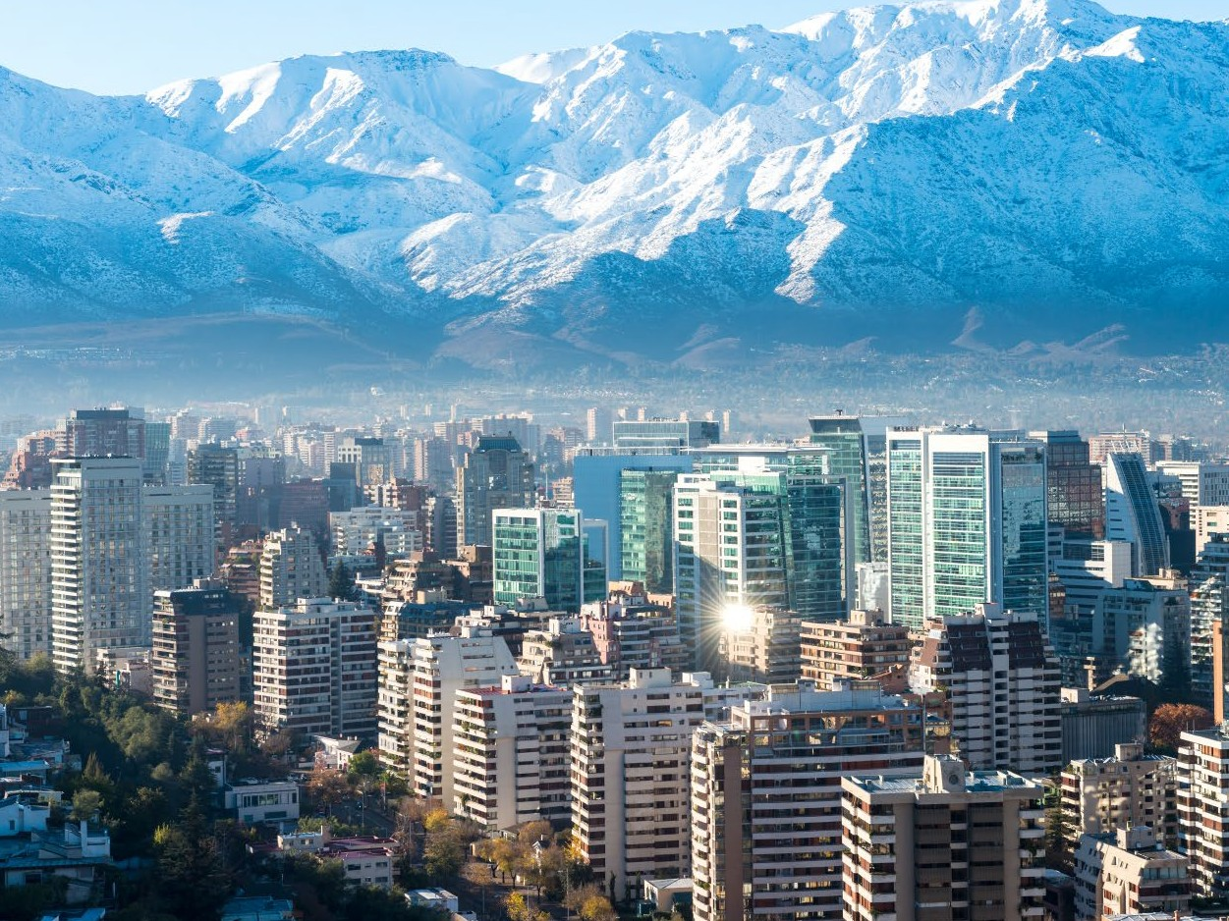

Main Highlights
SANTIAGO & THE CENTRAL ZONE
Santiago
Valparaíso
The Wine Country
Ski Resorts
“Santiago is one of the world’s top travel destinations, thanks to its growing cultural life, new infrastructure dedicated to the arts, and first-class hotel options.”
(The New York Times)
Some of the best vineyards in the world are located just outside of Santiago.
Santiago and Valparaiso are two must visit destinations, full of cultural activities and bustling city life.
World class ski resorts.
Beautiful coast line, with modern cities & quiet seaside towns.

Slide 30
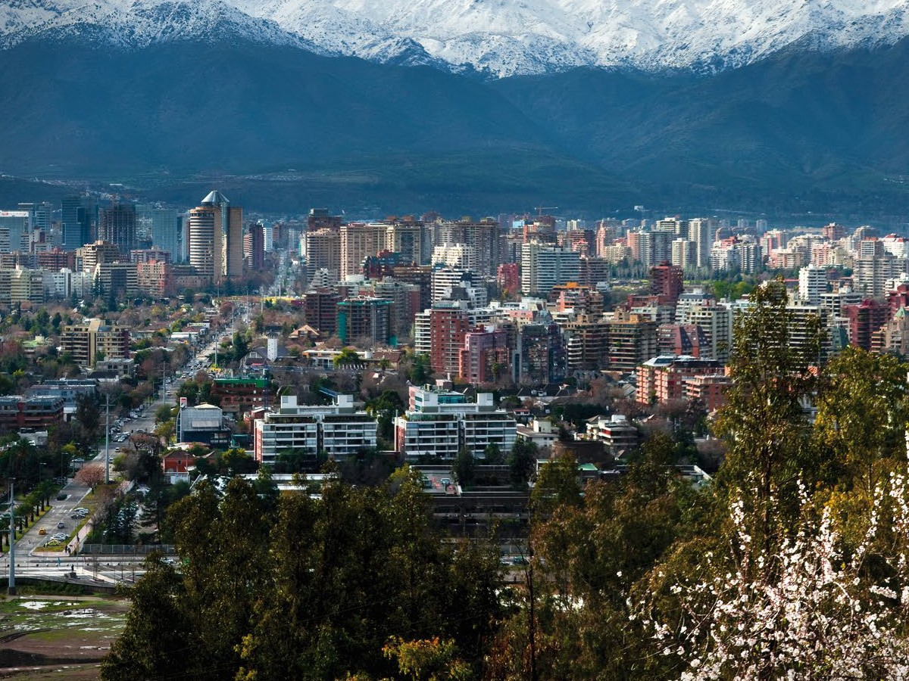
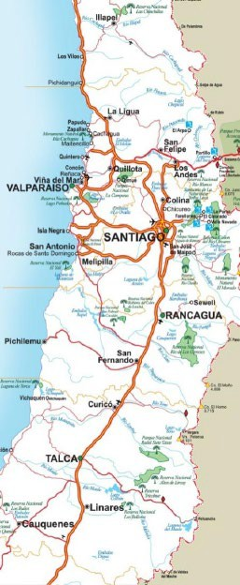


SANTIAGO & THE CENTRAL ZONE
NORTH DISTANCES TABLE
City
Kilometers Miles from
 | from Santiago | Santiago
Valparaíso | 120 | 74
Viña del Mar | 120 | 74
Santiago | 0 | 0
Rancagua | 87 | 54
Curicó | 194 | 120
Talca | 257 | 159
JAN FEB MAR APR MAY JUN
CLIMATE
OF THE AREA
JUL AUG SEP
OCT NOV DEC
La Serena

Slide 31
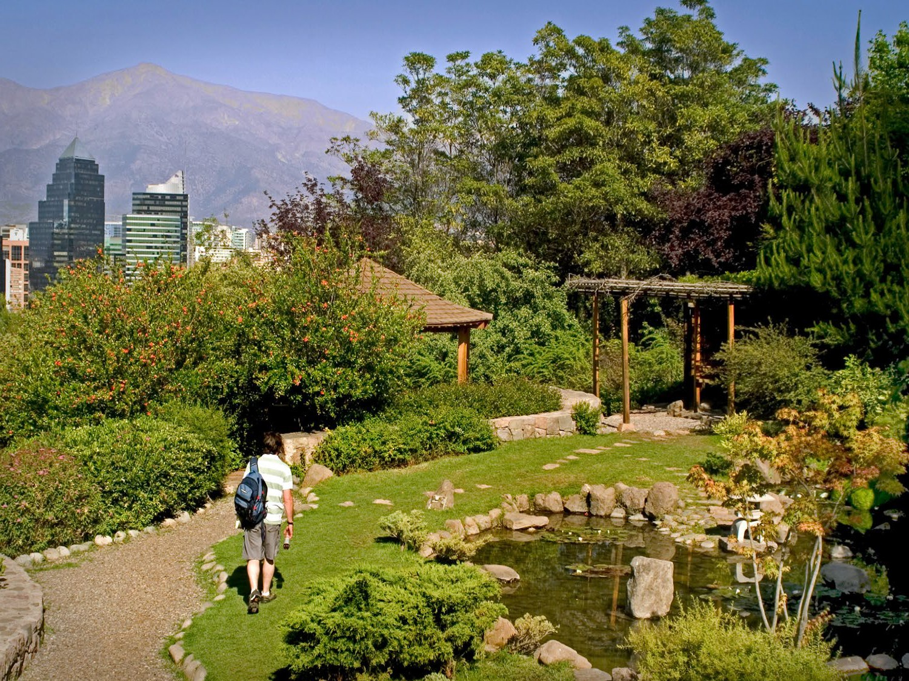

SANTIAGO & THE CENTRAL ZONE
Santiago
Airport Arturo Merino Benítez
Recommended stay
3 days

Slide 32
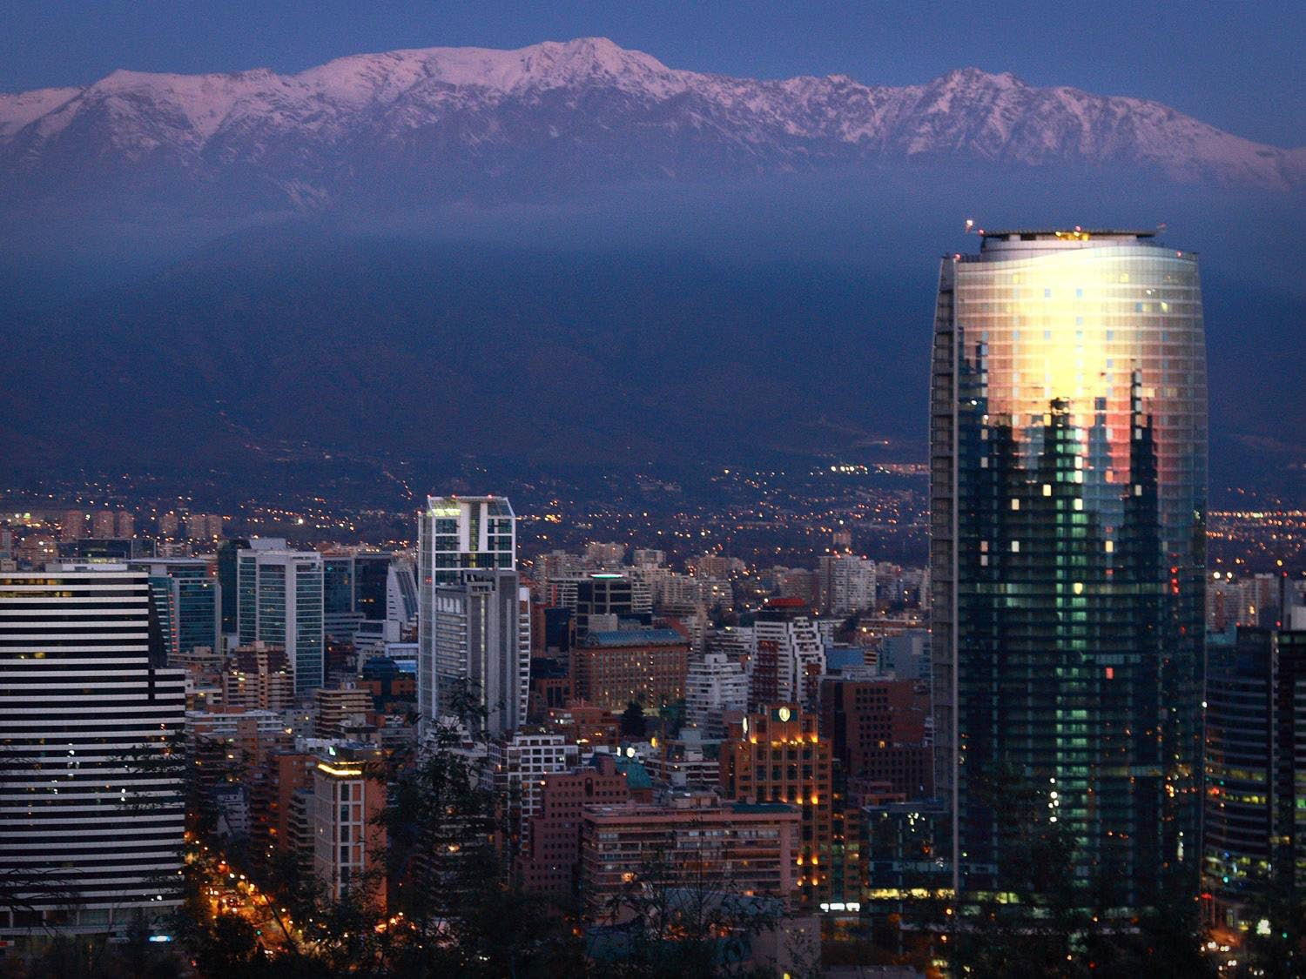
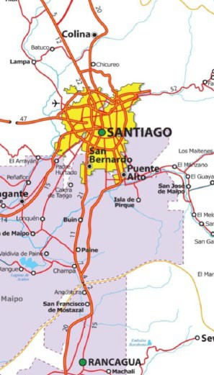
WHAT TO DO / WHAT TO SEE
SANTIAGO & THE CENTRAL ZONE
SANTIAGO
The neighborhoods of Lastarria, Italia, and bohemian Bellavista: restaurants, design shops, bars and cafés.
Strategically located 1 hour from the mountains and ski resorts and 1 hour from the beach.
Santiago is full of history, and has a great mix of traditional and modern architecture.
Surrounded by more than 50 vineyards.
Santiago boasts cultural activities every day of the year.

Slide 33
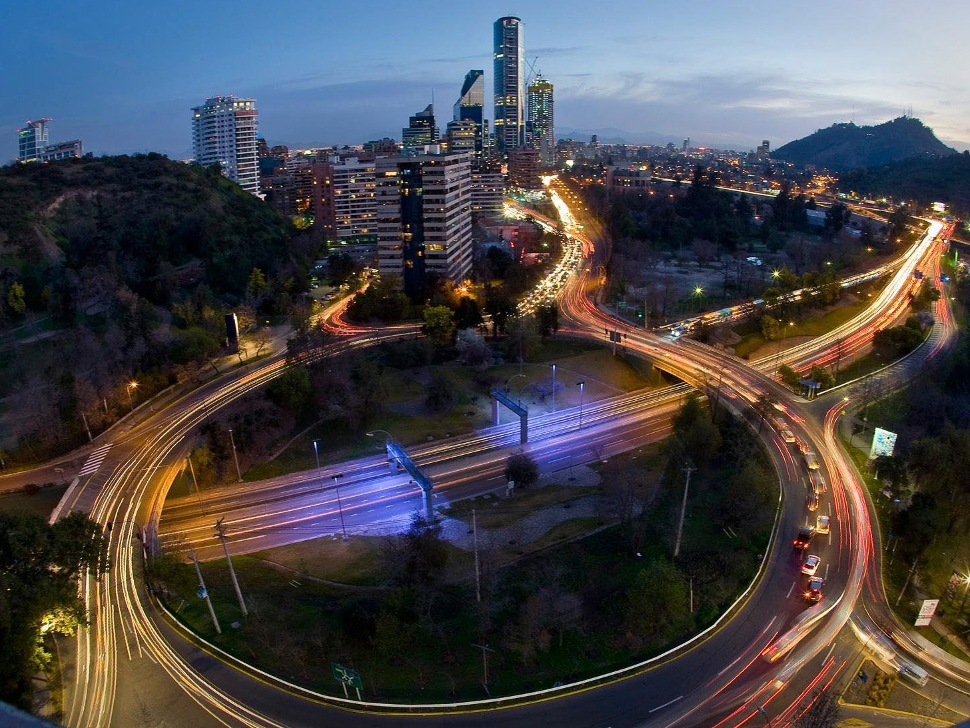
SANTIAGO
SANTIAGO & THE CENTRAL ZONE

Slide 34
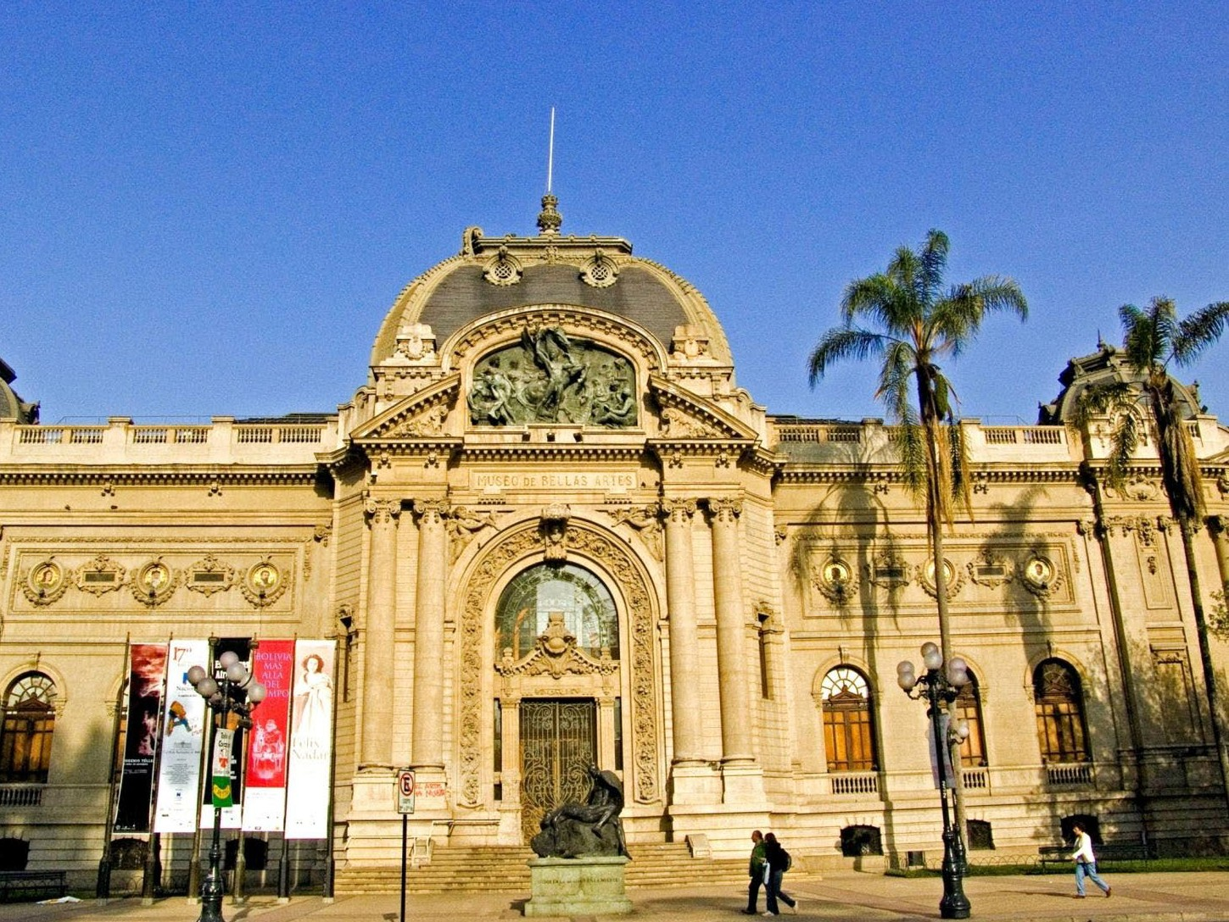
SANTIAGO
SANTIAGO & THE CENTRAL ZONE

Slide 35
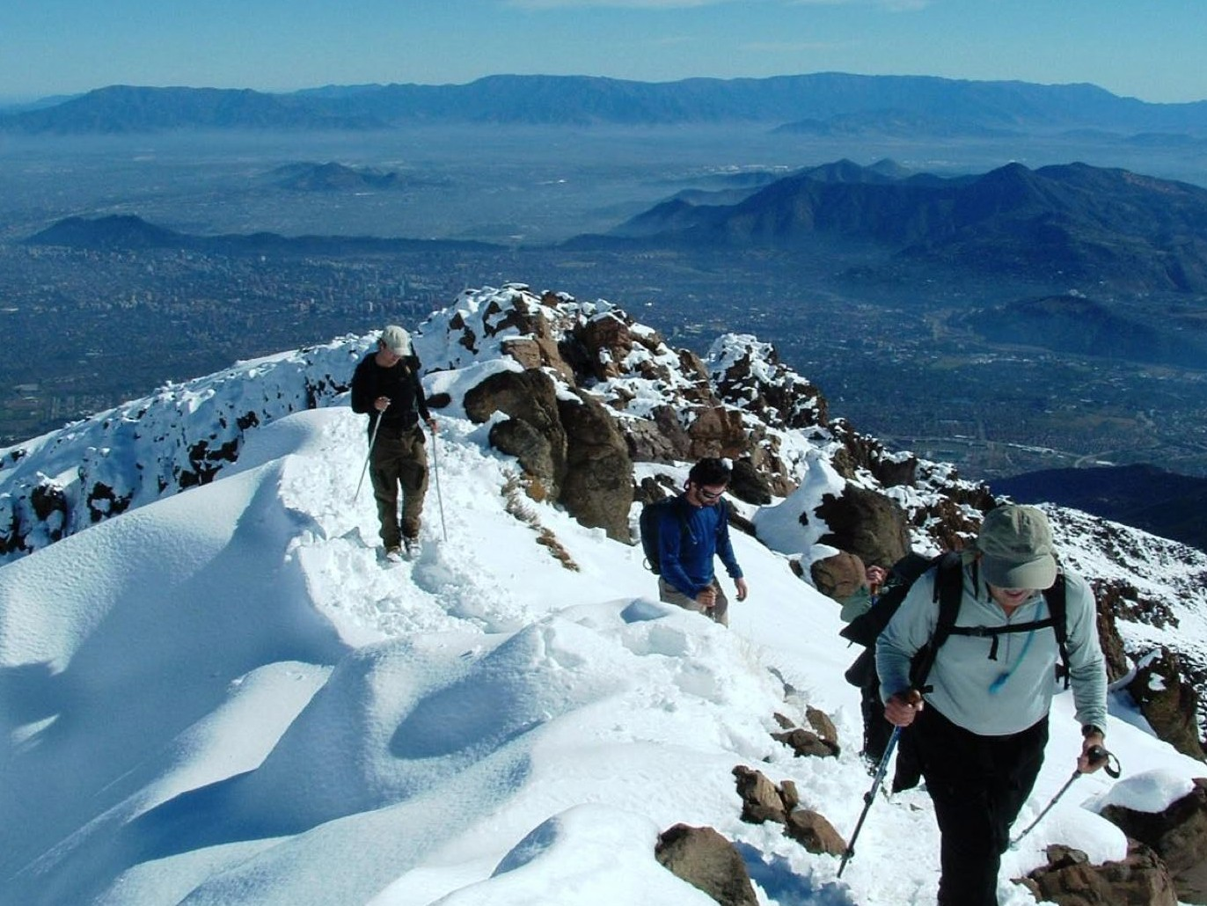
SANTIAGO
SANTIAGO & THE CENTRAL ZONE

Slide 36
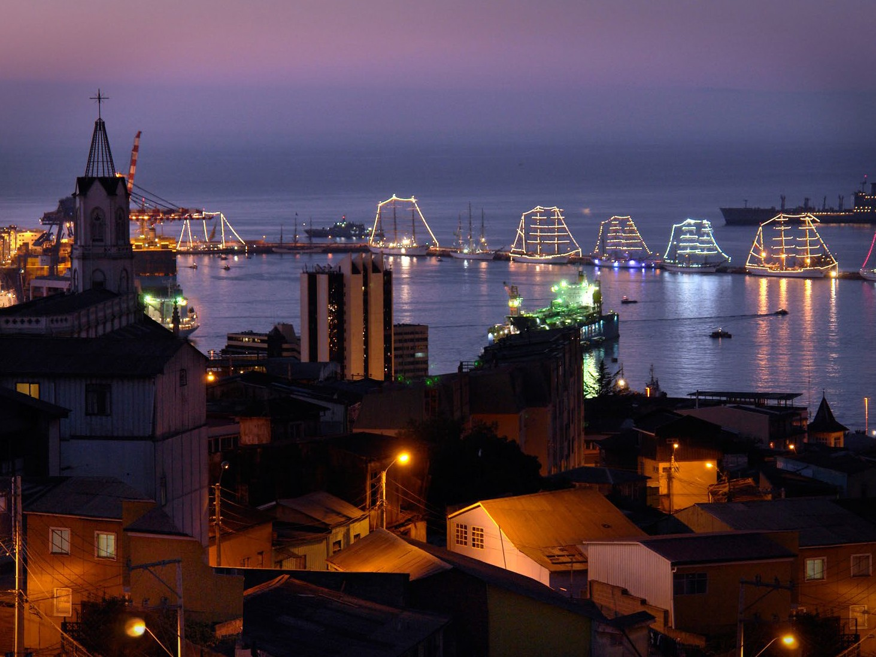

SANTIAGO & THE CENTRAL ZONE
Valparaíso
Recommended stay
2 days
Transfer 1hr 20m
from Santiago

Slide 37
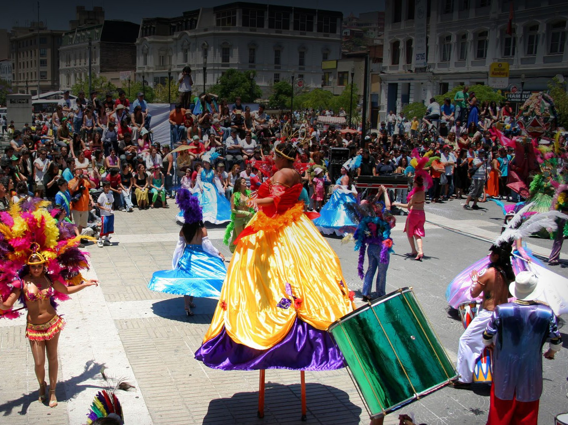
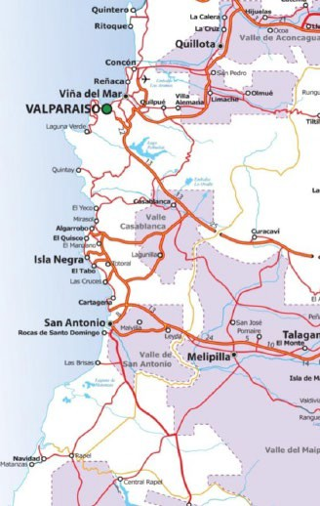

WHAT TO DO / WHAT TO SEE
SANTIAGO &
THE CENTRAL ZONE
VALPARAÍSO
Valparaiso is known for its bohemian flair, a UNESCO World Heritage Site.
Enjoy multiple beaches: Reñaca, Viña del Mar, Algarrobo, Santo Domingo, Zapallar, Cachagua.
Visit its modern sister city - Viña del Mar.
Pablo Neruda Museums located in close by Isla Negra and Valparaiso
Most important port of Chile and a must –visit for any major cruise ship visiting the country.

Slide 38

VALPARAÍSO
SANTIAGO & THE CENTRAL ZONE

Slide 39

VALPARAÍSO
SANTIAGO & THE CENTRAL ZONE

Slide 40

VALPARAÍSO
SANTIAGO & THE CENTRAL ZONE

Slide 41


SANTIAGO & THE CENTRAL ZONE
Wine Routes
Recommended stay
2 - 3 days
Transfer 40 m / 3 hrs
from Santiago

Slide 42


WHAT TO DO / WHAT TO SEE
SANTIAGO &
THE CENTRAL ZONE
GET A TASTE OF CHILE
Wine routes: Featuring daily visiting schedules, tastings, wine shops and excellent restaurants.
Chile produces some of the best wines in the world, some varieties are hard to find elsewhere, like Carmenere.

Slide 43

WINE ROUTES
SANTIAGO & THE CENTRAL ZONE

Slide 44

WINE ROUTES
SANTIAGO & THE CENTRAL ZONE

Slide 45

WINE ROUTES
SANTIAGO & THE CENTRAL ZONE

Slide 46


SANTIAGO & THE CENTRAL ZONE
Ski Resort
Recommended stay
1 - 6 days
Transfer 1hr 15m / 2 hr 30m from Santiago

Slide 47


SKI RESORTS
WHAT TO DO / WHAT TO SEE
SANTIAGO &
THE CENTRAL ZONE
THE MAJESTY OF THE ANDES
Ski Resorts: Valle Nevado, La Parva, Portillo, El Colorado and Farellones are famous for their runs, service and wide range of hotel operations.
Resorts near Santiago are located at high altitude, providing great snow.

Slide 48

SKI CENTERS
SANTIAGO & THE CENTRAL ZONE

Slide 49

SKI CENTERS
SANTIAGO & THE CENTRAL ZONE

Slide 50

SKI CENTERS
SANTIAGO & THE CENTRAL ZONE

Slide 51

ZONE 3: LAKES, RIVERS & VOLCANOES

Slide 52


Main high
lights
mple local c welling kn oat excursio ica’s only sa
LAKES, RIVERS & VOLCANOES
Chillan and the nearby Andes
Pucón
The Llanquihue Lake area
Ski Resorts
You can sa traditional d enjoy rowb South Amer
uisine, sleep in a
own as a ruca, and
ns on Budi Lake, ltwater lake.
The world renown Lake Crossing to Argentina
Chillán, Pucón, Volcán Osorno, Antillanca, Huilo Huilo, Las Araucarias, Corralco, and Antuco, great ski resorts that will put you in touch with nature
This area boasts dozens of natural hot springs. Health & Wellness destination.

Slide 53




LAKES, RIVERS & VOLCANOES
NORTH DISTANCES TABLE
City | Kilometers from Santiago | Miles from Santiago
Chillán | 407 | 252
Concepción | 519 | 322
Los Ángeles | 517 | 321
Temuco | 677 | 420
Valdivia | 839 | 521
Osorno | 913 | 567
Puerto Montt | 1.016 | 631
Termas de Chillan
Pucón
JAN FEB MAR APR MAY JUNE
CLIMATE
OF THE AREA
JULY AUG SEPT OCT NOV DEC
Puerto Varas

Slide 54




LAKES, RIVERS & VOLCANOES
Chillán
11 daily flights to Concepcion
1h flight to Concepcion
3:45m bus / train to Chillán. 1:30m transfer from Concepcion to Chillán
3 DAY recommended stay

Slide 55


LAKES, RIVERS & VOLCANOES
WHAT TO DO / WHAT TO SEE
SKI THE MOUNTAINS OF CHILLÁN
SKIING AND HOT SPRINGS: snow
activities, thermal pools, Zip-lining through the forest canopy, spas, and casinos in first-class hotels.
Chillán has the longest run in the southern Hemisphere and some of the greatest snow conditions.
The most consistent average snow fall in the country

Slide 56

CHILLÁN LAKES, RIVERS & VOLCANOES

Slide 57

CHILLÁN LAKES, RIVERS & VOLCANOES

Slide 58

CHILLÁN LAKES, RIVERS & VOLCANOES

Slide 59




LAKES, RIVERS & VOLCANOES
Pucón
5 flights daily to Temuco 1:20h flight Recommended stay 3 DAYS 3 DAY recommended stay
Frequency of Flights and Itineraries
Departures from Santiago

Slide 60


LAKES, RIVERS & VOLCANOES
WHAT TO DO / WHAT TO SEE
SPORTS, ADVENTURE AND ENTERTAINMENT IN PUCÓN
Entertainment & Wellness: Casinos, restaurants, artisan fairs, markets, hot spring circuits, and great hotels with a wide range of pricing.
Pucón is renowned as the Adventure Mecca of South America; national parks, kayaking, rafting, trekking, and volcano climbing are all readily available.

Slide 61

PUCÓN
LAKES, RIVERS & VOLCANOES

Slide 62

PUCÓN
LAKES, RIVERS & VOLCANOES

Slide 63

PUCÓN
LAKES, RIVERS & VOLCANOES

Slide 64




LAKES, RIVERS & VOLCANOES
Puerta Varas
5 flights daily to Puerto Montt
1H 45M
Recommended stay 3 DAYS
Transfer 30m from Tepual Airport
Frequency of Flights and Itineraries
Departures from Santiago

Slide 65


LAKES, RIVERS & VOLCANOES
WHAT TO DO / WHAT TO SEE
TOTAL RELAXATION ON LLANQUIHUE
Lake Llanquihue is surrounded by picturesque towns like Puerto Varas, Frutillar, Ensenada and Puerto Octay.
Puerto Varas offers boutique hotels, fine crafts shops, and gourmet chocolate.
Visit the Puyehue and Vicente Perez Rosales National parks and be amazed by the pristine nature of the area.
Lake Crossing into Argentina

Slide 66

LLANQUIHUE AREA
LAKES, RIVERS & VOLCANOES

Slide 67

LLANQUIHUE AREA
LAKES, RIVERS & VOLCANOES

Slide 68

LLANQUIHUE AREA
LAKES, RIVERS & VOLCANOES

Slide 69

ZONE 4: PATAGONIA & EXTREME SOUTH

Slide 70


Main highlights
PATAGONIA & EXTREME SOUTH
Patagonia features 240,000 square kilometers of surface area, and more than 50 percent of its wildlife areas are National Preservation areas.
The Southern Highway (Carretera Austral) is one of the most scenic routes on Earth.
Torres del Paine has been consistently recognized among the best trekking routes.
Explore the surroundings of General Carrera Lake, near Coyhaique in the Aysen region.
Visit Antarctica and Tierra del Fuego.
The Southern Highway & Coyhaique
Torres del Paine Punta Arenas Antartica

Slide 71




PATAGONIA & EXTREME SOUTH
NORTH DISTANCES TABLE
City | Kilometers from Santiago | Miles from Santiago
Coyhaique | 1.649 | 1.024
Puerto Aysén | 1.642 | 1.020
Punta Arenas | 3.090 | 1.920
Puerto Natales | 3.103 | 1.928
Coyhaique
Torres del Paine
Punta Arenas
JAN FEB MAR APR MAY JUNE
CLIMATE
OF THE AREA
JULY AUG SEPT OCT NOV DEC

Slide 72


PATAGONIA & EXTREME SOUTH
WHAT TO DO / WHAT TO SEE
DISCOVER THE SOUTHERN HIGHWAY
The highway is 1,200 kilometers long,
From Puerto Montt to Villa o’Higgins.
Spectacular fly-fishing conditions for rainbow and brown trout.
The Fjords of northern patagonia can be accesed by this route, providing adventure cruising and Sea – kayaking opportunities.

Slide 73



PATAGONIA & EXTREME SOUTH
Coyhaique
5 flights daily to Balmaceda
3h 10m flights Recommended stay 4 days

Slide 74



PATAGONIA & EXTREME SOUTH
WHAT TO DO / WHAT TO SEE
COYHAIQUE
The city is an ideal base for overland trips to the area’s abundant natural attractions, including:
The ancient Alerce forests of
Pumalín Park
The hanging glaciers of Queulat National Park
The stunning Fjords, mountains and icebergs of Laguna San Rafael Park and General Carrera Lake – the deepest lake in South America.

Slide 75

COYHAIQUE
PATAGONIA & EXTREME SOUTH

Slide 76

NEAR COYHAIQUE
PATAGONIA & EXTREME SOUTH

Slide 77

NEAR COYHAIQUE
PATAGONIA & EXTREME SOUTH

Slide 78

NEAR COYHAIQUE
PATAGONIA & EXTREME SOUTH

Slide 79



PATAGONIA & EXTREME SOUTH
Torres del Paine
8 daily flights daily to Punta Arenas
3H 30m
Recommended stay 4 DAYS
Transfer to Torres del Paine 3hr

Slide 80

PATAGONIA & EXTREME SOUTH
WHAT TO DO / WHAT TO SEE
EXPLORE TORRES DEL PAINE
NATIONAL PARK
Torres del Paine National Park: a UNESCO Biosphere Reserve since 1978.
The trail system of this park has been consistently named among the best trekking routes of the World

Slide 81

TORRES DEL PAINE
PATAGONIA & EXTREME SOUTH

Slide 82

TORRES DEL PAINE
PATAGONIA & EXTREME SOUTH

Slide 83

TORRES DEL PAINE
PATAGONIA & EXTREME SOUTH

Slide 84



PATAGONIA & EXTREME SOUTH
Punta Arenas
8 daily flights
3h 30m flights Recommended stay 4 days

Slide 85



PATAGONIA & EXTREME SOUTH
WHAT TO DO / WHAT TO SEE
PUNTA ARENAS
Glaciers in the Northern and Southern Ice Fields.
Cruises to Antarctica, navigating the
southernmost seas on the planet.
Whale and Penguin watching
Access to Tierra del Fuego. The last continental frontier.

Slide 86

PUNTA ARENAS
PATAGONIA & EXTREME SOUTH

Slide 87

PUNTA ARENAS
PATAGONIA & EXTREME SOUTH

Slide 88

PUNTA ARENAS
PATAGONIA & EXTREME SOUTH

Slide 89

ZONE 5:
ISLANDS EASTER, ISLAND ROBINSON CRUSOE & CHILOÉ

Slide 90


Main highlights
ISLANDS EASTER, ISLAND ROBINSON CRUSOE & CHILOÉ
Easter Island (also known as Rapa Nui) was declared a UNESCO World Heritage Site in 1995.
Sixteen of Chiloé’s 80 churches have been named UNESCO World Heritage Sites, and are open to tourists.
Robinson Crusoe Island is the only of the three Juan Fernández Islands that is inhabited, and takes its name from the 1719 Daniel Defoe novel.
Easter Island
Robinson Crusoe
Chiloé

Slide 91




ISLANDS EASTER ISLAND ROBINSON CRUSOE & CHILOÉ
DISTANCES ISLANDS
Island Distance to continent
Coyhaique 90 kms
Puerto Aysén 670 kms
55m
416m
Punta Arenas 3.700 kms
2.299m
JAN FEB MAR APR MAY JUNE
CLIMATE
OF THE AREA
JULY AUG SEPT OCT NOV DEC

Slide 92


ISLANDS EASTER, ISLAND ROBINSON CRUSOE & CHILOÉ
Easter Island
6 weekly flights
5h flight
Recommended stay 4 days

Slide 93


ISLANDS EASTER, ISLAND ROBINSON CRUSOE & CHILOÉ
WHAT TO DO / WHAT TO SEE
THE FASCINATING CULTURE OF EASTER ISLAND
Easter Island features more than 600 Moai statues, which were carved by past generations of Rapa Nui people.
The island features some of the clearest waters in the world, making diving a must for visitors.
In February, the islanders celebrate the traditional Tapati festival.

Slide 94

EASTER ISLAND
ISLANDS EASTER, ISLAND ROBINSON & CHILOÉ

Slide 95

EASTER ISLAND
ISLANDS EASTER, ISLAND ROBINSON & CHILOÉ

Slide 96

EASTER ISLAND
ISLANDS EASTER, ISLAND ROBINSON & CHILOÉ

Slide 97


ISLANDS EASTER ISLAND ROBINSON CRUSOE & CHILOÉ
Robinson Crusoe
1 weekly flights
3h flight
Recommended stay 4 days

Slide 98


ISLANDS EASTER, ISLAND ROBINSON CRUSOE & CHILOÉ
WHAT TO DO / WHAT TO SEE
JUAN FERNANDEZ ISLANDS, A PARADISE OF BIODIVERSITY
Robinson Crusoe Island offers terrific conditions for diving and snorkeling, with lobster fishing being the island’s primary economic resource.
This island is famous for it’s endemic flora & fauna.

Slide 99

JUAN FERNANDEZ
ISLANDS EASTER, ISLAND ROBINSON & CHILOÉ

Slide 100

JUAN FERNANDEZ
ISLANDS EASTER, ISLAND ROBINSON & CHILOÉ

Slide 101


ISLANDS EASTER ISLAND ROBINSON CRUSOE & CHILOÉ
Chiloé
5 daily flights to Puerto Montt
1h 25m flight Recommended stay 4 days
1h transfer from Puerto Montt

Slide 102


ISLANDS EASTER, ISLAND ROBINSON CRUSOE & CHILOÉ
WHAT TO DO / WHAT TO SEE
CHLOÉ, A LAND OF TRADITIONS AND ARCHITECTURAL HERITAGE
Chiloé boasts an interesting local culture, full of legends and folk traditions that make this island a cultural epicenter in Chile
Chiloé National Park features trekking paths that lead through lush native forests and take you to remote beaches.
Sample the local cuisine, such as Curanto, the flagship dish of the south.

Slide 103

CHILOÉ ISLANDS EASTER, ISLAND ROBINSON & CHILOÉ

Slide 104

CHILOÉ ISLANDS EASTER, ISLAND ROBINSON & CHILOÉ

Slide 105




CHILE INVITES YOU
www.chile.travel
Twitter Spanish : http://twitter.com/chiletravel_es | Facebook: http://www.facebook.com/Chiletravelguide Youtube channel: http://www.youtube.com/chiletravelchannel | Flicker: http://www.flickr.com/groups/flickrchiletravel/

