Slide 1
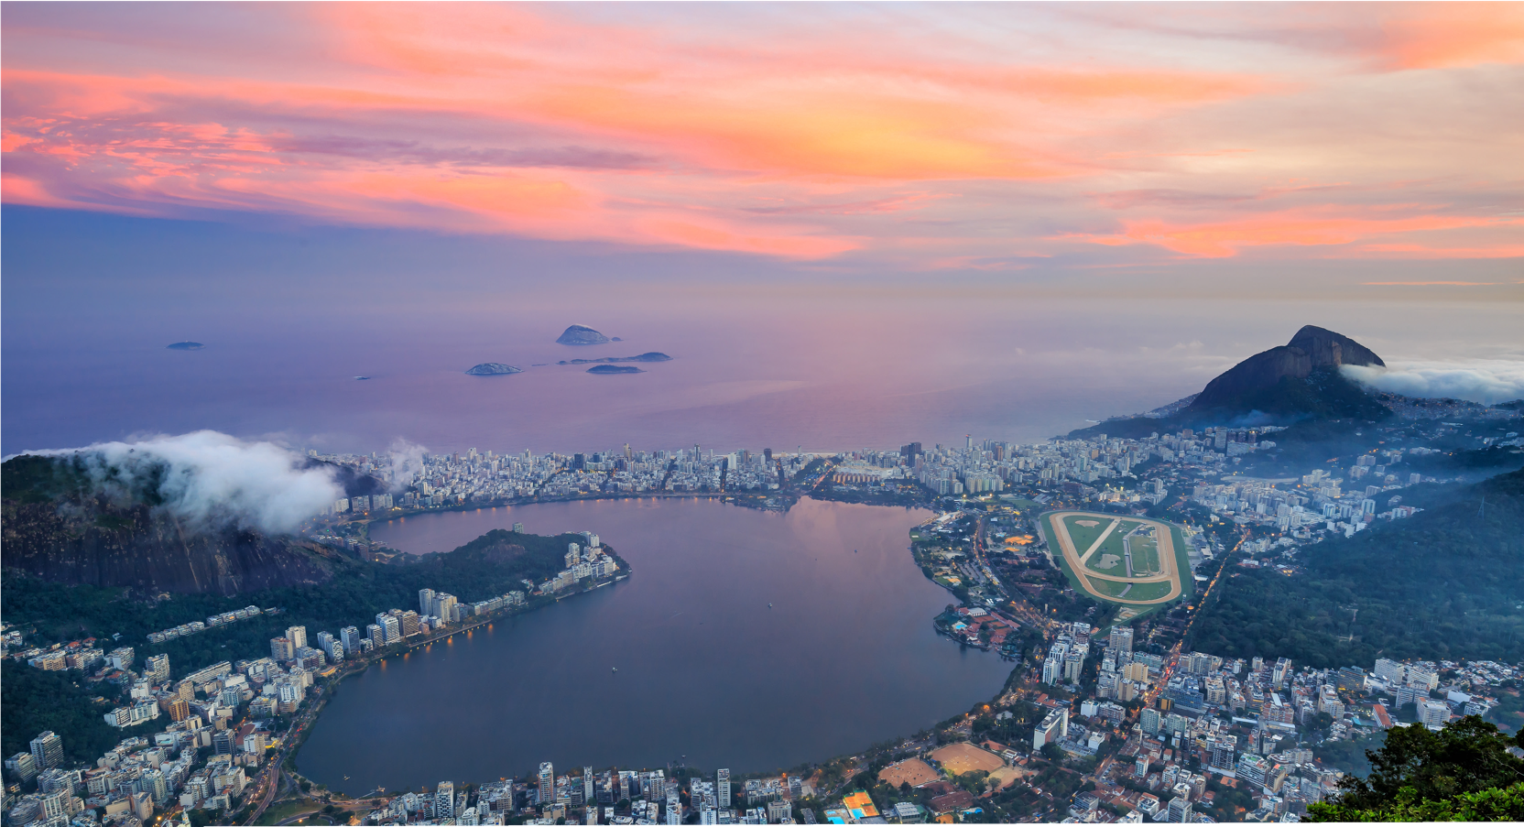

South America
is our business.

Slide 2
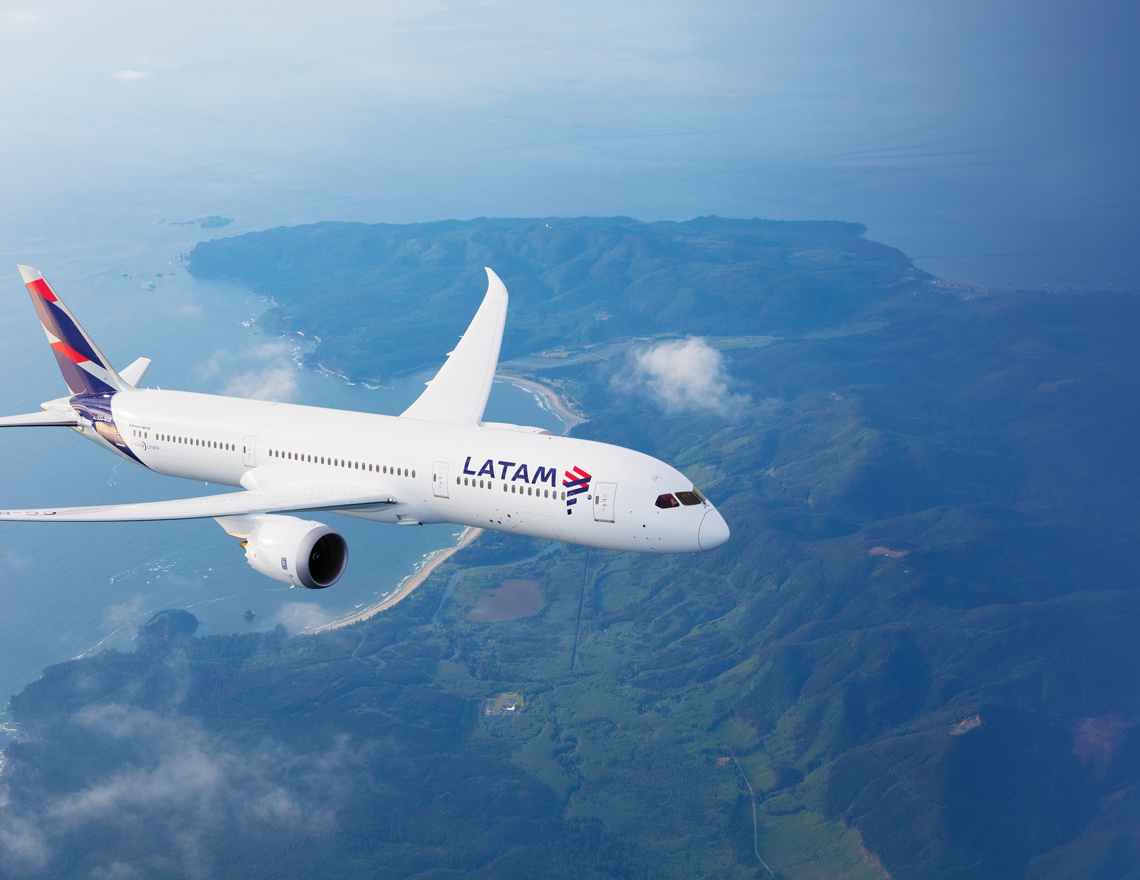

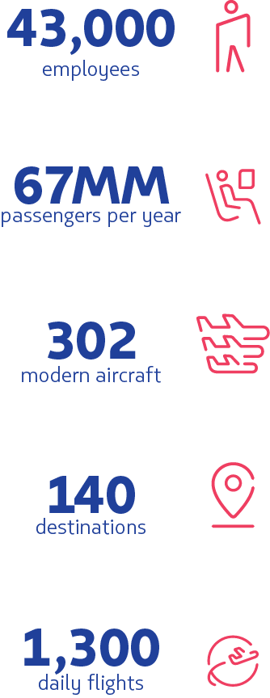
40,000
employees
67MM
passengers per year
302
modern aircraft
140+
destinations
1,300
daily flights

Slide 3
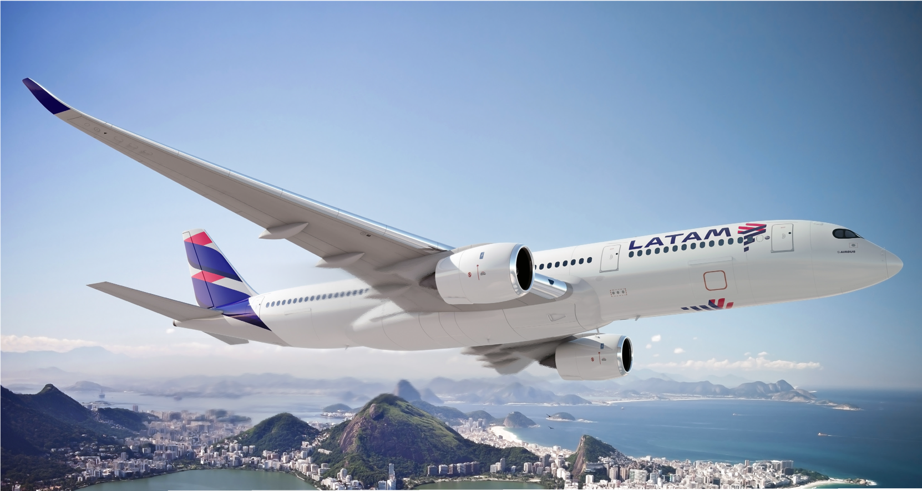

GREATNESS
in the sky

Slide 4
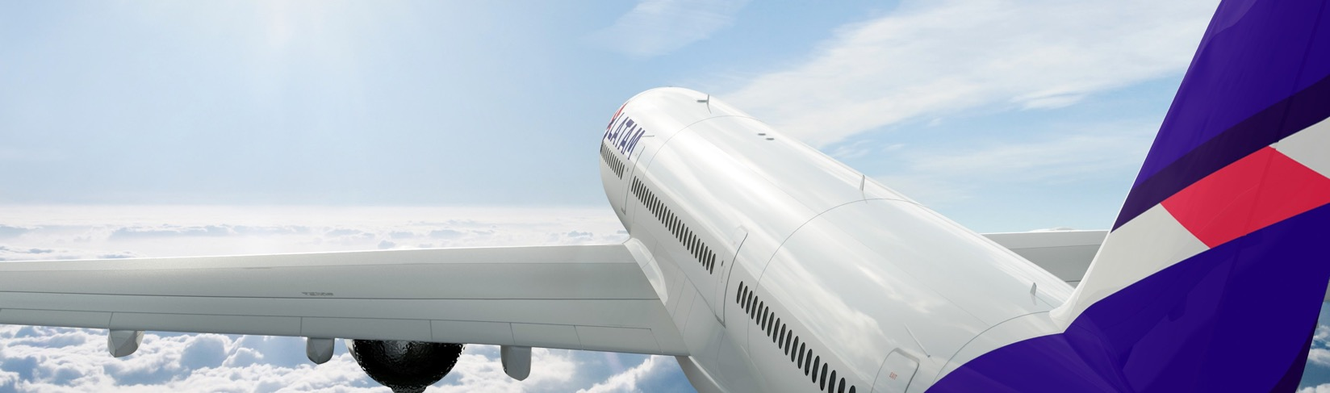
OUR FLEET
The most modern
Our modern fleet is comprised of 302 aircraft. It’s one of the youngest fleets in South America and the industry, with an average age of 6.7 years.
LATAM Airlines was the first Brazilian airline to have IOSA certification, granted by IATA
LATAM Airlines was one of the first airlines in the Americas to receive a Boeing 787 Dreamliner
LATAM Airlines currently owns 9 Airbus 350-XWB, reducing the company’s carbon footprint
LATIN LAWYER
1st place
“Deal of the Year: LAN-TAM Merger”

Slide 5


FLEET INFORMATION
46
Airbus 321 / 321neo
49
10
Airbus 319
Aircraft
Aircraft
Boeing 787-8
Aircraft
124
07
14
Airbus 320
Aircraft
Airbus 350 XWB
Aircraft
Boeing 787-9
Aircraft
06
34
10
Airbus 320neo
Aircraft
Boeing 767
Aircraft
Boeing 777
Aircraft
*At year end 2018

Slide 6
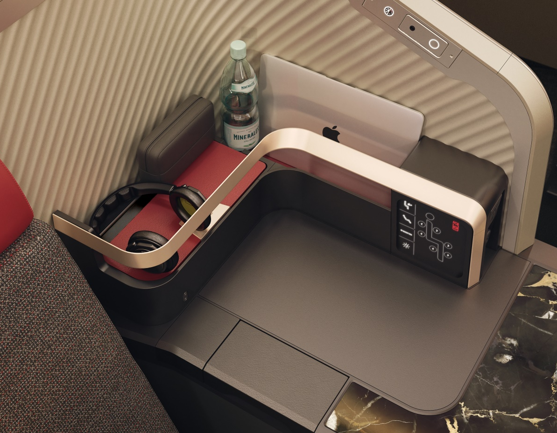

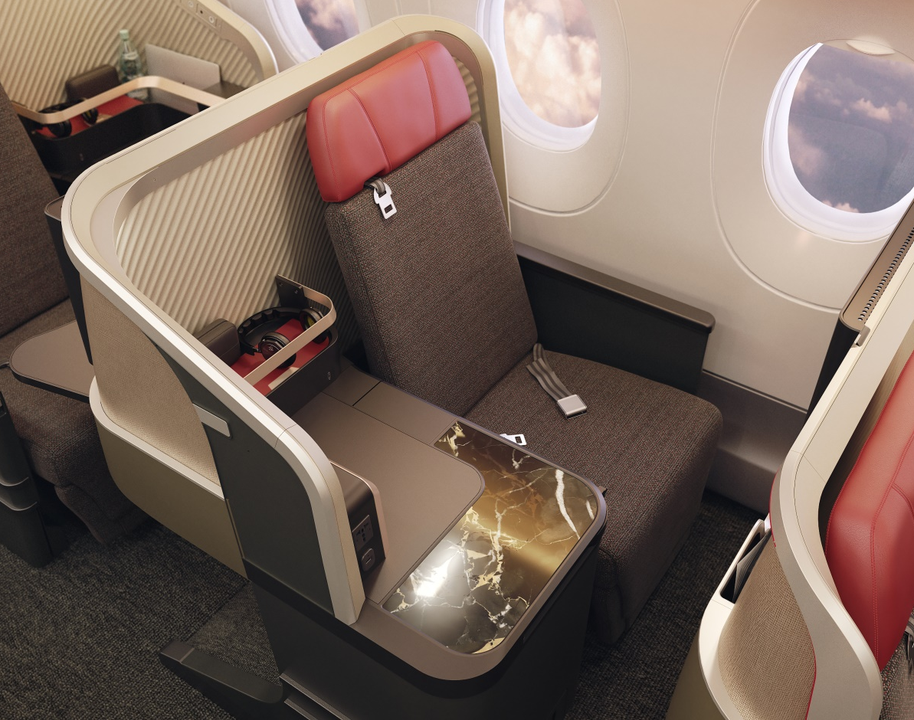



ENHANCING THE
TRAVEL EXPERIENCE
LATAM Airlines is investing US$400M to renovate and transform the cabins of over 200 aircraft
A new Premium Business direct aisle access seat
The economy cabin will feature ergonomically designed Recaro seats
Passengers in economy will also have the option to upgrade to LATAM+seats, that includes priority check-in and boarding
For passengers traveling to and from the Unites States, we will transform the cabins of our Boeing 767 and 777 aircraft, as well as those of our new Boeing 787-9s and Airbus A350-1000s due for delivery over the coming years
Notes:
Ojo cambio de texto

Slide 7
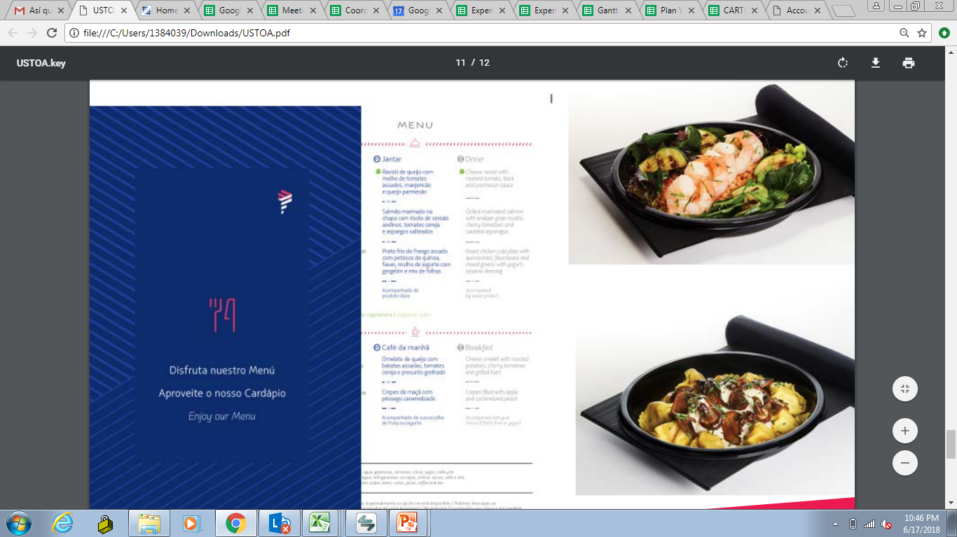
FULL MEALS
Best in-flight service
With even the simplest service details, like a smile or a friendly greeting, we show our constant commitment to offering the best in-flight service. Specially selected Economy meals and snacks inspired by local flavors delight travelers.
constant commitment
to offering you the best on-board service
delicious meals
With 3 menu option sinspired by the flavors of South America
complimentary
fine wines and spirits
inspired by the flavors of South America

Slide 8

IN-FLIGHT
ENTERTAINMENT
wireless in-flight
entertainment
best recent movie and series
Watch it on your smartphone, tablet or laptop
Available in our Airbus fleet

Slide 9

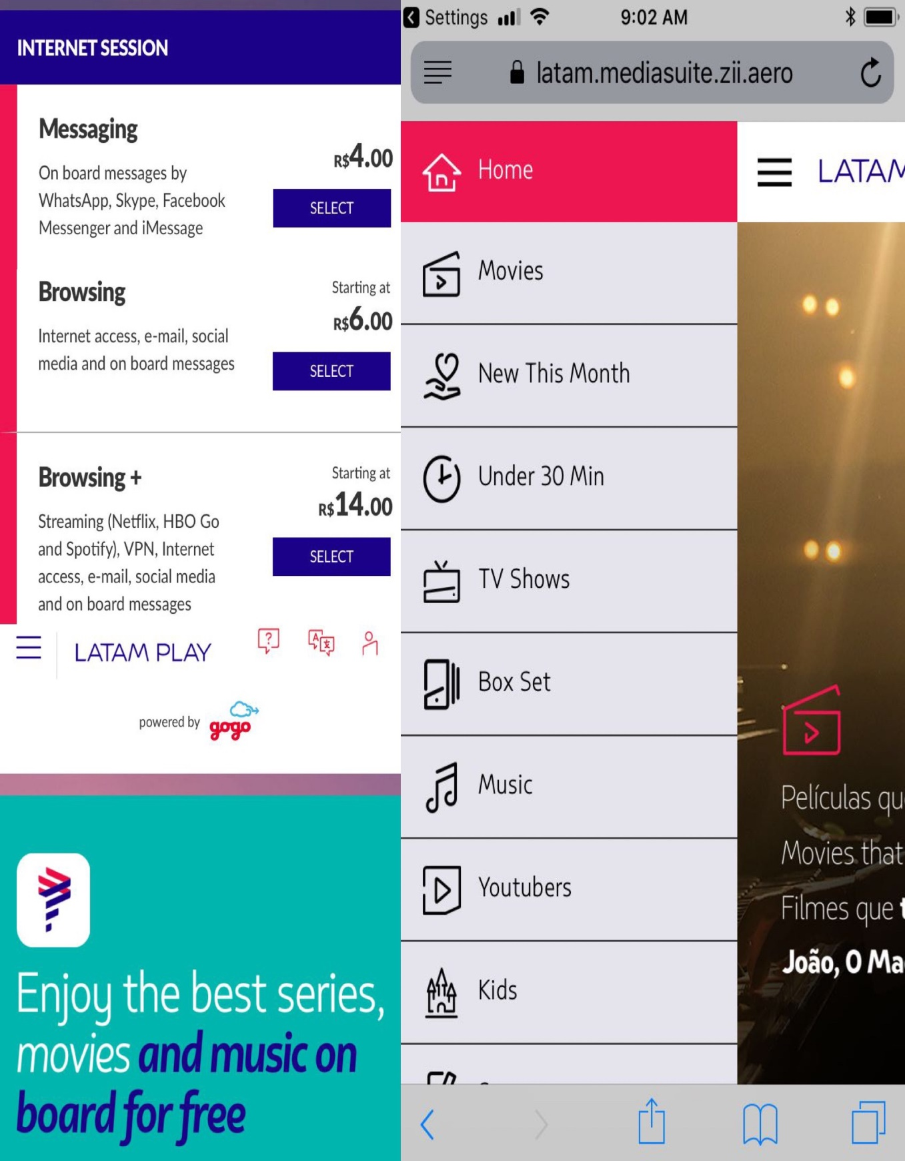
NEW WIFI
ON-BOARD
Partner with Gogo
Only in LATAM Airlines Brasil
Enjoy the best series, movies and music on board for free

Slide 10
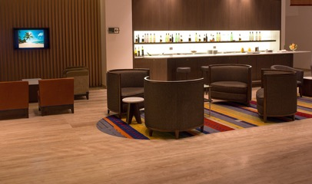
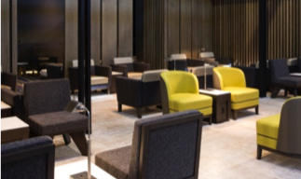
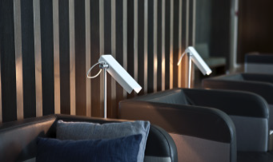
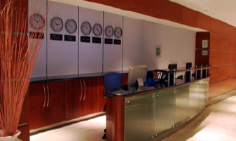
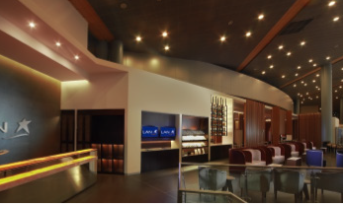
1 VIP LOUNGE SANTIAGO
Arturo Merino Benitez International Airport
Showers, ironing and shoe-shine service, business center, newspapers, magazines, Wi-Fi, lounge, area to relax in, fax, photocopier, phone, TV.
Largest VIP Lounge in South America
1 VIP LOUNGE SÃO PAULO
Guarulhos International Airport
Newspapers and magazines, Wi-Fi, buffet area, business center, showers.
Second Largest VIP Lounge in South America
VIP LOUNGES
Ahead of the flight
Nothing can make a traveler feel better than a calm and relaxed atmosphere before boarding the aircraft, with consistent and memorable high-quality service and amenities, along with world-class design.
1 VIP LOUNGE BUENOS AIRES
Buenos Aires Ezeiza Airport
Showers, ironing and shoe shine service, local and international reading material, buffet, open bar, business center, cable TV, luggage lockers, Wi-Fi.
1 VIP LOUNGE MIAMI
Miami International Airport
Snacks, beverages, bar, TV, Wi-Fi, business center, reading material, showers.
UNDER RENOVATION
1 VIP LOUNGE BOGOTA
El Dorado International Airport
Showers, ironing and shoe-shine services, reading material, cocktail-style buffet, open bar from 12 p.m. to 12 a.m., business center, Wi-Fi, cable TV.

Slide 11
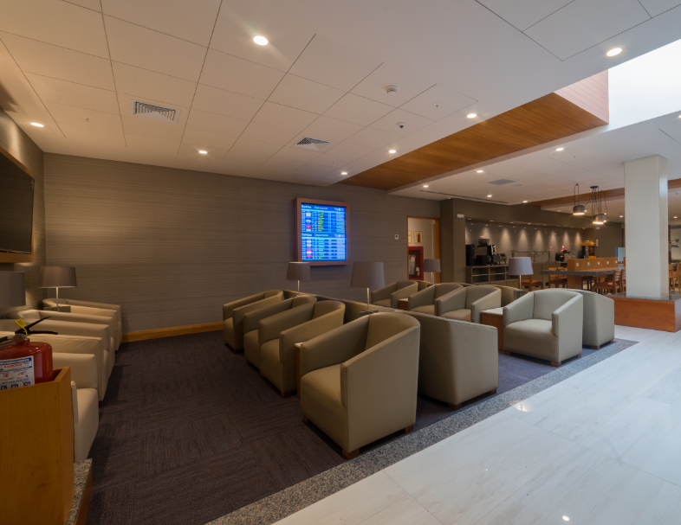


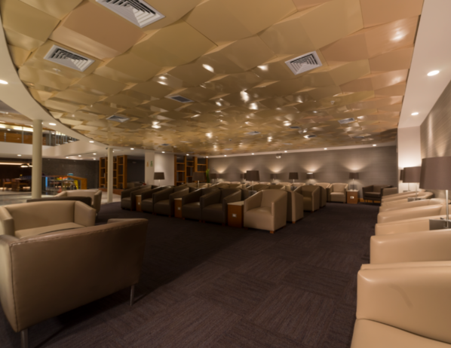




LIMA VIP LOUNGE
Now Open
Access applies to:
Premium Business / Premium Economy Passengers
Black Signature, Black and Platinum Passengers + 1 Companion
Emerald and oneworld® Sapphire Passengers + 1 Companion
480 passenger capacity
Children area
Business center
Shower services
Open 24h
Rest area
Bar area

Slide 12
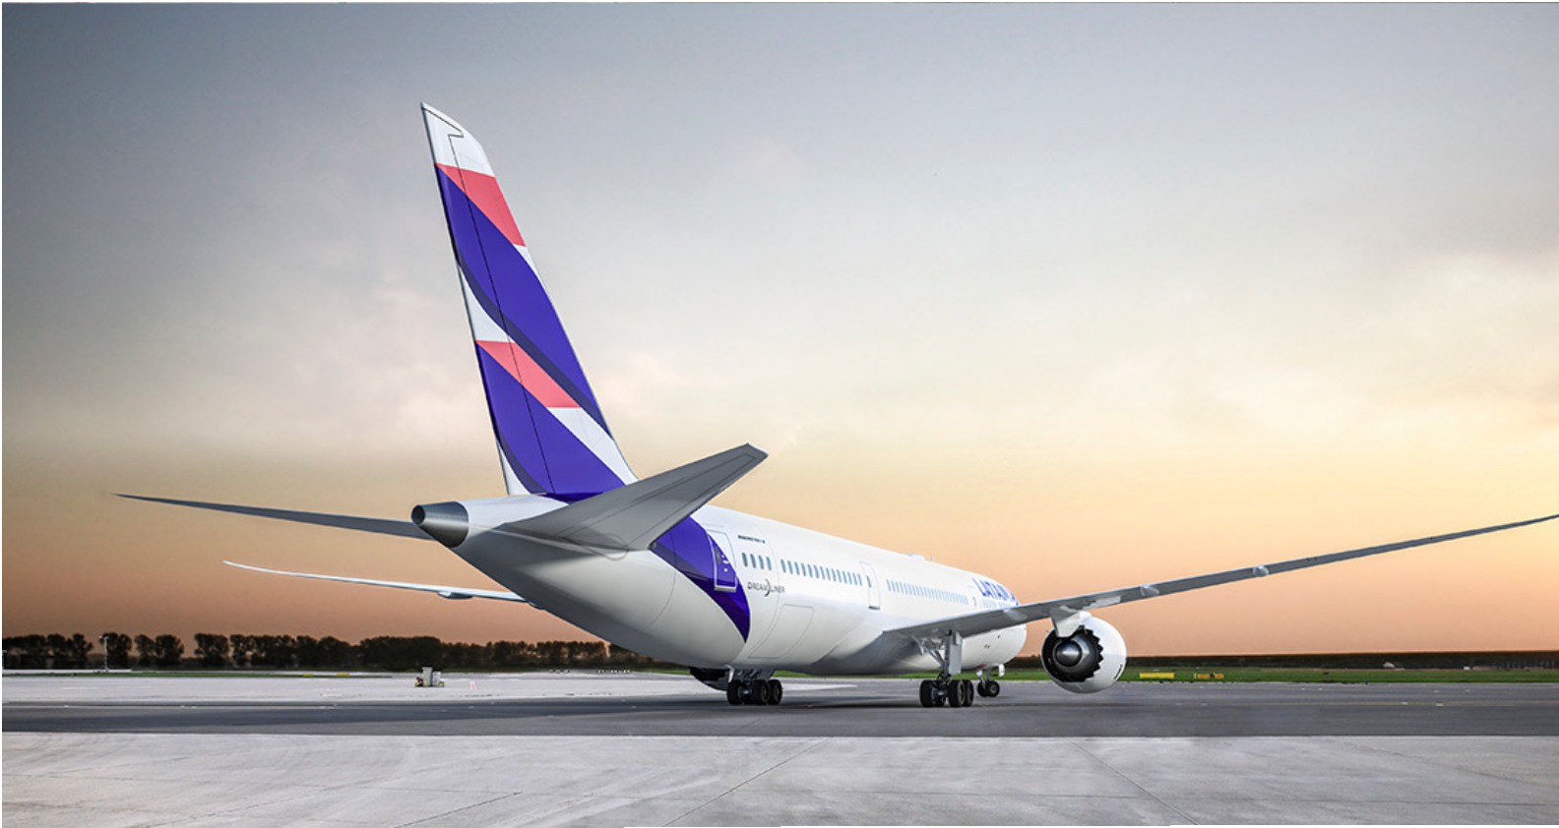
WE
connect you

Slide 13
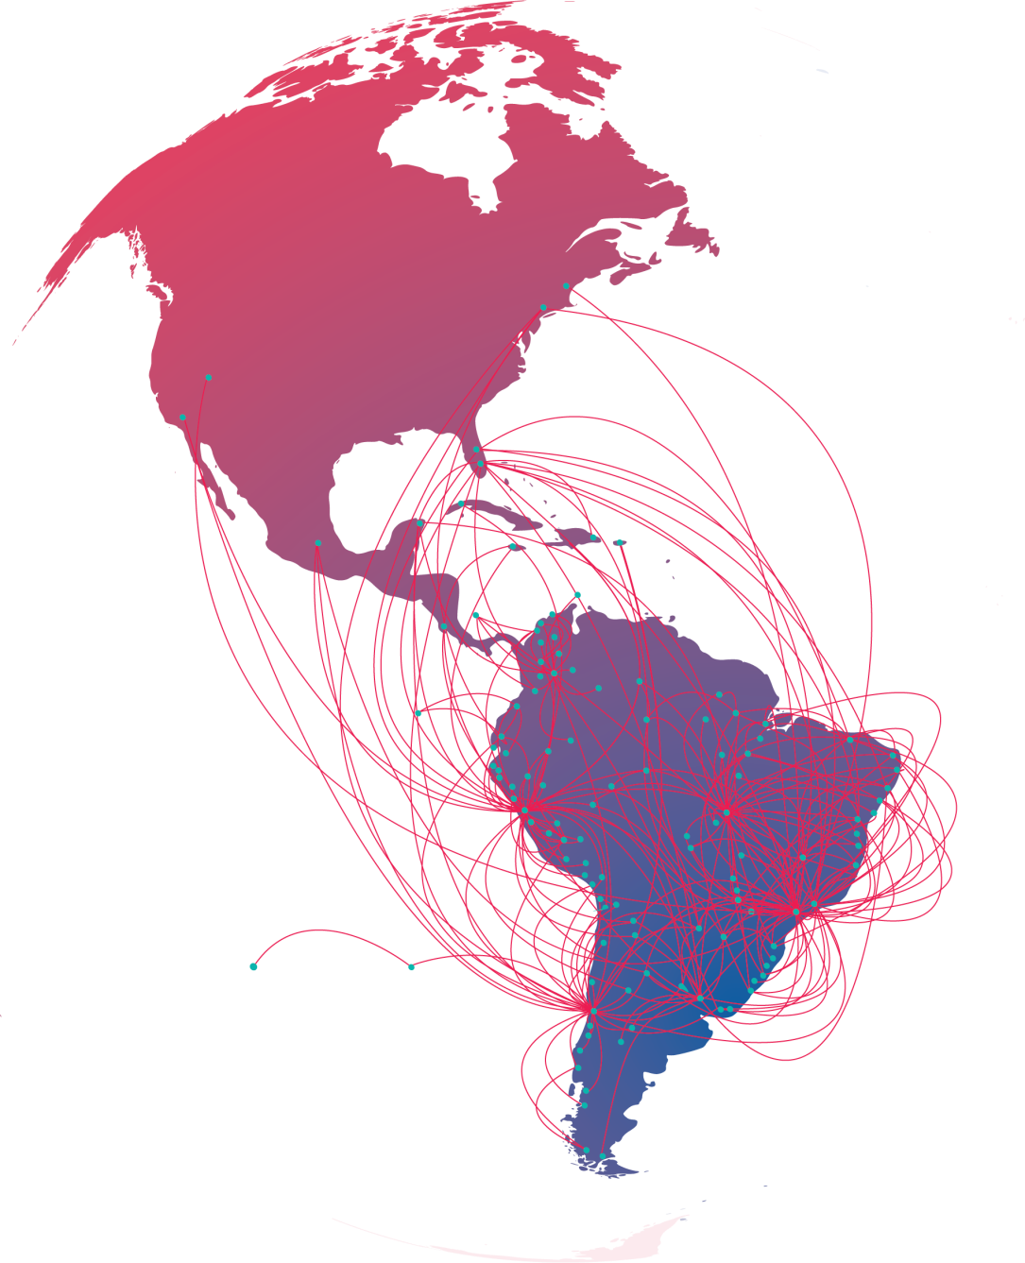
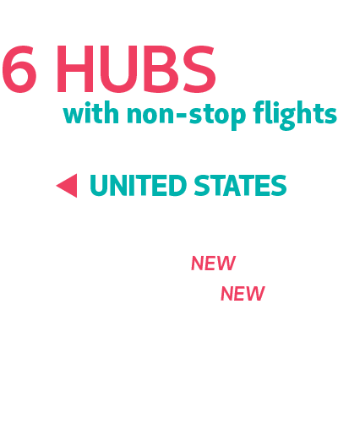

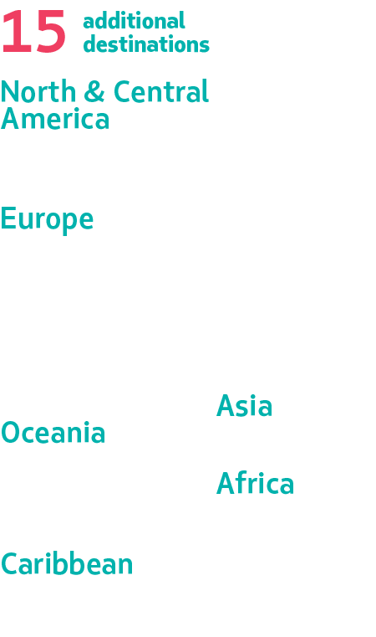
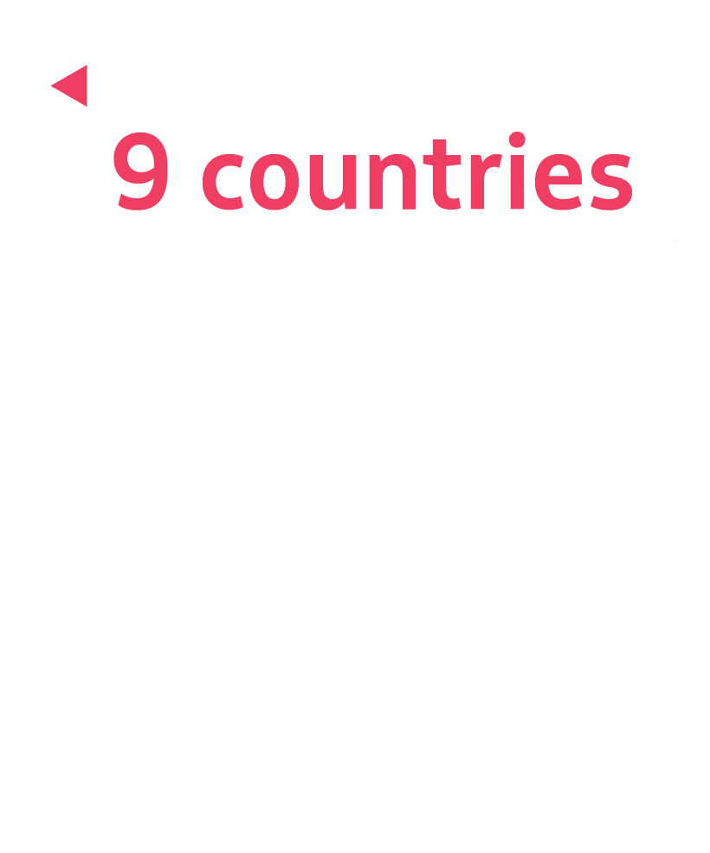
Aircraft
142
WEEKLY FLIGHTS
MIA (67)
ORL (22)
NYC (32)
LAX (15)
BOS (3)
LAS (3)
BR (50)
CL (24)
PE (40)
AR (8)
EC (9)
CO (7)
RD (1)
Notes:
WEEKELY FLIGHTS 142:
MIA 67
ORL 22
NYC 32
LAX 15
BOS 3
LAS 3
BR 50
CL 24
PE 40
AR 8
EC 9
CO 7
RD 1

Slide 14



BOSTON – SÃO PAULO
The only NON-STOP
ROUTE
Boston
Connecting flights from São Paulo
continuing service to Rio de Janeiro (GIG), Vitória (VIX), Belo Horizonte (BHZ) in Brazil, Buenos Aires (EZE) , Mendoza (MDZ), Córdoba (COR), Tucumán (TUC) in Argentina, Santiago de Chile (SCL), Lima (LIM) Peru, Asunción (ASU) Paraguay , among other destinations.
LIM
GYN
VIX
Starting on July 2nd, 2018
BHZ RIO
TUC
ASU
São Paulo
4 flights per week
with a travel time of ten hours and 20 minutes
COR
CBW
SCL
MDZ
ROS
EZE
PDP
Boeing 767
free of charge baggage allowance, complimentary food and beverage service

Slide 15
LAS VEGAS – SÃO PAULO
NEW NON-STOP ROUTE
Las Vegas
Las Vegas is now the airlines’ sixth gateway in United States with direct flights to South America, and the fifth U.S. city with direct flights to Brazil. The Las Vegas to São Paulo flight will be operated in high-travel seasons, from June to September and December to March.
Starting on June 2018
3 flights per week
with a travel time of twelve hours and 15 minutes
São Paulo
Boeing 767
free of charge baggage allowance,
complimentary food and beverage service

Slide 16
MIAMI – SALVADOR
DE BAHIA
NEW NON-STOP ROUTE
Miami
The first flight will take off from Miami, while the operation from the capital city of Bahia will begin on April 30th. Also, the company currently operates other non-stop scheduled routes connecting Miami to São Paulo, Rio de Janeiro, Manaus, Recife, and Belem.
Starting on April 29th, 2018
Salvador
One flight per week
with a travel time of eight hours
Boeing 767
free of charge baggage allowance, complimentary food and beverage service

Slide 17
ORLANDO – FORTALEZA
NEW NON-STOP ROUTE
Orlando
LATAM Airlines continues to lead the
United States -Brazil market and now accounts for 26% of all seats available to travelers between these two countries.
Fortaleza
Starting on July 5th, 2018
2 flights per week
with a travel time of seven hours and 35 minutes
Boeing 767
free of charge baggage allowance,
complimentary food and beverage service

Slide 18
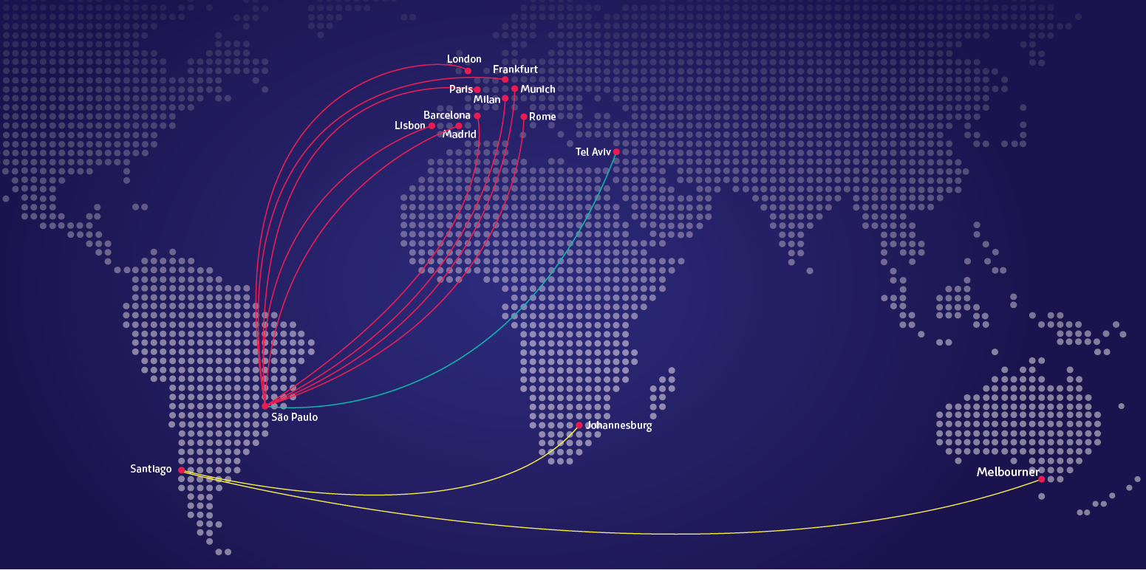
NEW NON-STOP CONNECTIONS
TO THE WORLD
Now we offer non-stop routes from São Paulo, Brazil to: Barcelona, Frankfurt, Munich, Lisbon, London, Madrid, Milan, Paris, Rome and Tel Aviv. We also fly non-stop from Sao Paulo to Johannesburg and from Santiago to Melbourne.
Notes:
OPTION 1

Slide 19
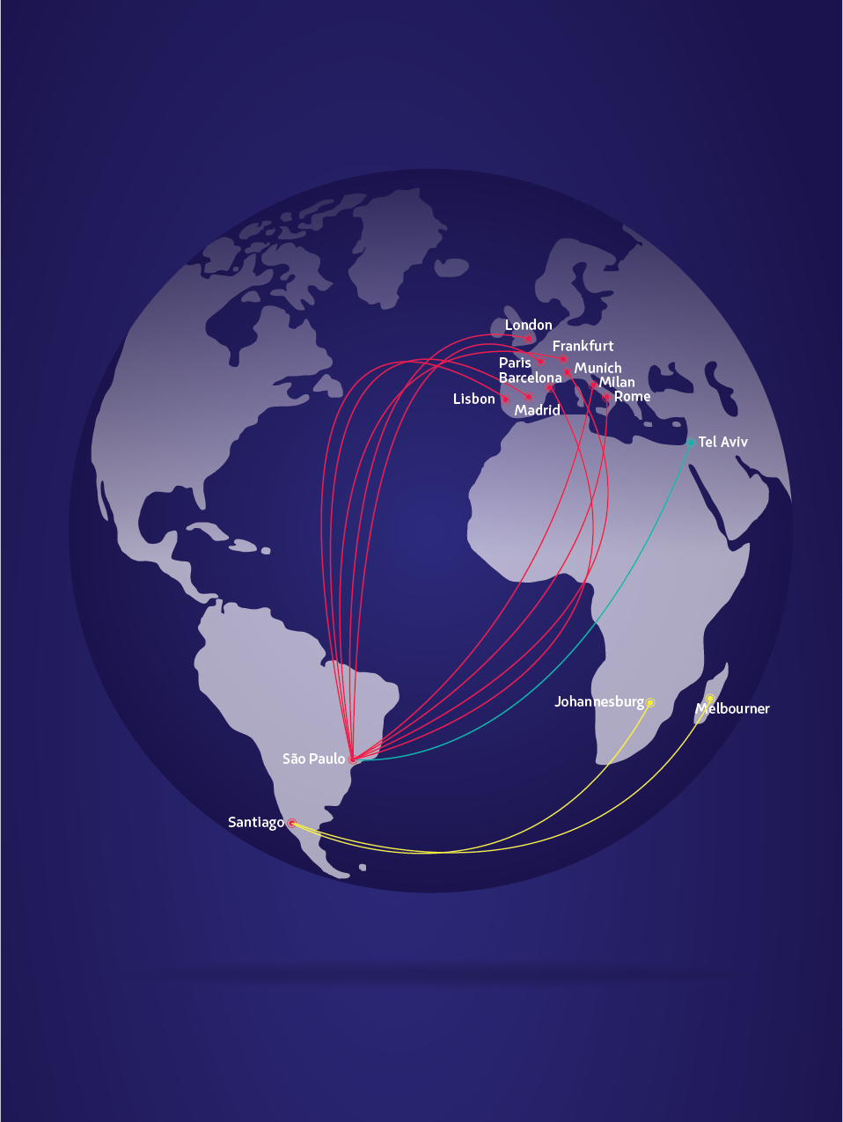
NEW NON-STOP
CONNECTIONS
TO THE WORLD
Now we offer non-stop routes from São Paulo, Brazil to: Barcelona, Frankfurt, Munich, Lisbon, London, Madrid, Milan, Paris, Rome and Tel Aviv. We also fly non-stop from Sao Paulo to Johannesburg and from Santiago to Melbourne.
Notes:
OPTION 2

Slide 20

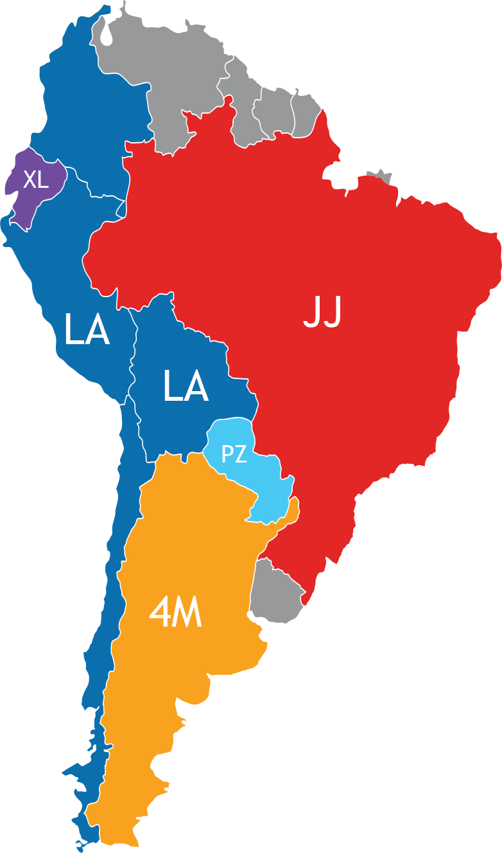
A BIGGER NETWORK WITHIN SOUTH AMERICA
LA
/LA
COLOMBIA
Barranquilla
Bogotá
Bucaramanga
Cali
Cartagena
Cúcuta
Leticia
Medellín
Montería
Pereira
San Andrés
Santa Marta
Valledupar
Yopal
PERU
Arequipa
Ayacucho
Cajamarca
Chiclayo
Cusco
Iquitos
Jaén
Jauja
Juliaca
Lima
Pisco
Piura
Pucallpa
Puerto Maldonado
CHILE
Antofagasta
Arica
Balmaceda
Calama
Castro
Concepción
Copiapó
Iquique
Isla De Pascua
La Serena
Osorno
Puerto Montt
Puerto Natales
ECUADOR
Baltra
Cuenca
Guayaqyil
Quito
San Cristóbal
Tacna
Talara
Tarapoto
Trujillo
Tumbes
Punta Arenas
Santiago De Chile
Temuco
Valdivia
PARAGUAY
Asunción
Cuidad Del Este
BRAZIL
Bauru
Belem
Belo Horizonte
Boa Vista
Brasilia
Campo Grande
Cuiabá
Curitiba
Florianópolis
Foz Do Iguaçu
Goiania
Ilheus
Imperatriz
BOLIVIA
La Paz
Fortaleza
Jaguaruna
João Pessoa
Joinville
Londrina
Macapà
Manaus
Marabá
Natal
Palmas
Porto Alegre
Porto Seguro
Porto Velho
Recife Maceió
Ribeirão Prieto
Rio Blanco
Rio De Janeiro
Salvador
Santarém
São Luis
São Paulo
São José do Rio Preto
Teresina
Tres Largoas
Uberlandia
Vitoria
ARGENTINA
Bahía Blanca
Bariloche
Buenos Aires
Calafate
Comodoro Rivadavia
Córdoba
Iguazú
Mendoza
Neuquén
Río Gallegos
Salta
San Juan
Tucumán
Ushuaia
Notes:
AR 14
BR 42
CL 16
PE 18
CO 14 (MEDELLIN-Adz)
EC 5

Slide 21
  ENHANCING OUR REACH
ROUTE | STATUS | FREQUENCY
SCL-CUZ | Operating | MO, WE, SA
CUZ-IQT | Operating (Seasonal until NOV 28th) | MO, WE, SA
CUZ-TRU | Operating (Seasonal until NOV 29th) | TU, TH, SU
CUZ-PIO | Operating (Seasonal until NOV 25th) | TH, SU
CUZ-PEM | Operating | DAILY
CUZ-AQP | Operating | DAILY
LIM-SJO | Operating | TU, FR, SA, SU
LIM-GIG | Operating | TU, TH, SA, SU
LIM-IGU | Operating | TU, TH, FR, SA, SU
LIM-CTG | Operating | DAILY
LIM-MDE | Operating | MO, WE, FR
LIM-CLO | Starting JAN 2nd | WE, FR, SU
LIM-SLA | Operating | MO, TU, WE, SU
SLA-IGR | Seasonal (DEC 16th – MAR 3rd) | TH, SU
EZE-FLN | Seasonal (JAN 1st – FEB 15th) | MO, TU, WE, SA
BRC-TUC | Seasonal (JUL 3rd – SEPT 15th) | TH, SU
SCL-POA | Starting JAN 15th | TU, TH, SA
Notes:
TOCA Hacerla

Slide 22
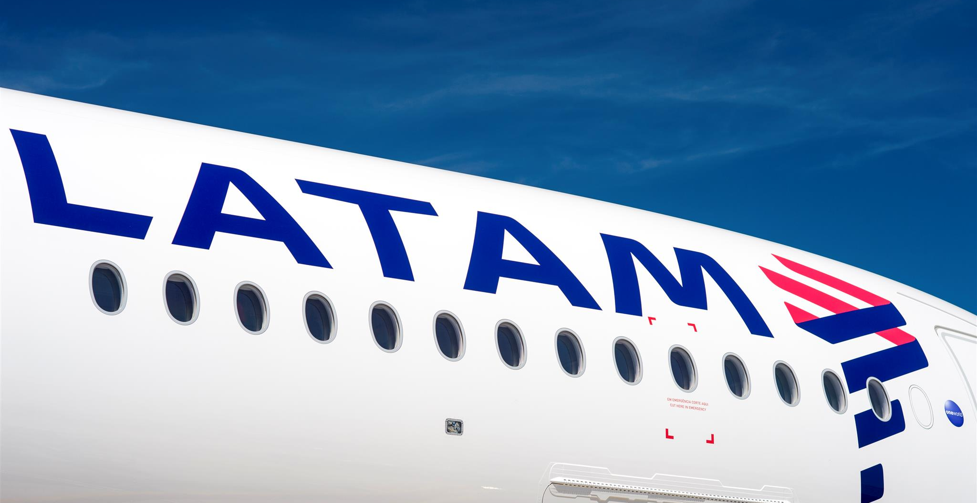
NEW SALES MODEL

Slide 23
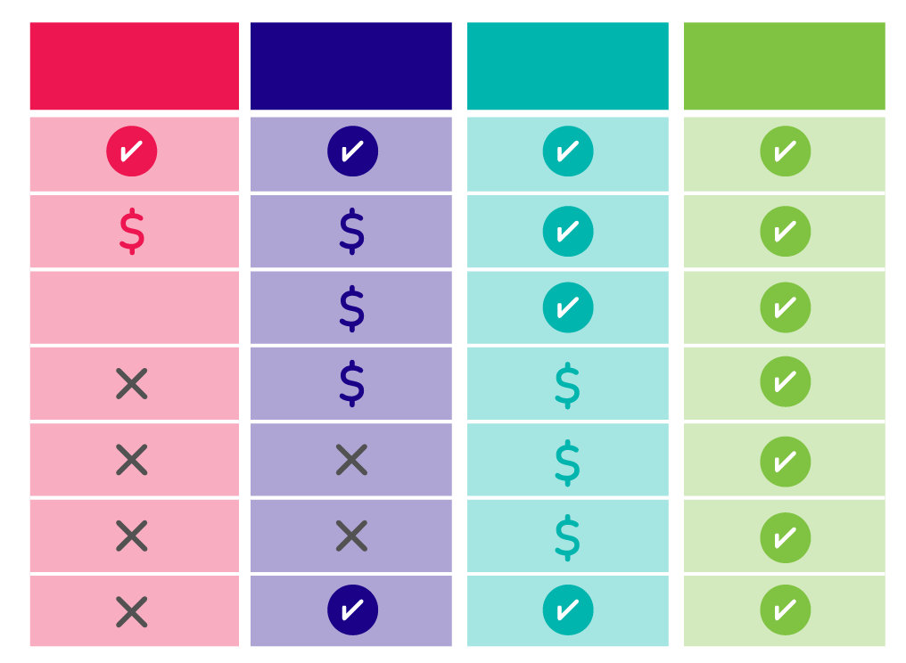










BRANDED FARES
NOW IN ARGENTINA
Carry-on
1 piece 18 lbs.
Checked baggage*
1 piece 50 lbs.
Seat selection*
Favorite seat*
Refunds
Changes
Before the flight
LATAM PASS Miles Accrual
PROMO
Lowest fare
LIGHT
Add what you want
PLUS
Travel as usual
TOP*
More freedom & flexibility
Included
Extra Charge
Not Available

Slide 24

BRANDED CODES
  The pricing codes for these new families or bundles will be the following:
PROMO
LIGHT
PLUS
TOP
SN
SL
SE
SF
  The Fare Basis also changes in this new model, and they will have the following structure. For example, the VHWSE1 Fare Basis will have the Brand code in the 4th and 5th character, as you see it on the image.
V | H | W | SE | 1
Reservation class (maybe combined with Bundle Light, Plus and Top)* |  |  | Brand Indicator (Plus) | Three digit numeric rule
Notes:
OPTION 2

Slide 25
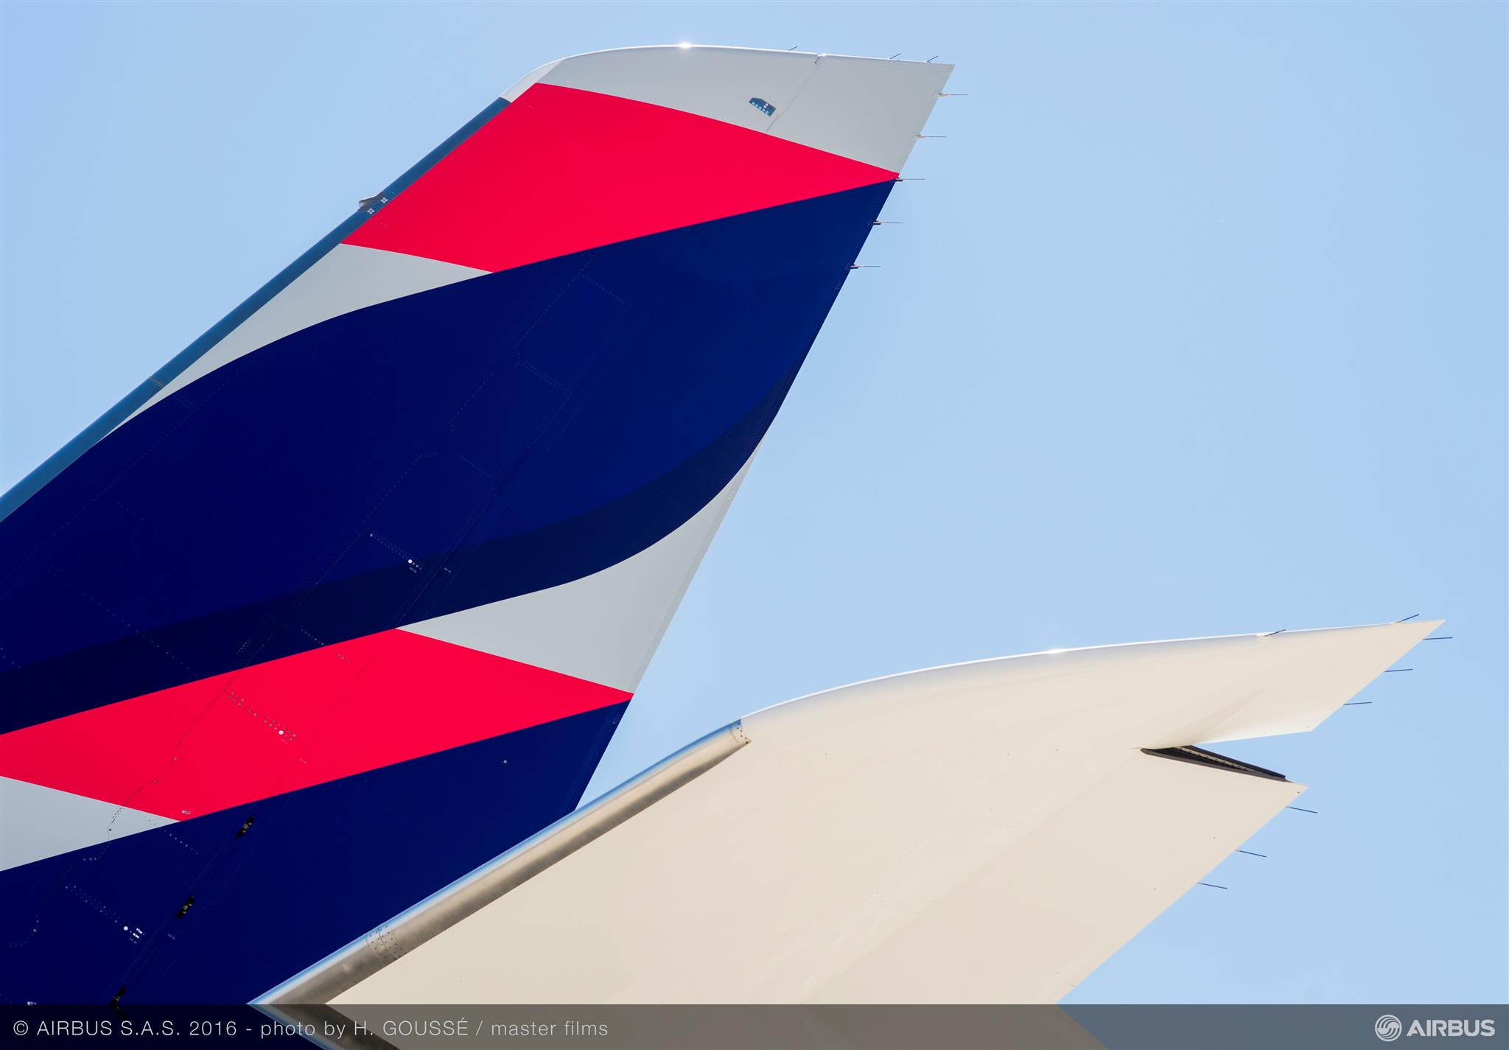
Involuntary changes
policy

Slide 26
OPTIONS | NO PENALTY APPLIES | REGULATIONS NOT TO BE CONSIDERED TO REISSUE AND REFUND | CONSIDERATIONS
DATE, FLIGHT CHANGES on LATAM ﬂights (Same origin - destination). The Involuntary Rerouting must be processed through LATAM. | Changes subject to cabin availability: To bring forward the original travel date in 7 days To postpone the original travel date no later than 15 days For other airlines, the ﬂight alternative applies subject to class availability. If the booking class is not available, the Travel Agents must contact their LATAM for assistance | No restrictions apply; ADVP, Min/Max Stay, Blackouts, Day/time, Penalties, Ticket validity, Seasonality, Travel restriction, etc | Changes out of the range established (-7/+15 ﬂight departure) apply free of penalty, subject to class availability, fare diﬀerences, fare regulations and ticket validity
CHANGE OF DESTINATION on LATAM FLIGHTS (Name changes are not applicable). | Subject to class availability, applicable fare diﬀerences and ticket validity | Penalty item | Reissue applies as voluntary reissue. The accepted value is proportional to the unused coupons
REFUND | Proportional to the unused coupons and subject to ticket validity. | Penalty item
It is important to include the require documentation on the endosement box and an ISO message. And request waiver if other carriers are involved.
All contingencies will be announce in our LATAM trade website
Notes:
Texto abajo del cuador es nuevo

Slide 27
ADDITIONAL TOPICS
NDC
ONLINE TOOLS:
Group check-in & Augmented reality tool
MARKETING OPPORTUNITIES:
Coops, Proposal, Tactical fares

Slide 28

LATAM AWARDS
APEX 2019
1st place
Five Star Global Airline
World Airline Awards (Skytrax)
2nd place
“Best Airline in South America”
IHS Jane´s ATC Award: Environment 1st place
Green Skies of Peru Project
Brand Finance: Ranking of Brazilian Brands
1st place
“La Financial Brand of the
Most Valuable Company in Brazil”
GT Tested Reader Survey awards
1st place
Best Airline to South America
Marketing Content Awards 1st place for In magazine “Best Airline Publication”
MERCO Ranking
1st place
“Business Reputation in the Transport and Logistics Sector”
Carta Capital magazine: Most Admired Companies in Brazil 1st place
“Airline” and “Business Services”
Word Travel Awards (WTA)
1st place
“South America’s Leading Airline”
Latin Trade Ranking
1st place in 8 of 11 categories
“The Best Airlines Flying in Latin America”
Content Marketing Awards
2nd place
for Nas Nuvens magazine “Best Airline Publication”
Grupo Padrão: Companies Most Respected by Consumers 1st place
“Airline”
World Airline Awards (Skytrax)
1st place
“South America’s Leading Airline”
Business Traveler’s Cellars in the Sky Airline Wine Awards 3rd place
“Best-Presented Business Class Wine List”
Top of Mind-Data-Folha/ Grupo Folha
1st place
“Airline”
La Segunda-Adimark: Chile’s Most Respected Companies 1st place
“Most Respected Company”
Global Traveler Wine Competition 3rd place
“Best Red Wine
International Business Class”
Global Traveler Wine Competition 2nd place
“Best Red Wine International Business Class”

